Slide 1
Converting Between Units of Area and Volume
Silent
Teacher
Intelligent Practice
Narration
Your Turn
$$0.1 m^{2}to{ km}^{2}=$$
$$2 m^{3}to cm^{3}=$$
Practice

Slide 2
Worked Example
Your Turn
$$7 cm^{2} to {mm}^{2}$$
$$7 km^{2} to m^{2}$$
@misslaceymaths

Slide 3
Worked Example
Your Turn
$$2500 {cm}^{2} to m^{2}$$
$$2500 {mm}^{2} to {cm}^{2}$$
@misslaceymaths

Slide 4
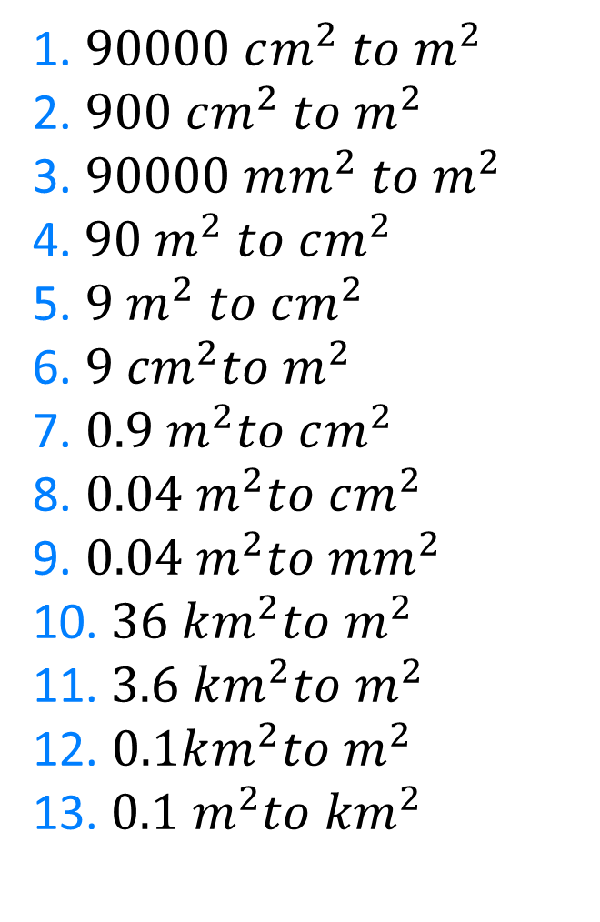
1. $90000 cm^{2} to m^{2}$
2. $900 cm^{2} to{ m}^{2}$
3. $90000 mm^{2} to{ m}^{2}$
4.$90 m^{2} to cm^{2}$
5. $9 m^{2} to cm^{2}$
6. $9 {cm}^{2}to m^{2}$
7. $0.9 m^{2}to cm^{2}$
8. $0.04 m^{2}to cm^{2}$
9. $0.04 m^{2}to mm^{2}$
10.$36 km^{2}to{ m}^{2}$
11.$3.6 km^{2}to{ m}^{2}$
12. $0.1km^{2}to{ m}^{2}$
13.$0.1 m^{2}to{ km}^{2}$
@misslaceymaths

Slide 5
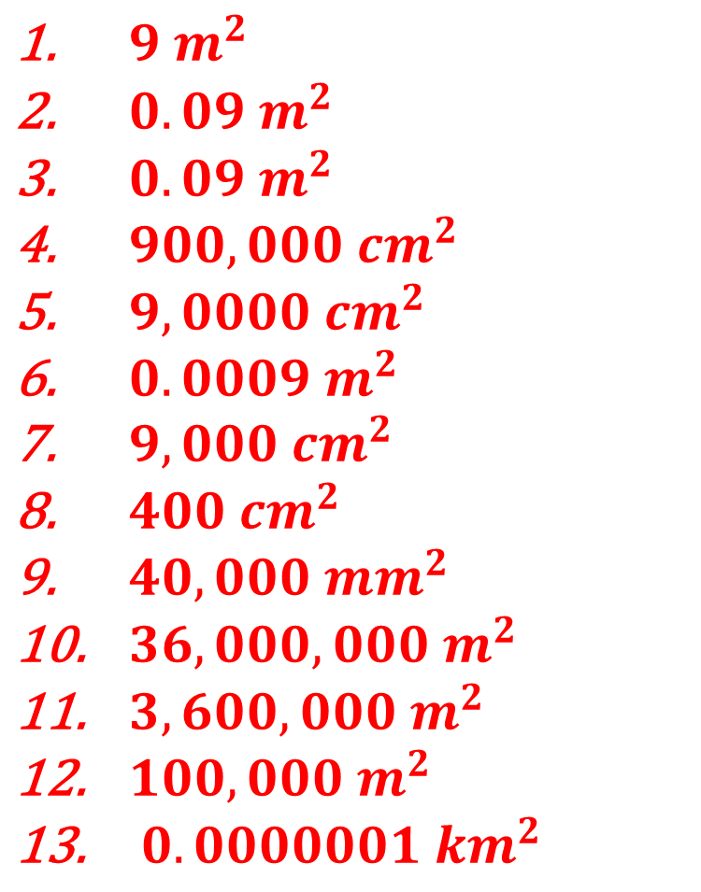
1. $90000 cm^{2} to m^{2}$
2. $900 cm^{2} to{ m}^{2}$
3. $90000 mm^{2} to{ m}^{2}$
4.$90 m^{2} to cm^{2}$
5. $9 m^{2} to cm^{2}$
6. $9 {cm}^{2}to m^{2}$
7. $0.9 m^{2}to cm^{2}$
8. $0.04 m^{2}to cm^{2}$
9. $0.04 m^{2}to mm^{2}$
10.$36 km^{2}to{ m}^{2}$
11.$3.6 km^{2}to{ m}^{2}$
12. $0.1km^{2}to{ m}^{2}$
13.$0.1 m^{2}to{ km}^{2}$
$9 m^{2}$
$0.09 m^{2}$
$0.09 m^{2}$
$900,000 {cm}^{2}$
$9,0000{ cm}^{2}$
${0.0009 m}^{2}$
$9,000 cm^{2}$
$400 cm^{2}$
$40,000 mm^{2}$
$36,000,000{ m}^{2}$
$3,600,000 m^{2}$
$100,000 m^{2}$
$0. 0000001 {km}^{2}$
@misslaceymaths

Slide 6

Worked Example
Your Turn
$$7 cm^{3} to {mm}^{3}$$
$$7 m^{3} to {cm}^{3}$$
@misslaceymaths

Slide 7

Worked Example
Your Turn
$$5 {mm}^{3} to cm^{3}$$
$$5 {cm}^{3} to m^{3}$$
@misslaceymaths

Slide 8
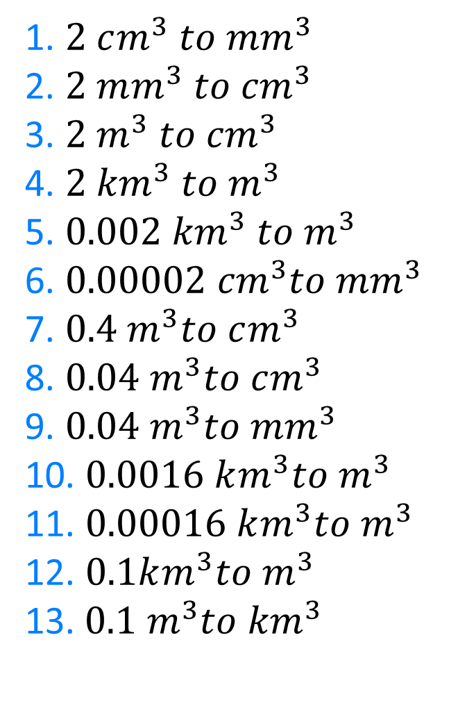
1. $2 cm^{3} to {mm}^{3}$
2. $2 mm^{3} to{ cm}^{3}$
3. $2 m^{3} to{ cm}^{3}$
4. $2 {km}^{3} to m^{3}$
5. $0.002 {km}^{3} to m^{3}$
6. $0.00002 {cm}^{3}to {mm}^{3}$
7. $0.4 m^{3}to cm^{3}$
8. $0.04 m^{3}to cm^{3}$
9. $0.04 m^{3}to mm^{3}$
10. $0.0016 km^{3}to{ m}^{3}$
11. $0.00016 km^{3}to{ m}^{3}$
12. $0.1km^{3}to{ m}^{3}$
13.$0.1 m^{3}to{ km}^{3}$
@misslaceymaths

Slide 9
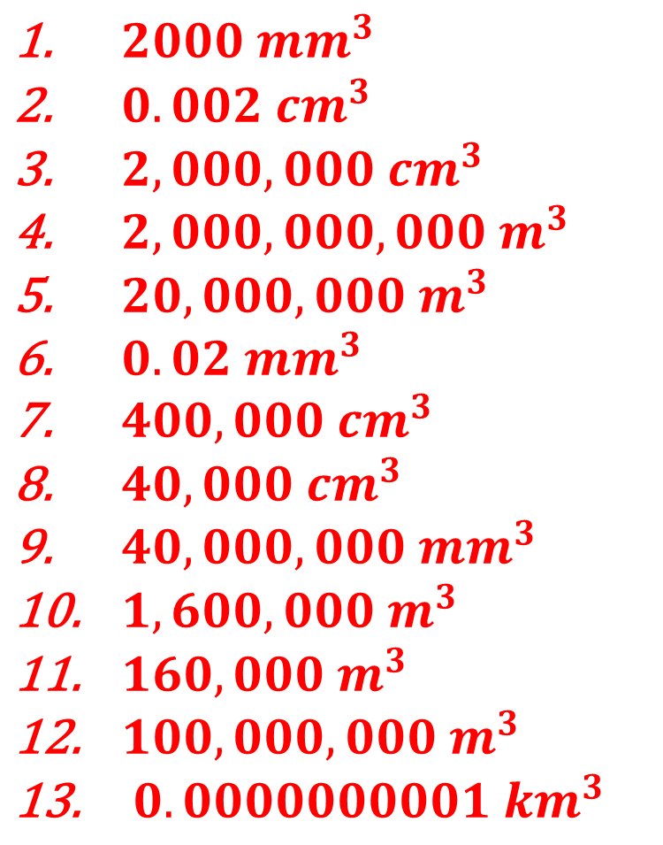
1. $2 cm^{3} to {mm}^{3}$
2. $2 mm^{3} to{ cm}^{3}$
3. $2 m^{3} to{ cm}^{3}$
4. $2 {km}^{3} to m^{3}$
5. $0.002 {km}^{3} to m^{3}$
6. $0.00002 {cm}^{3}to {mm}^{3}$
7. $0.4 m^{3}to cm^{3}$
8. $0.04 m^{3}to cm^{3}$
9. $0.04 m^{3}to mm^{3}$
10. $0.0016 km^{3}to{ m}^{3}$
11. $0.00016 km^{3}to{ m}^{3}$
12. $0.1km^{3}to{ m}^{3}$
13.$0.1 m^{3}to{ km}^{3}$
$2000 {mm}^{3}$
$0.002 cm^{3}$
$2,000,000 cm^{3}$
$2,000,000,000 m^{3}$
$20,000,000{ m}^{3}$
${0.02 mm}^{3}$
$400,000 cm^{3}$
$40,000 cm^{3}$
$40,000,000 mm^{3}$
$1,600,000{ m}^{3}$
$160,000 m^{3}$
$100,000,000 m^{3}$
$0. 0000000001 {km}^{3}$
@misslaceymaths

