Slide 1
Introducing Algebraic Fractions With Division
Silent
Teacher
Intelligent Practice
Narration
Your Turn
$$101+1001$$
$$100+1011$$
$$110+1011$$
Practice

Slide 2
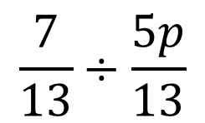
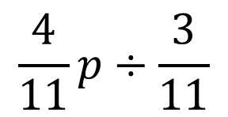
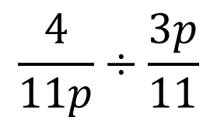
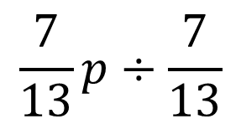
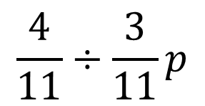
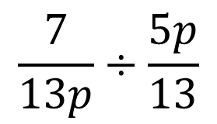
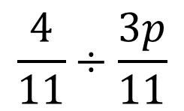
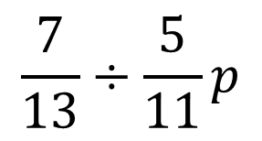
Worked Examples
Your Turn
$$\frac{4}{11}÷\frac{3p}{11}$$
$$\frac{7}{13}÷\frac{5p}{13}$$
$$\frac{4}{11}÷\frac{3}{11}p$$
$$\frac{7}{13}÷\frac{5}{11}p$$
$$\frac{4}{11}p÷\frac{3}{11}$$
$$\frac{7}{13}p÷\frac{7}{13}$$
$$\frac{4}{11p}÷\frac{3p}{11}$$
$$\frac{7}{13p}÷\frac{5p}{13}$$
@MrDraperMaths
Notes:
Example Problem Pairs

Slide 3
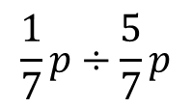
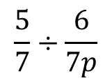
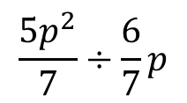
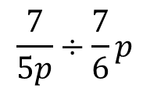
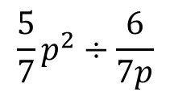
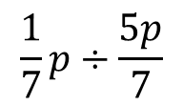
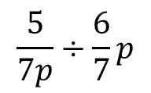
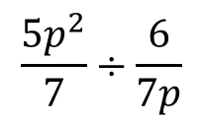
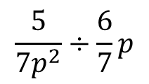
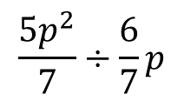
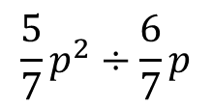
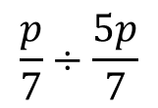
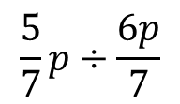
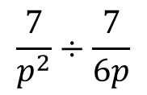
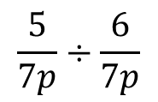
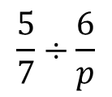
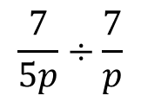
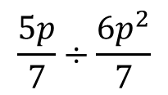
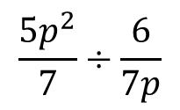
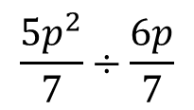
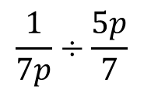
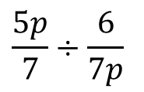
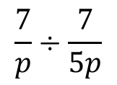
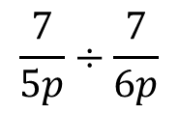
$$\frac{p}{7}÷\frac{5p}{7}$$
$$\frac{5p}{7}÷\frac{6p^{2}}{7}$$
13.
$$\frac{5p^{2}}{7}÷\frac{6}{7}p$$
19.
$$\frac{5}{7p^{2}}÷\frac{6}{7}p$$
1.
7.
$$\frac{1}{7}p÷\frac{5p}{7}$$
$$\frac{5}{7}p÷\frac{6p}{7}$$
$$\frac{5p^{2}}{7}÷\frac{6}{7p}$$
$$\frac{7}{p^{2}}÷\frac{7}{6p}$$
2.
8.
14.
20.
$$\frac{1}{7}p÷\frac{5}{7}p$$
$$\frac{5}{7p}÷\frac{6}{7}p$$
$$\frac{5p^{2}}{7}÷\frac{6}{7}p$$
$$\frac{7}{p}÷\frac{7}{5p}$$
3.
9.
15.
21.
$$\frac{1}{7p}÷\frac{5p}{7}$$
$$\frac{5}{7}÷\frac{6}{7p}$$
16.
$$\frac{5p^{2}}{7}÷\frac{6}{7p}$$
22.
$$\frac{7}{5p}÷\frac{7}{p}$$
4.
10.
$$\frac{5}{7p}÷\frac{6}{7p}$$
$$\frac{5p}{7}÷\frac{6}{7p}$$
$$\frac{5}{7}p^{2}÷\frac{6}{7p}$$
$$\frac{7}{5p}÷\frac{7}{6p}$$
5.
11.
17.
23.
$$\frac{5p^{2}}{7}÷\frac{6p}{7}$$
$$\frac{5}{7}÷\frac{6}{p}$$
$$\frac{5}{7}p^{2}÷\frac{6}{7}p$$
$$\frac{7}{5p}÷\frac{7}{6}p$$
6.
12.
18.
24.
@MrDraperMaths
Notes:
Questions

Slide 4
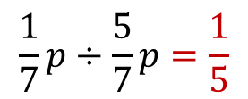
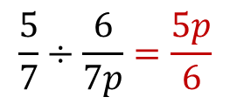
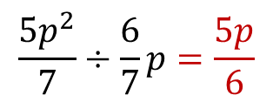
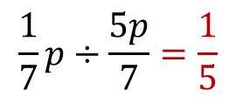
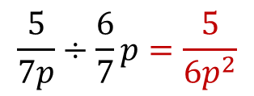
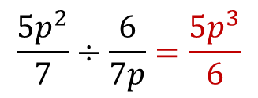
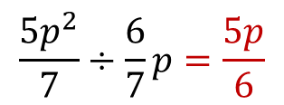
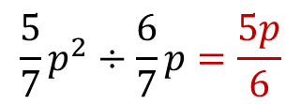
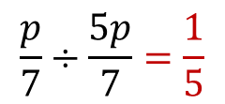
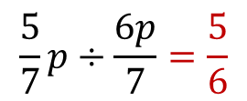
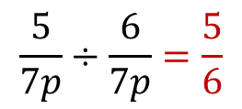
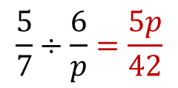
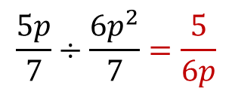
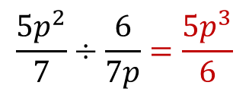
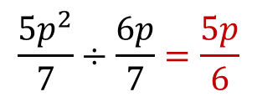
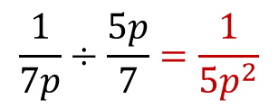
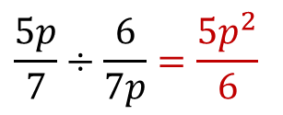
$$\frac{p}{7}÷\frac{5p}{7}=\frac{1}{5}$$
$$\frac{5p}{7}÷\frac{6p^{2}}{7}=\frac{5}{6p}$$
13.
$$\frac{5p^{2}}{7}÷\frac{6}{7}p=\frac{5p}{6}$$
19.
$$\frac{5}{7p^{2}}÷\frac{6}{7}p=\frac{5}{6p^{3}}$$
1.
7.
$$\frac{1}{7}p÷\frac{5p}{7}=\frac{1}{5}$$
$$\frac{5}{7}p÷\frac{6p}{7}=\frac{5}{6}$$
$$\frac{5p^{2}}{7}÷\frac{6}{7p}=\frac{5p^{3}}{6}$$
$$\frac{7}{p^{2}}÷\frac{7}{6p}=\frac{6}{p}$$
2.
8.
14.
20.
$$\frac{1}{7}p÷\frac{5}{7}p=\frac{1}{5}$$
$$\frac{5}{7p}÷\frac{6}{7}p=\frac{5}{6p^{2}}$$
$$\frac{5p^{2}}{7}÷\frac{6}{7}p=\frac{5p}{6}$$
$$\frac{7}{p}÷\frac{7}{5p}=5$$
3.
9.
15.
21.
$$\frac{1}{7p}÷\frac{5p}{7}=\frac{1}{5p^{2}}$$
$$\frac{5}{7}÷\frac{6}{7p}=\frac{5p}{6}$$
16.
$$\frac{5p^{2}}{7}÷\frac{6}{7p}=\frac{5p^{3}}{6}$$
22.
$$\frac{7}{5p}÷\frac{7}{p}=\frac{1}{5}$$
4.
10.
$$\frac{5}{7p}÷\frac{6}{7p}=\frac{5}{6}$$
$$\frac{5p}{7}÷\frac{6}{7p}=\frac{5p^{2}}{6}$$
$$\frac{5}{7}p^{2}÷\frac{6}{7p}=\frac{5p^{3}}{6}$$
$$\frac{7}{5p}÷\frac{7}{6p}=\frac{6}{5}$$
5.
11.
17.
23.
$$\frac{5p^{2}}{7}÷\frac{6p}{7}=\frac{5p}{6}$$
$$\frac{5}{7}÷\frac{6}{p}=\frac{5p}{42}$$
$$\frac{5}{7}p^{2}÷\frac{6}{7}p=\frac{5p}{6}$$
$$\frac{7}{5p}÷\frac{7}{6}p=\frac{6}{5p^{2}}$$
6.
12.
18.
24.
@MrDraperMaths
Notes:
Answers

