Slide 1
Positive, negative or zero: Adding and subtracting
Silent
Teacher
Intelligent Practice
Narration
Your Turn
$$7287−7296$$
$$7287−7196$$
Practice

Slide 2
Worked Example
Your Turn
$$526 −562=$$
$$562 −526=$$
@mrbartonmaths

Slide 3
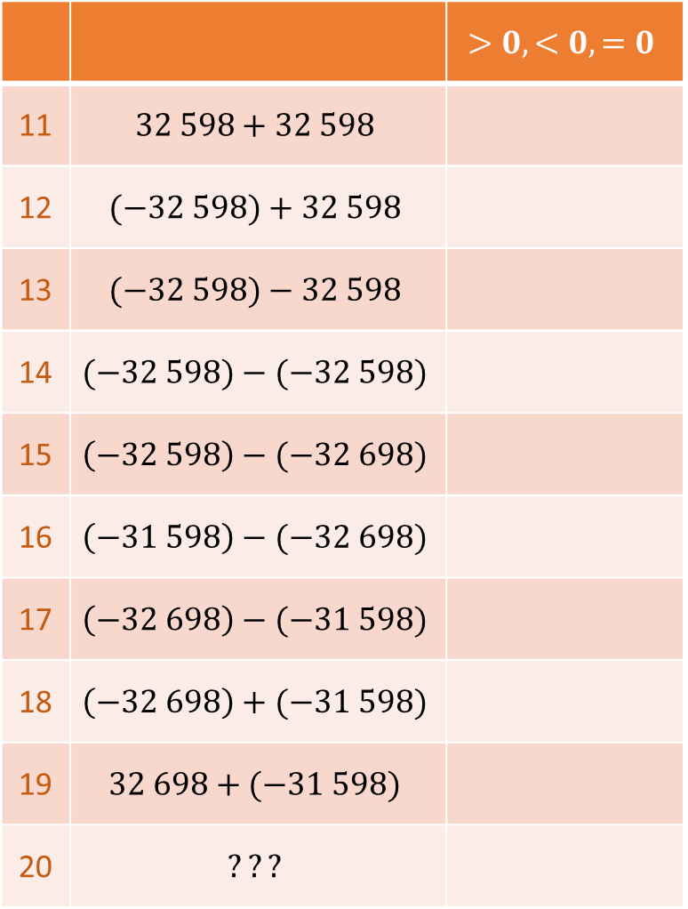
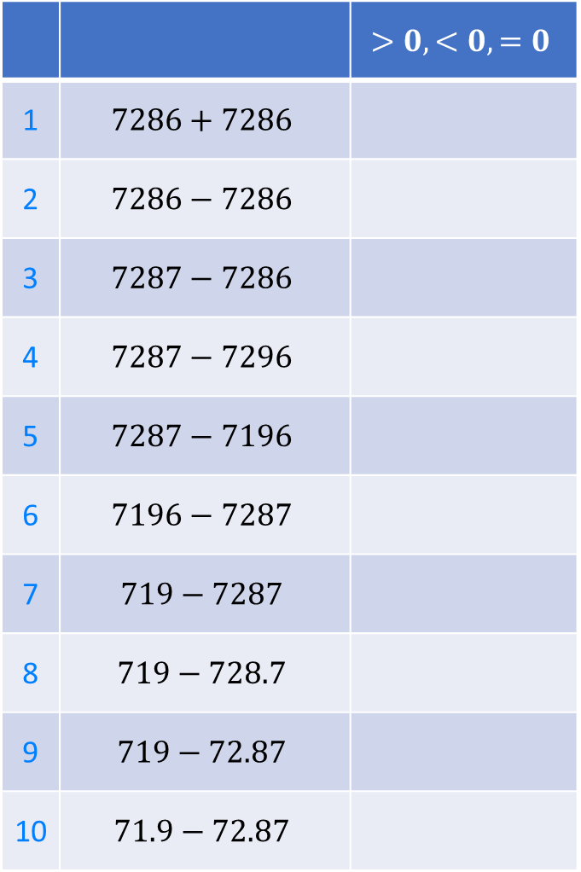
 |  | $$>0, <0, =0$$
1 | $$7286+7286$$
2 | $$7286−7286$$
3 | $$7287−7286$$
4 | $$7287−7296$$
5 | $$7287−7196$$
6 | $$7196−7287$$
7 | $$719−7287$$
8 | $$719−728.7$$
9 | $$719−72.87$$
10 | $$71.9−72.87$$
 |  | $$>0, <0, =0$$
11 | $$32 598+32 598$$
12 | $$(−32 598)+32 598$$
13 | $$(−32 598)−32 598$$
14 | $$(−32 598)−(−32 598)$$
15 | $$\left(−32 598\right)−(−32 698)$$
16 | $$\left(−31 598\right)−(−32 698)$$
17 | $$\left(−32 698\right)−(−31 598)$$
18 | $$\left(−32 698\right)+(−31 598)$$
19 | $$32 698+(−31 598)$$
20 | $$???$$
@mrbartonmaths

Slide 4
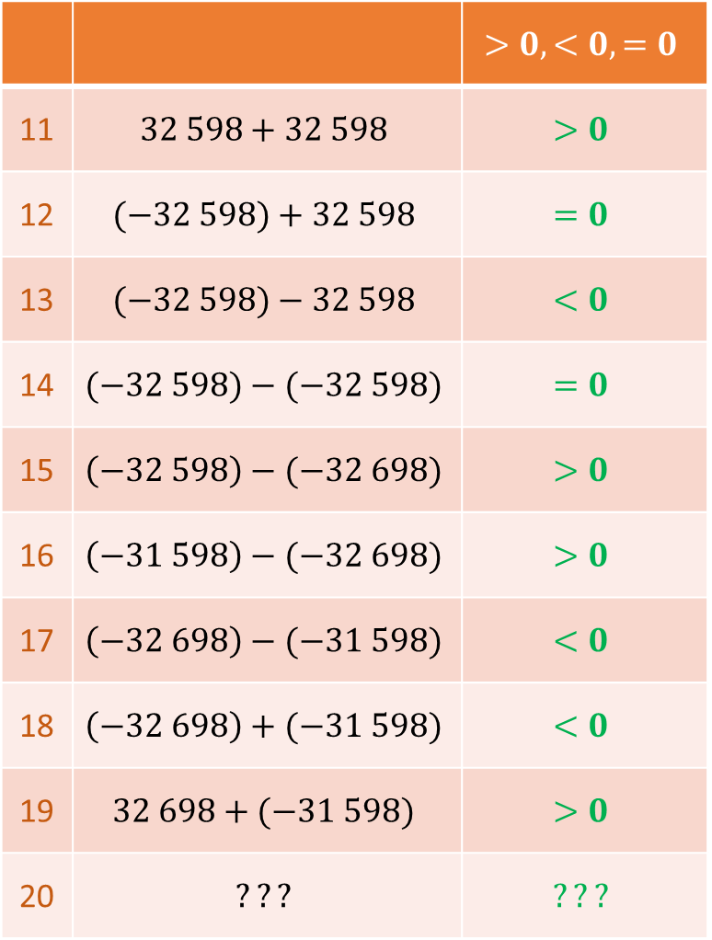
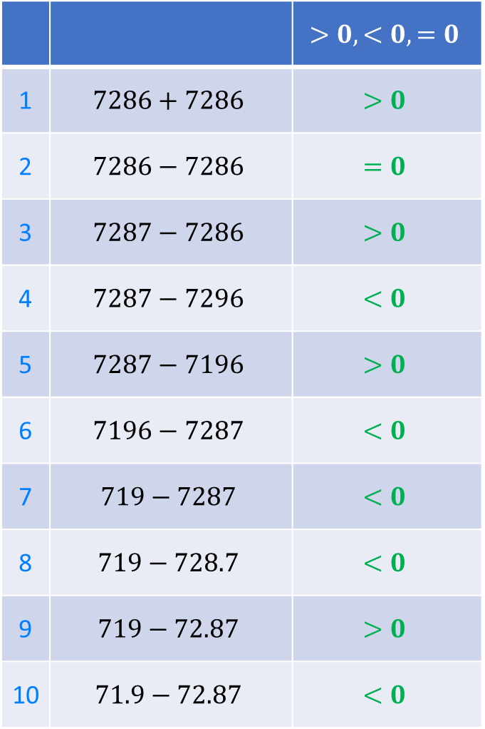
 |  | $$>0, <0, =0$$
1 | $$7286+7286$$ | $$>0$$
2 | $$7286−7286$$ | $$=0$$
3 | $$7287−7286$$ | $$>0$$
4 | $$7287−7296$$ | $$<0$$
5 | $$7287−7196$$ | $$>0$$
6 | $$7196−7287$$ | $$<0$$
7 | $$719−7287$$ | $$<0$$
8 | $$719−728.7$$ | $$<0$$
9 | $$719−72.87$$ | $$>0$$
10 | $$71.9−72.87$$ | $$<0$$
 |  | $$>0, <0, =0$$
11 | $$32 598+32 598$$ | $$>0$$
12 | $$(−32 598)+32 598$$ | $$=0$$
13 | $$(−32 598)−32 598$$ | $$<0$$
14 | $$(−32 598)−(−32 598)$$ | $$=0$$
15 | $$\left(−32 598\right)−(−32 698)$$ | $$>0$$
16 | $$\left(−31 598\right)−(−32 698)$$ | $$>0$$
17 | $$\left(−32 698\right)−(−31 598)$$ | $$<0$$
18 | $$\left(−32 698\right)+(−31 598)$$ | $$<0$$
19 | $$32 698+(−31 598)$$ | $$>0$$
20 | $$???$$ | $$???$$
@mrbartonmaths

Slide 5
 |  | $$>0, <0, =0$$
1 | $$7286+7286$$ | $$>0$$
2 | $$7286−7286$$ | $$=0$$
3 | $$7287−7286$$ | $$>0$$
4 | $$7287−7296$$ | $$<0$$
5 | $$7287−7196$$ | $$>0$$
6 | $$7196−7287$$ | $$<0$$
7 | $$719−7287$$ | $$<0$$
8 | $$719−728.7$$ | $$<0$$
9 | $$719−72.87$$ | $$>0$$
10 | $$71.9−72.87$$ | $$<0$$
 |  | $$>0, <0, =0$$
11 | $$32 598+32 598$$ | $$>0$$
12 | $$(−32 598)+32 598$$ | $$=0$$
13 | $$(−32 598)−32 598$$ | $$<0$$
14 | $$(−32 598)−(−32 598)$$ | $$=0$$
15 | $$\left(−32 598\right)−(−32 698)$$ | $$>0$$
16 | $$\left(−31 598\right)−(−32 698)$$ | $$>0$$
17 | $$\left(−32 698\right)−(−31 598)$$ | $$<0$$
18 | $$\left(−32 698\right)+(−31 598)$$ | $$<0$$
19 | $$32 698+(−31 598)$$ | $$>0$$
20 | $$???$$ | $$???$$
@mrbartonmaths

