Slide 1
Probability of single and combined events
Silent
Teacher
Intelligent Practice
Narration
Your Turn
Practice

Slide 2
From Q2 onward, before working out the answer, take a moment to predict if the probability will be greater than, less than or the same as the box directly above
Single pick
Two picks
(no replacement)
Probability of picking a red | Probability of picking a yellow
Probability of picking two reds | Probability of picking a red and a yellow (any order)
1.
2.
3.
4.
5.

Slide 3
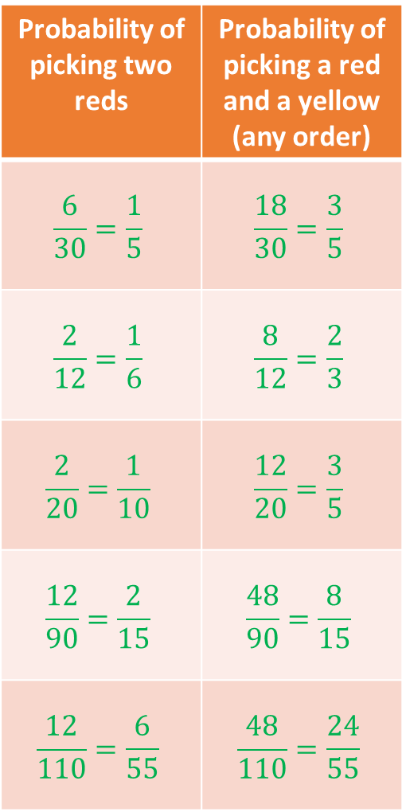
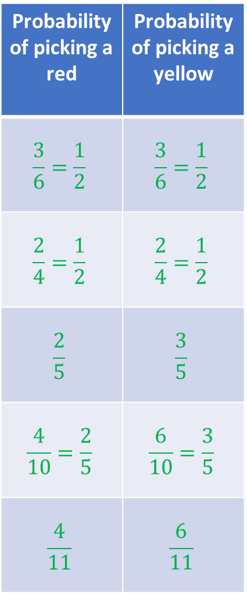
From Q2 onward, before working out the answer, take a moment to predict if the probability will be greater than, less than or the same as the box directly above
Single pick
Two picks
(no replacement)
Probability of picking a red | Probability of picking a yellow
$$\frac{3}{6}=\frac{1}{2}$$ | $$\frac{3}{6}=\frac{1}{2}$$
$$\frac{2}{4}=\frac{1}{2}$$ | $$\frac{2}{4}=\frac{1}{2}$$
$$\frac{2}{5}$$ | $$\frac{3}{5}$$
$$\frac{4}{10}=\frac{2}{5}$$ | $$\frac{6}{10}=\frac{3}{5}$$
$$\frac{4}{11}$$ | $$\frac{6}{11}$$
Probability of picking two reds | Probability of picking a red and a yellow (any order)
$$\frac{6}{30}=\frac{1}{5}$$ | $$\frac{18}{30}=\frac{3}{5}$$
$$\frac{2}{12}=\frac{1}{6}$$ | $$\frac{8}{12}=\frac{2}{3}$$
$$\frac{2}{20}=\frac{1}{10}$$ | $$\frac{12}{20}=\frac{3}{5}$$
$$\frac{12}{90}=\frac{2}{15}$$ | $$\frac{48}{90}=\frac{8}{15}$$
$$\frac{12}{110}=\frac{6}{55}$$ | $$\frac{48}{110}=\frac{24}{55}$$
1.
2.
3.
4.
5.

Slide 4
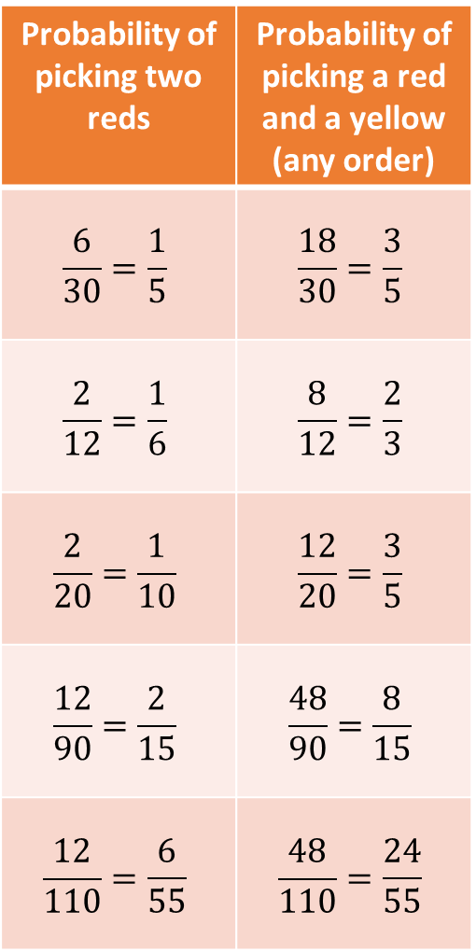
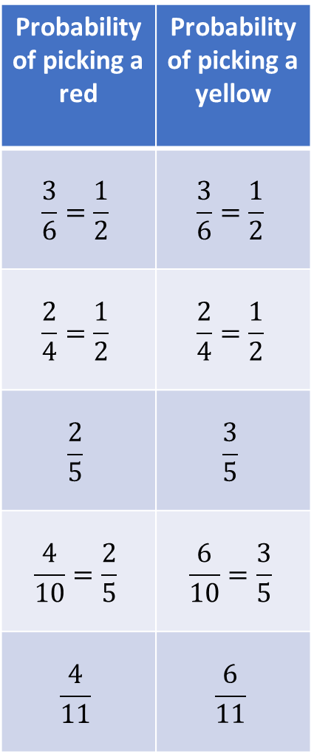
From Q2 onward, before working out the answer, take a moment to predict if the probability will be greater than, less than or the same as the box directly above
Single pick
Two picks
(no replacement)
Probability of picking a red | Probability of picking a yellow
$$\frac{3}{6}=\frac{1}{2}$$ | $$\frac{3}{6}=\frac{1}{2}$$
$$\frac{2}{4}=\frac{1}{2}$$ | $$\frac{2}{4}=\frac{1}{2}$$
$$\frac{2}{5}$$ | $$\frac{3}{5}$$
$$\frac{4}{10}=\frac{2}{5}$$ | $$\frac{6}{10}=\frac{3}{5}$$
$$\frac{4}{11}$$ | $$\frac{6}{11}$$
Probability of picking two reds | Probability of picking a red and a yellow (any order)
$$\frac{6}{30}=\frac{1}{5}$$ | $$\frac{18}{30}=\frac{3}{5}$$
$$\frac{2}{12}=\frac{1}{6}$$ | $$\frac{8}{12}=\frac{2}{3}$$
$$\frac{2}{20}=\frac{1}{10}$$ | $$\frac{12}{20}=\frac{3}{5}$$
$$\frac{12}{90}=\frac{2}{15}$$ | $$\frac{48}{90}=\frac{8}{15}$$
$$\frac{12}{110}=\frac{6}{55}$$ | $$\frac{48}{110}=\frac{24}{55}$$
1.
2.
3.
4.
5.

