Slide 1
Multiplying Fractions: Cross Cancelling
Silent
Teacher
Intelligent Practice
Narration
Your Turn
$$\frac{2}{5} ×\frac{25}{18}$$
$$÷2$$
$$÷5$$
$$=\frac{2}{5} ×\frac{25}{18}$$
$$÷5$$
$$÷2$$
Practice
$$=\frac{1}{1} ×\frac{5}{9}$$

Slide 2
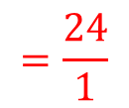
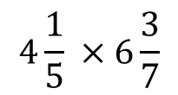
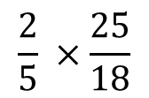

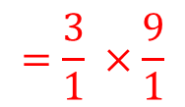
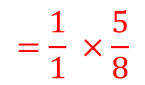
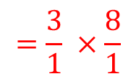
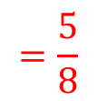

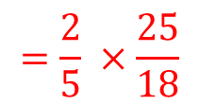
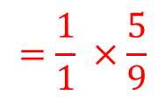
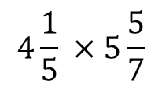
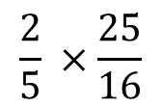
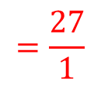
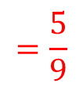
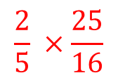
Worked Example
Your Turn
$$\frac{2}{5} ×\frac{25}{18}$$
$$\frac{2}{5} ×\frac{25}{16}$$
$$Calculate:$$
$$Calculate:$$
$$÷2$$
$$÷5$$
$$÷2$$
$$÷5$$
$$=\frac{2}{5} ×\frac{25}{18}$$
$$\frac{2}{5} ×\frac{25}{16}$$
$$÷5$$
$$÷2$$
$$÷5$$
$$÷2$$
$$=\frac{1}{1} ×\frac{5}{9}$$
$$=\frac{5}{9}$$
$$=\frac{1}{1} ×\frac{5}{8}$$
$$=\frac{5}{8}$$
$$4\frac{1}{5} ×5\frac{5}{7}$$
$$4\frac{1}{5} ×6\frac{3}{7}$$
$$÷7$$
$$÷5$$
$$÷7$$
$$÷5$$
$$=\frac{21}{5} ×\frac{40}{7}$$
$$=\frac{21}{5} ×\frac{45}{7}$$
$$÷5$$
$$÷7$$
$$÷5$$
$$÷7$$
$$=\frac{3}{1} ×\frac{8}{1}$$
$$=\frac{24}{1}$$
$$=\frac{3}{1} ×\frac{9}{1}$$
$$=\frac{27}{1}$$

Slide 3
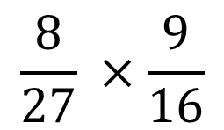
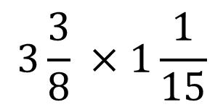
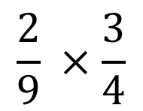
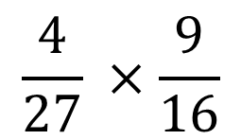
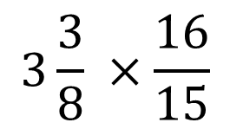
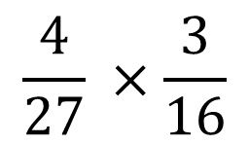
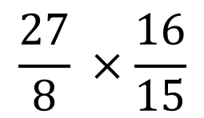
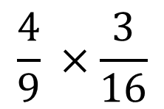
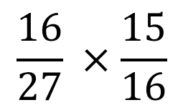
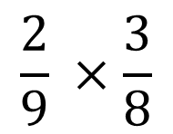
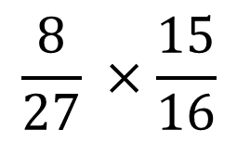
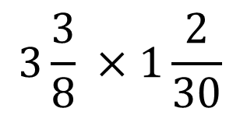
1)
$$\frac{2}{9} ×\frac{3}{4}$$
5)
$$\frac{4}{27} ×\frac{9}{16}$$
9)
$$\frac{27}{8} ×\frac{16}{15}$$
$$\frac{2}{9} ×\frac{3}{8}$$
6)
$$\frac{8}{27} ×\frac{9}{16}$$
$$3\frac{3}{8} ×\frac{16}{15}$$
2)
10)
3)
$$\frac{4}{9} ×\frac{3}{16}$$
7)
$$\frac{8}{27} ×\frac{15}{16}$$
$$3\frac{3}{8} ×1\frac{1}{15}$$
11)
4)
$$\frac{4}{27} ×\frac{3}{16}$$
8)
$$\frac{16}{27} ×\frac{15}{16}$$
12)
$$3\frac{3}{8} ×1\frac{2}{30}$$

Slide 4
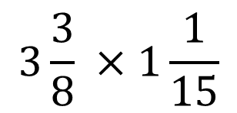
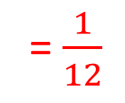
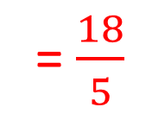
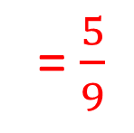
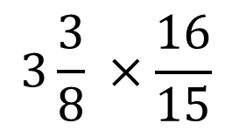
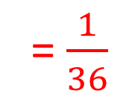
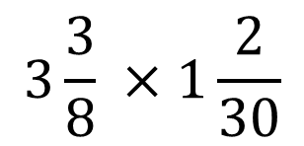
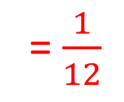
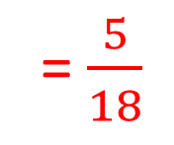
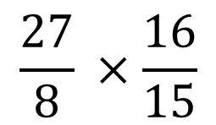
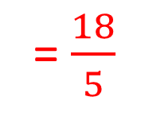
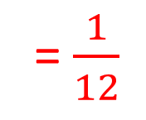
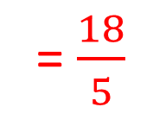
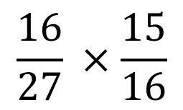
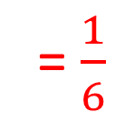
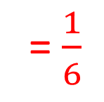
1)
$$\frac{2}{9} ×\frac{3}{4}$$
= $\frac{1}{6}$
5)
$$\frac{4}{27} ×\frac{9}{16}$$
= $\frac{1}{12}$
9)
$$\frac{27}{8} ×\frac{16}{15}$$
= $\frac{18}{5}$
2)
$$\frac{2}{9} ×\frac{3}{8}$$
= $\frac{1}{12}$
6)
$$\frac{8}{27} ×\frac{9}{16}$$
$$3\frac{3}{8} ×\frac{16}{15}$$
= $\frac{18}{5}$
= $\frac{1}{6}$
10)
3)
$$\frac{4}{9} ×\frac{3}{16}$$
= $\frac{1}{12}$
7)
$$\frac{8}{27} ×\frac{15}{16}$$
= $\frac{5}{18}$
11)
$$3\frac{3}{8} ×1\frac{1}{15}$$
= $\frac{18}{5}$
4)
$$\frac{4}{27} ×\frac{3}{16}$$
= $\frac{1}{36}$
8)
$$\frac{16}{27} ×\frac{15}{16}$$
= $\frac{5}{9}$
12)
$$3\frac{3}{8} ×1\frac{2}{30}$$
= $\frac{18}{5}$

