Slide 1
Probability adds to one
True/false
Reflect
Your Turn
Win | Lose
$$\frac{1}{2}$$ | $$\frac{1}{2}$$
Rule

Slide 2
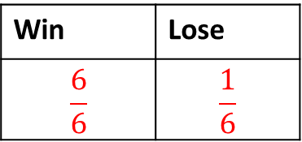
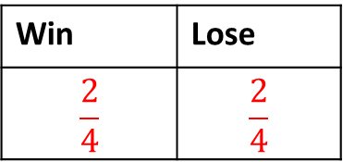
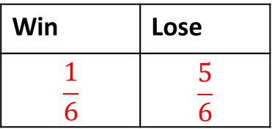
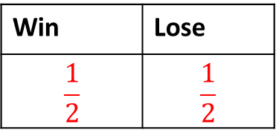
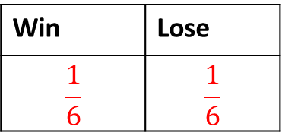
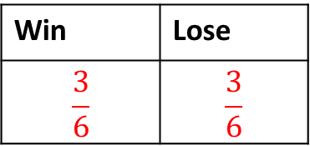
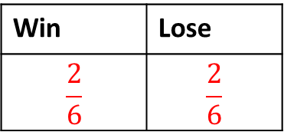
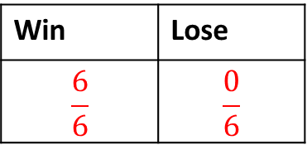
Win | Lose
$$\frac{1}{2}$$ | $$\frac{1}{2}$$
Win | Lose
$$\frac{1}{6}$$ | $$\frac{1}{6}$$
Yes No
Yes No
Win | Lose
$$\frac{2}{4}$$ | $$\frac{2}{4}$$
Win | Lose
$$\frac{1}{6}$$ | $$\frac{5}{6}$$
Yes No
Yes No
Win | Lose
$$\frac{2}{6}$$ | $$\frac{2}{6}$$
Win | Lose
$$\frac{6}{6}$$ | $$\frac{1}{6}$$
Yes No
Yes No
Win | Lose
$$\frac{3}{6}$$ | $$\frac{3}{6}$$
Win | Lose
$$\frac{6}{6}$$ | $$\frac{0}{6}$$
Yes No
Yes No

Slide 3
Win | Lose
$$\frac{1}{2}$$ | $$\frac{1}{2}$$
Win | Lose
$$\frac{1}{6}$$ | $$\frac{1}{6}$$
Yes No
Yes No
Win | Lose
$$\frac{2}{4}$$ | $$\frac{2}{4}$$
Win | Lose
$$\frac{1}{6}$$ | $$\frac{5}{6}$$
Yes No
Yes No
Win | Lose
$$\frac{2}{6}$$ | $$\frac{2}{6}$$
Win | Lose
$$\frac{6}{6}$$ | $$\frac{1}{6}$$
Yes No
Yes No
Win | Lose
$$\frac{3}{6}$$ | $$\frac{3}{6}$$
Win | Lose
$$\frac{6}{6}$$ | $$\frac{0}{6}$$
Yes No
Yes No

Slide 4
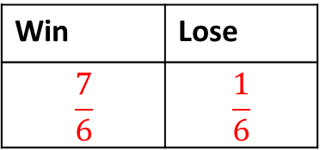
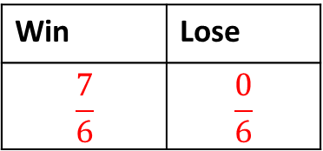
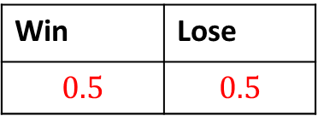
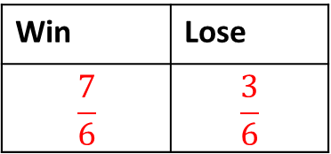
Win | Lose
$$\frac{7}{6}$$ | $$\frac{0}{6}$$
Tea | Coffee | Water
$$\frac{1}{2}$$ | $$\frac{1}{3}$$ | $$\frac{1}{3}$$
Yes No
Yes No
Win | Lose
$$\frac{7}{6}$$ | $$\frac{1}{6}$$
Tea | Coffee | Water
$$\frac{2}{10}$$ | $$\frac{2}{10}$$ | $$\frac{6}{10}$$
Yes No
Yes No
Win | Lose
$$\frac{7}{6}$$ | $$\frac{3}{6}$$
Tea | Coffee | Water
$$0.2$$ | $$0.2$$ | $$0.6$$
Yes No
Yes No
Win | Lose
$$0.5$$ | $$0.5$$
Tea | Coffee | Water
$$0.8$$ | $$\frac{1}{5}$$ | $$0$$
Yes No
Yes No

Slide 5
Win | Lose
$$\frac{7}{6}$$ | $$\frac{0}{6}$$
Tea | Coffee | Water
$$\frac{1}{2}$$ | $$\frac{1}{3}$$ | $$\frac{1}{3}$$
Yes No
Yes No
Win | Lose
$$\frac{7}{6}$$ | $$\frac{1}{6}$$
Tea | Coffee | Water
$$\frac{2}{10}$$ | $$\frac{2}{10}$$ | $$\frac{6}{10}$$
Yes No
Yes No
Win | Lose
$$\frac{7}{6}$$ | $$\frac{3}{6}$$
Tea | Coffee | Water
$$0.2$$ | $$0.2$$ | $$0.6$$
Yes No
Yes No
Win | Lose
$$0.5$$ | $$0.5$$
Tea | Coffee | Water
$$0.8$$ | $$\frac{1}{5}$$ | $$0$$
Yes No
Yes No

Slide 6
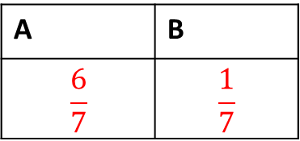
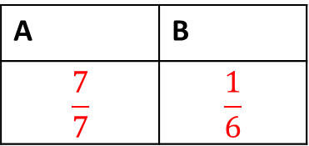
Your Turn
1)
3)
A | B
$$\frac{6}{7}$$ | $$\frac{1}{7}$$
Red | Green | Blue
$$\frac{1}{4}$$ | $$\frac{1}{4}$$ | $$\frac{1}{4}$$
Yes No
Yes No
2)
4)
A | B
$$\frac{7}{7}$$ | $$\frac{1}{6}$$
Red | Green | Blue
$$0.25$$ | $$0.25$$ | $$0.50$$
Yes No
Yes No

Slide 7
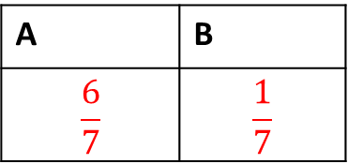
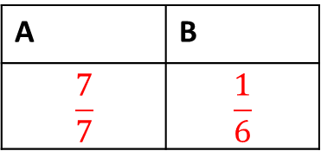
Your Turn
1)
3)
A | B
$$\frac{6}{7}$$ | $$\frac{1}{7}$$
Red | Green | Blue
$$\frac{1}{4}$$ | $$\frac{1}{4}$$ | $$\frac{1}{4}$$
Yes No
Yes No
2)
4)
A | B
$$\frac{7}{7}$$ | $$\frac{1}{6}$$
Red | Green | Blue
$$0.25$$ | $$0.25$$ | $$0.50$$
Yes No
Yes No

