Slide 1
Use the addition law for mutually exclusive events
Silent
Teacher
Intelligent Practice
Narration
Your Turn
Win | Lose
$$\frac{1}{2}$$ | $$\frac{1}{2}$$
Win | Lose
$$0.5$$ | $$0.5$$
Practice

Slide 2
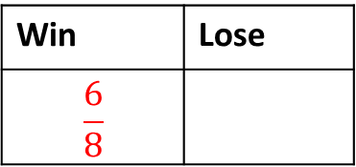
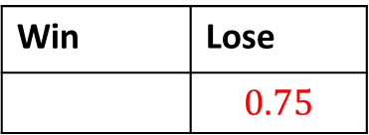
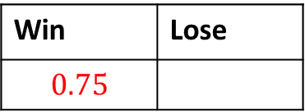
Worked Example
Your Turn
Castle FC play football matches every Saturday.
The table shows the probability that Castle FC will win or draw.
Castle FC play football matches every Saturday.
The table shows the probability that Castle FC will win or draw.
Work out the probability that Castle FC will lose
Work out the probability that Castle FC will lose
Win | Lose
$$\frac{3}{4}$$
Win | Lose
$$\frac{6}{8}$$
Work out the probability that Castle FC will lose
Work out the probability that Castle FC will win
Win | Lose
$$0.75$$
Win | Lose
 | $$0.75$$

Slide 3
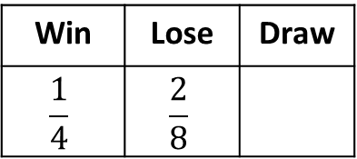
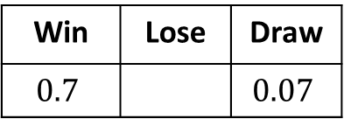
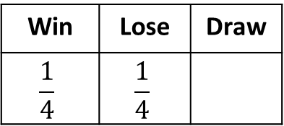
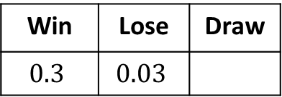
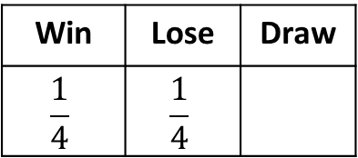
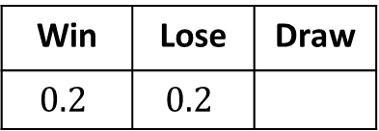
Aiden is a boxer. The table shows the probability that Aiden will win, lose or draw.
Work out the probability that Aiden will draw
Work out the probability that Aiden will draw
Win | Lose | Draw
$$\frac{1}{4}$$ | $$\frac{1}{4}$$
Win | Lose | Draw
$$0.2$$ | $$0.2$$
Work out the probability that Aiden will draw or win
Work out the probability that Aiden will draw
Win | Lose | Draw
$$\frac{1}{4}$$ | $$\frac{1}{4}$$
Win | Lose | Draw
$$0.3$$ | $$0.03$$
Work out the probability that Aiden will draw
Work out the probability that Aiden will draw or lose
Win | Lose | Draw
$$\frac{1}{4}$$ | $$\frac{2}{8}$$
Win | Lose | Draw
$$0.7$$ |  | $$0.07$$

Slide 4
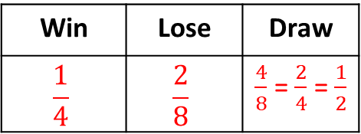
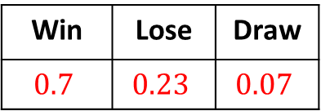
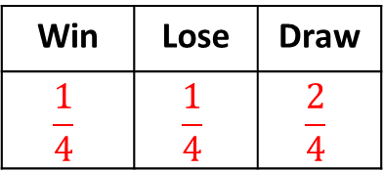
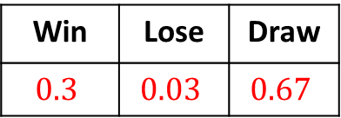
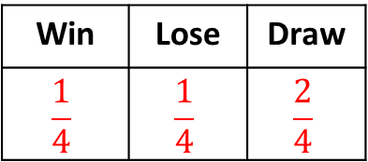
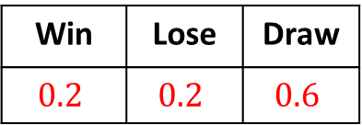
Aiden is a boxer. The table shows the probability that Aiden will win, lose or draw.
Work out the probability that Aiden will draw
Work out the probability that Aiden will draw
Win | Lose | Draw
$$\frac{1}{4}$$ | $$\frac{1}{4}$$ | $$\frac{2}{4}$$
Win | Lose | Draw
$$0.2$$ | $$0.2$$ | $$0.6$$
Work out the probability that Aiden will draw or win
Work out the probability that Aiden will draw
$$\frac{3}{4}$$
Win | Lose | Draw
$$\frac{1}{4}$$ | $$\frac{1}{4}$$ | $$\frac{2}{4}$$
Win | Lose | Draw
$$0.3$$ | $$0.03$$ | $$0.67$$
Work out the probability that Aiden will draw
Work out the probability that Aiden will draw or lose
$$0.3$$
Win | Lose | Draw
$$\frac{1}{4}$$ | $$\frac{2}{8}$$ | $\frac{4}{8}$ = $\frac{2}{4}$ = $\frac{1}{2}$
Win | Lose | Draw
$$0.7$$ | $$0.23$$ | $$0.07$$

Slide 5
Aiden is a boxer. The table shows the probability that Aiden will win, lose or draw.
Work out the probability that Aiden will win
Win | Lose
$$x$$ | $$x$$
Work out the probability that Aiden’s match will be postponed
Win | Lose | Draw | Postponed
$$2x$$ | $$2x$$ | $$2x$$ | $$4x$$
Work out the probability that Aiden’s match will be postponed
Win | Lose | Draw | Postponed
$$\frac{3}{4}x$$ | $$2x$$ | $$2x$$ | $$\frac{1}{4}x$$

Slide 6
Aiden is a boxer. The table shows the probability that Aiden will win, lose or draw.
Work out the probability that Aiden will win
Win | Lose
$$0.5$$ | $$0.5$$
Work out the probability that Aiden’s match will be postponed
Win | Lose | Draw | Postponed
$$0.2$$ | $$0.2$$ | $$0.2$$ | $$0.4$$
Work out the probability that Aiden’s match will be postponed
Win | Lose | Draw | Postponed
$$0.15$$ | $$0.4$$ | $$0.4$$ | $$0.05$$

Slide 7
Castle FC play football matches every Saturday.
In their last 10 matches, Castle FC have drawn 5 matches, lost 2 and won the rest.
Complete the probability table for Castle FC
Win | Lose | Draw
Castle FC play football matches every Saturday.
In their last 50 matches, Castle FC have drawn 10 matches, lost 5 and won the rest.
Complete the probability table for Castle FC as decimals
Win | Lose | Draw

Slide 8
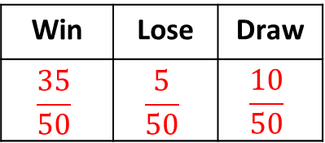
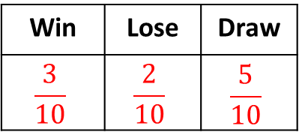
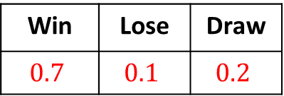
Castle FC play football matches every Saturday.
In their last 10 matches, Castle FC have drawn 5 matches, lost 2 and won the rest.
Complete the probability table for Castle FC
Win | Lose | Draw
$$\frac{3}{10}$$ | $$\frac{2}{10}$$ | $$\frac{5}{10}$$
Castle FC play football matches every Saturday.
In their last 50 matches, Castle FC have drawn 10 matches, lost 5 and won the rest.
Complete the probability table for Castle FC as decimals
Win | Lose | Draw
$$\frac{35}{50}$$ | $$\frac{5}{50}$$ | $$\frac{10}{50}$$
Win | Lose | Draw
$$0.7$$ | $$0.1$$ | $$0.2$$

