Slide 1
Upper and Lower Bounds
Silent
Teacher
Intelligent Practice
Narration
Your Turn
$$x cm$$
8$cm$
Practice

Slide 2
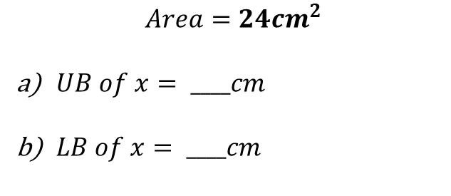
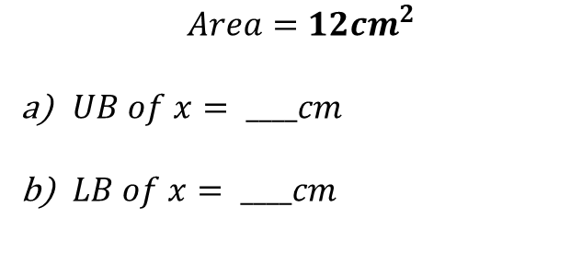
Worked Example
Your Turn
All numbers in bold have been rounded to the nearest integer (whole number)
All numbers in bold have been rounded to the nearest integer (whole number)
$$x cm$$
$$x cm$$
8$cm$
8$cm$
$$Area=24cm^{2}$$
$UB of x= ____cm$
$LB of x= ____cm$
$$Area=12cm^{2}$$
$UB of x= ____cm$
$LB of x= ____cm$
@MrTFarahmand

Slide 3
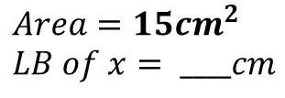
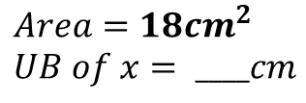
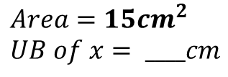
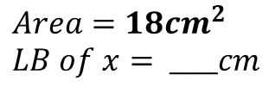
All numbers in bold have been rounded to the nearest integer (whole number)
1) 2) 3)
$$4cm$$
$$4cm$$
$$2cm$$
$$6cm$$
$$6cm$$
$$6cm$$
$$Max Area=____ cm^{2}$$
$$Min Area=____ cm^{2}$$
$$Min Area=____ cm^{2}$$
4) 5) 6)
$$2cm$$
$$x cm$$
$$x cm$$
$$6cm$$
$$6cm$$
$$6cm$$
$$Area=18cm^{2}$$
$$x= ____cm$$
$$Area=18cm^{2} \\ UB of x= ____cm$$
$$Max Area=____ cm^{2}$$
7) 8) 9)
$$x cm$$
$$x cm$$
$$x cm$$
$$6cm$$
$$6cm$$
$$6cm$$
$$Area=15cm^{2} \\ UB of x= ____cm$$
$$Area=18cm^{2} \\ LB of x= ____cm$$
$$Area=15cm^{2} \\ LB of x= ____cm$$
@MrTFarahmand

Slide 4
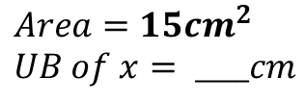
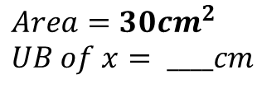
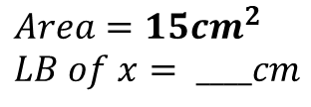
All numbers in bold have been rounded to the nearest integer (whole number)
10) 11) 12)
$$x cm$$
$$x cm$$
$$x cm$$
12$cm$
12$cm$
12$cm$
$$Area=15cm^{2} \\ LB of x= ____cm$$
$$Area=15cm^{2} \\ UB of x= ____cm$$
$$Area=30cm^{2} \\ UB of x= ____cm$$
@MrTFarahmand

Slide 5
All numbers in bold have been rounded to the nearest integer (whole number)
1) 2) 3)
$$4cm$$
$$4cm$$
$$2cm$$
$$6cm$$
$$6cm$$
$$6cm$$
$$Max Area=29.25 cm^{2}$$
$$Min Area=19.25 cm^{2}$$
$$Min Area=8.25 cm^{2}$$
4) 5) 6)
$$2cm$$
$$x cm$$
$$x cm$$
$$6cm$$
$$6cm$$
$$6cm$$
$$Area=18cm^{2}$$
$$x=3 cm$$
$$Area=18cm^{2} \\ UB of x=3.36 cm$$
$$Max Area=16.25 cm^{2}$$
7) 8) 9)
$$x cm$$
$$x cm$$
$$x cm$$
$$6cm$$
$$6cm$$
$$6cm$$
$$Area=15cm^{2} \\ UB of x=2.81 cm$$
$$Area=18cm^{2} \\ LB of x=2.69 cm$$
$$Area=15cm^{2} \\ LB of x=2.23 cm$$

Slide 6
All numbers in bold have been rounded to the nearest integer (whole number)
10) 11) 12)
$$x cm$$
$$x cm$$
$$x cm$$
12$cm$
12$cm$
12$cm$
$$Area=15cm^{2} \\ LB of x=1.16 cm$$
$$Area=15cm^{2} \\ UB of x=1.35 cm$$
$$Area=30cm^{2} \\ UB of x=2.65 cm$$

