Slide 1
Algebra: Forming Expressions
True/false
Reflect
Your Turn
3 more than a
3 less than c
Rule

Slide 2
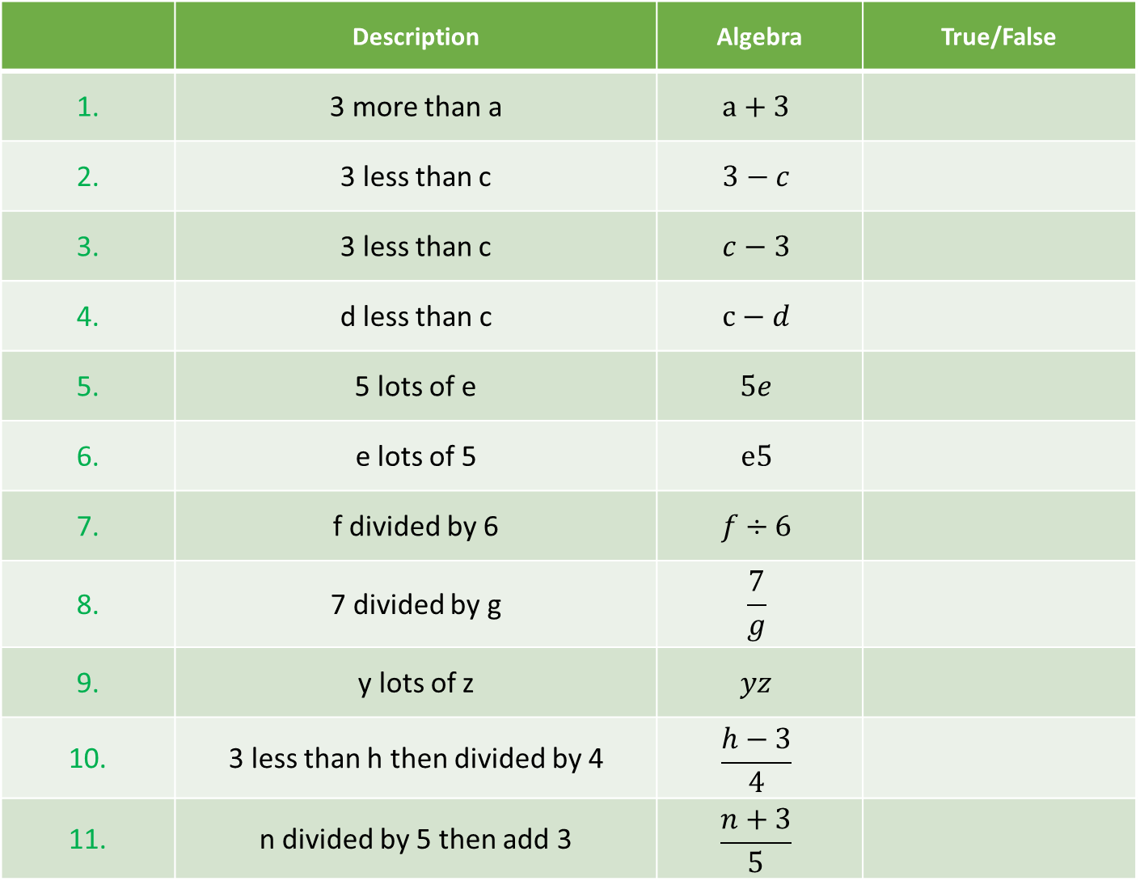
 | Description | Algebra | True/False
1. | 3 more than a | $$a+3$$
2. | 3 less than c | $$3−c$$
3. | 3 less than c | $$c−3$$
4. | d less than c | $$c−d$$
5. | 5 lots of e | $$5e$$
6. | e lots of 5 | $$e5$$
7. | f divided by 6 | $$f÷6$$
8. | 7 divided by g | $$\frac{7}{g}$$
9. | y lots of z | $$yz$$
10. | 3 less than h then divided by 4 | $$\frac{h−3}{4}$$
11. | n divided by 5 then add 3 | $$\frac{n+3}{5}$$

Slide 3
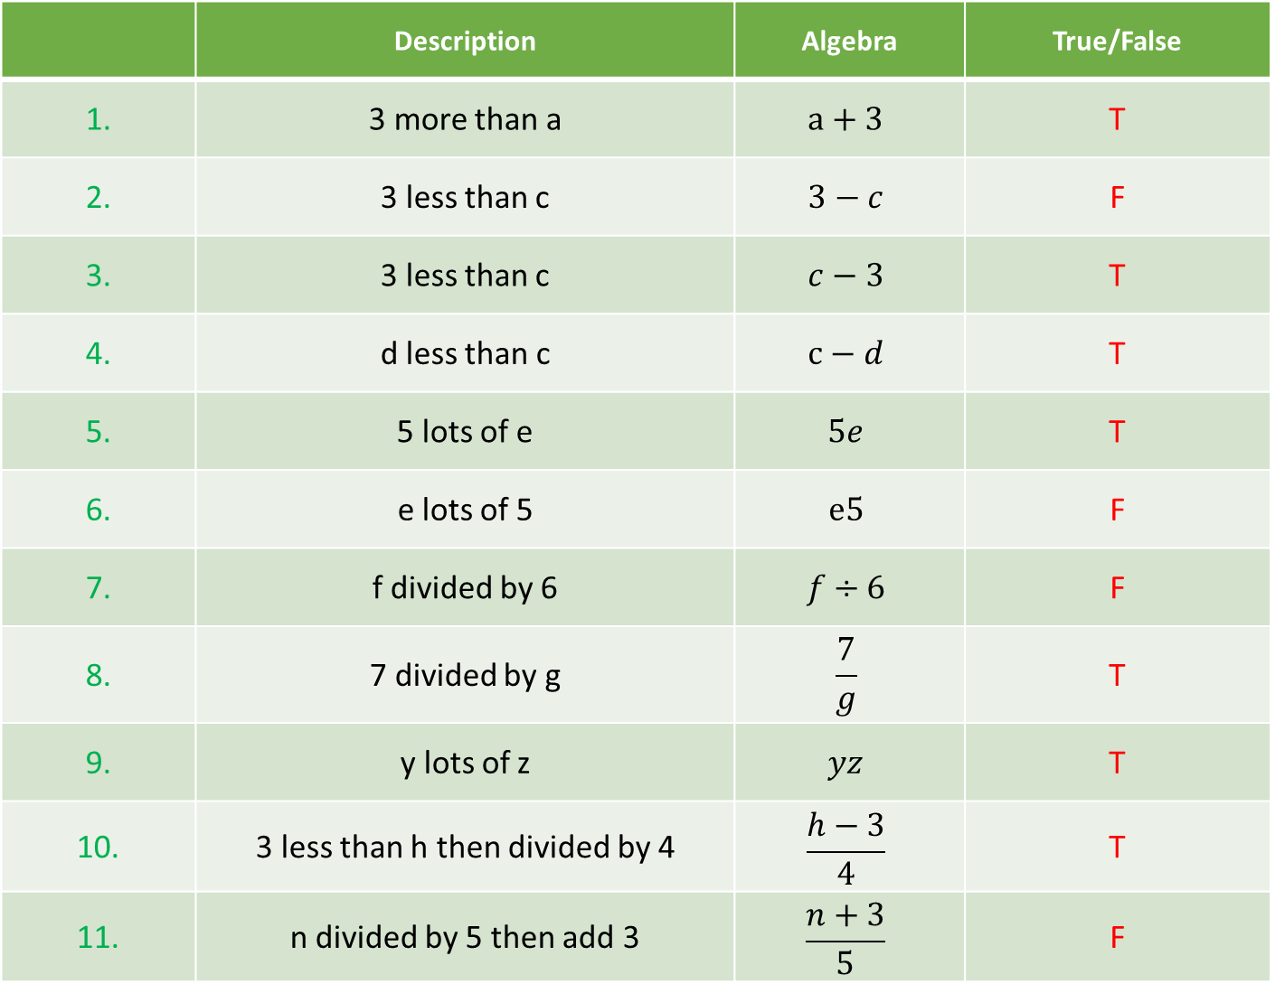
 | Description | Algebra | True/False
1. | 3 more than a | $$a+3$$ | T
2. | 3 less than c | $$3−c$$ | F
3. | 3 less than c | $$c−3$$ | T
4. | d less than c | $$c−d$$ | T
5. | 5 lots of e | $$5e$$ | T
6. | e lots of 5 | $$e5$$ | F
7. | f divided by 6 | $$f÷6$$ | F
8. | 7 divided by g | $$\frac{7}{g}$$ | T
9. | y lots of z | $$yz$$ | T
10. | 3 less than h then divided by 4 | $$\frac{h−3}{4}$$ | T
11. | n divided by 5 then add 3 | $$\frac{n+3}{5}$$ | F

Slide 4
Your Turn
 | Description | Algebra
1. | 7 less than b
2. | d less than 6
3. | 12 divided by c
4. | 4 lots of t, then divided by 3
5. | 5 divided by y then added to j

Slide 5
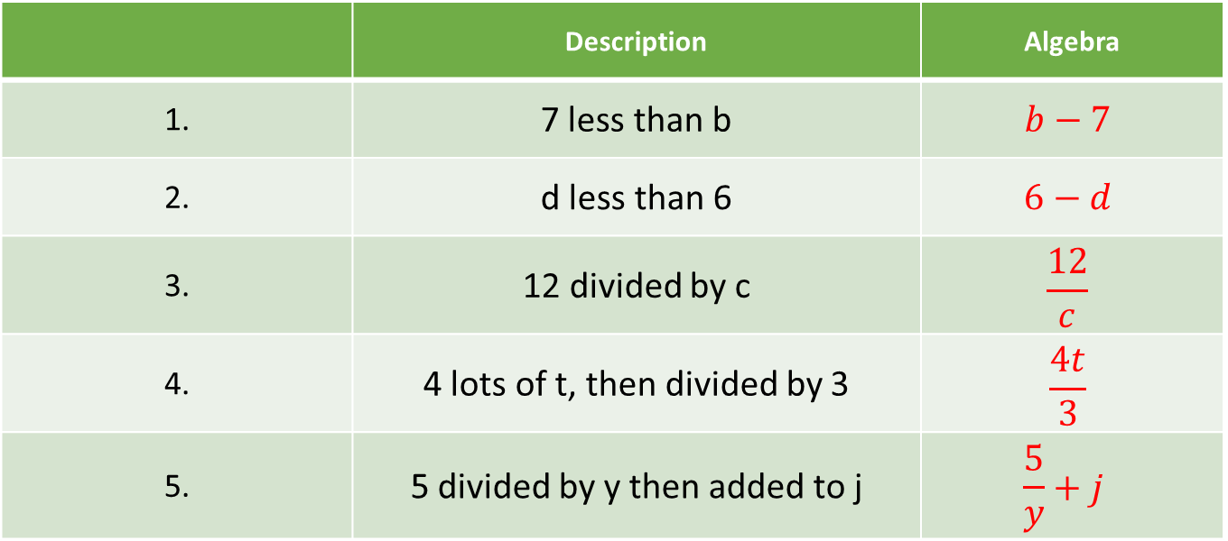
Your Turn - answers
 | Description | Algebra
1. | 7 less than b | $$b−7$$
2. | d less than 6 | $$6−d$$
3. | 12 divided by c | $$\frac{12}{c}$$
4. | 4 lots of t, then divided by 3 | $$\frac{4t}{3}$$
5. | 5 divided by y then added to j | $$\frac{5}{y}+j$$

