Slide 1
Fractions of an amount (missing triangle)
Silent
Teacher
Intelligent Practice
Narration
Your Turn
$$\frac{1}{5} of 30=$$
$$\frac{2}{5}of 15 =$$
Practice

Slide 2
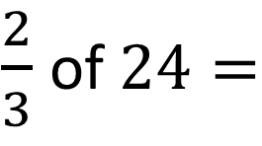
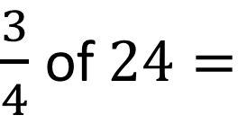
Worked Example
Your Turn
$\frac{3}{4}$ of $24=$
$\frac{2}{3}$ of $24=$
@mrbartonmaths

Slide 3
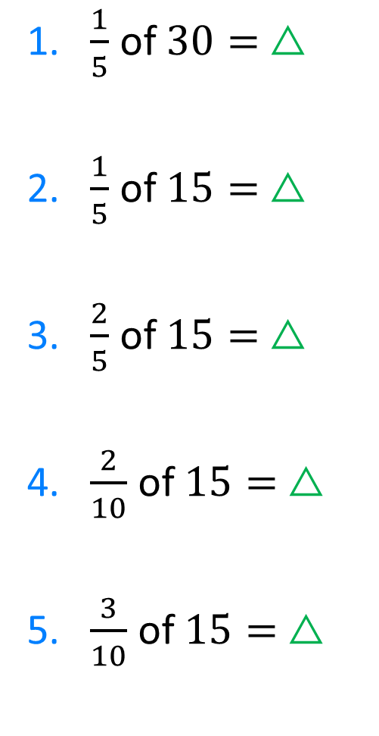
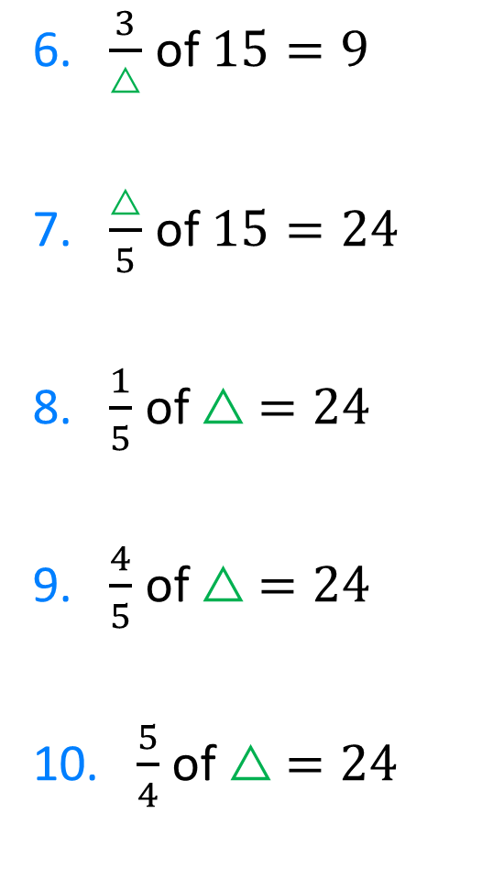
Can you work out the value of the $△$ in each of these questions?
Remember to Reflect, Expect, Check, Explain
1. $\frac{1}{5}$ of $30= △$
2. $\frac{1}{5}$ of $15= △$
3. $\frac{2}{5}$ of $15= △$
4. $\frac{2}{10}$ of $15= △$
5. $\frac{3}{10}$ of $15= △$
6. $\frac{3}{△}$ of $15=9$
7. $\frac{△}{5}$ of $15=24$
8. $\frac{1}{5}$ of $△ =24$
9. $\frac{4}{5}$ of $△ =24$
10. $\frac{5}{4}$ of $△ =24$

Slide 4
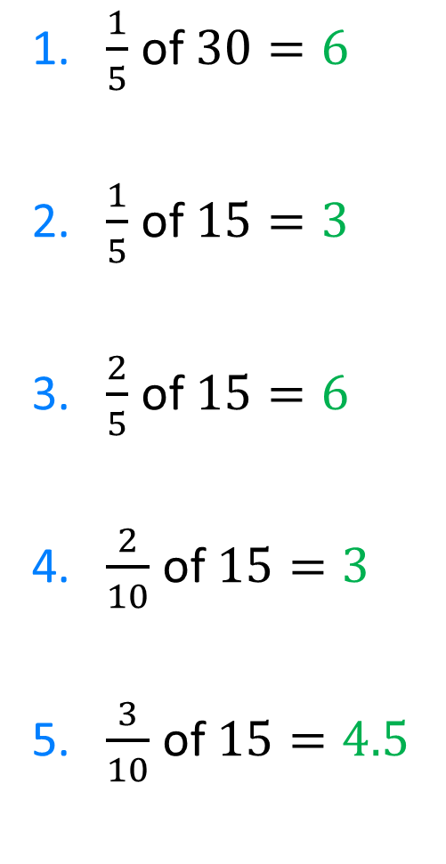
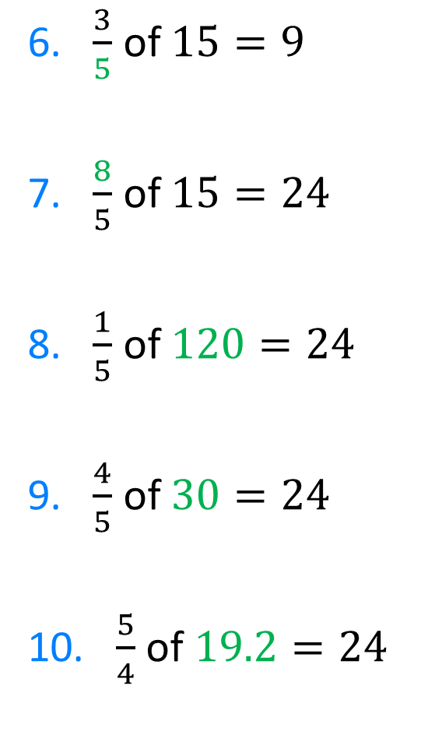
Can you work out the value of the $△$ in each of these questions?
Remember to Reflect, Expect, Check, Explain
1. $\frac{1}{5}$ of $30=6$
2. $\frac{1}{5}$ of $15=3$
3. $\frac{2}{5}$ of $15=6$
4. $\frac{2}{10}$ of $15=3$
5. $\frac{3}{10}$ of $15=4.5$
6. $\frac{3}{5}$ of $15=9$
7. $\frac{8}{5}$ of $15=24$
8. $\frac{1}{5}$ of $120=24$
9. $\frac{4}{5}$ of $30=24$
10. $\frac{5}{4}$ of $19.2=24$
$$△$$
$$△$$
$$△$$
$$△$$
$$△$$
$$△$$
$$△$$
$$△$$
$$△$$
$$△$$

Slide 5
Can you work out the value of the $△$ in each of these questions?
Remember to Reflect, Expect, Check, Explain
1. $\frac{1}{5}$ of $30=6$
2. $\frac{1}{5}$ of $15=3$
3. $\frac{2}{5}$ of $15=6$
4. $\frac{2}{10}$ of $15=3$
5. $\frac{3}{10}$ of $15=4.5$
6. $\frac{3}{5}$ of $15=9$
7. $\frac{8}{5}$ of $15=24$
8. $\frac{1}{5}$ of $120=24$
9. $\frac{4}{5}$ of $30=24$
10. $\frac{5}{4}$ of $19.2=24$

