Slide 1
HCF & LCM - Forwards & Backwards - Number & Algebra
Silent
Teacher
Intelligent Practice
Narration
Your Turn
HCF | LCM | Number a | Number b
7 | 42 | 14
HCF | LCM | Term a | Term b
$$5n$$ | $$110n$$ |  | $$55n$$
Practice

Slide 2
HCF | LCM | Number a | Number b
7 | 42 | 14
HCF | LCM | Number a | Number b
11 | 66 | 22
HCF | LCM | Number a | Number b
11 | 110 | 22
@dare_richard

Slide 3
HCF | LCM | Number a | Number b
2 | 30 |  | 10
3 | 45 | 9
 |  | 10 | 15
3 | 30 |  | 15
 |  | 12 | 20
6 | 60 | 12
10 | 60 | 60
1 | 60 |  | 15
8 | 120 | 24
4 | 120 | 24
4 | 120 | 40
12 | 120 |  | 60
30 | 120 | 30
1 | 120 | 15
5 | 120 | 15
120 | 120
@dare_richard

Slide 4
HCF | LCM | Number a | Number b
2 | 30 | 6 | 10
3 | 45 | 9 | 15
5 | 30 | 10 | 15
3 | 30 | 6 | 15
4 | 60 | 12 | 20
6 | 60 | 12 | 30
10 | 60 | 60 | 10
1 | 60 | 4 | 15
8 | 120 | 24 | 40
4 | 120 | 24 | 20
4 | 120 | 40 | 12
12 | 120 | 24 | 60
30 | 120 | 30 | 120
1 | 120 | 15 | 8
5 | 120 | 15 | 40
120 | 120 | 120 | 120
@dare_richard

Slide 5
HCF | LCM | Term a | Term b
 |  | $$10y$$ | $$14y$$
HCF | LCM | Term a | Term b
 |  | $$10n$$ | $$22n$$
HCF | LCM | Term a | Term b
 |  | $$110n$$ | $$11n$$
@dare_richard

Slide 6
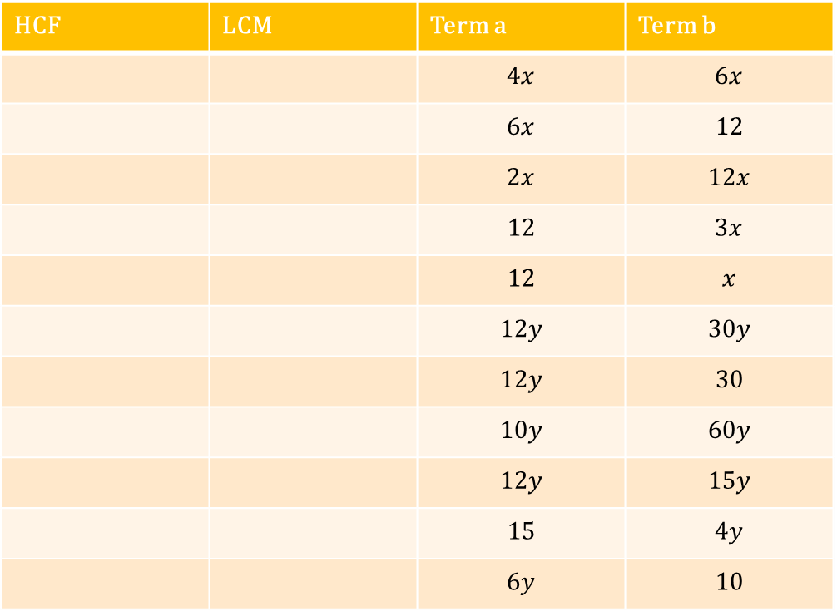
HCF | LCM | Term a | Term b
 |  | $$4x$$ | $$6x$$
 |  | $$6x$$ | $$12$$
 |  | $$2x$$ | $$12x$$
 |  | $$12$$ | $$3x$$
 |  | $$12$$ | $$x$$
 |  | $$12y$$ | $$30y$$
 |  | $$12y$$ | $$30$$
 |  | $$10y$$ | $$60y$$
 |  | $$12y$$ | $$15y$$
 |  | $$15$$ | $$4y$$
 |  | $$6y$$ | $$10$$
@dare_richard

Slide 7
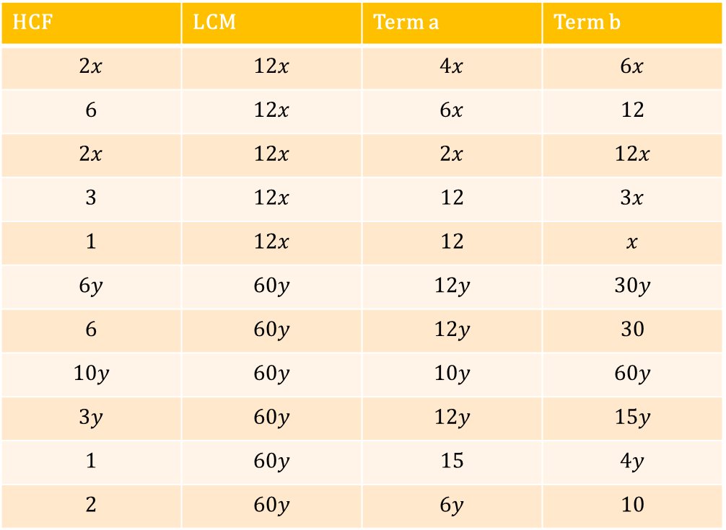
HCF | LCM | Term a | Term b
$$2x$$ | $$12x$$ | $$4x$$ | $$6x$$
$$6$$ | $$12x$$ | $$6x$$ | $$12$$
$$2x$$ | $$12x$$ | $$2x$$ | $$12x$$
$$3$$ | $$12x$$ | $$12$$ | $$3x$$
$$1$$ | $$12x$$ | $$12$$ | $$x$$
$$6y$$ | $$60y$$ | $$12y$$ | $$30y$$
$$6$$ | $$60y$$ | $$12y$$ | $$30$$
$$10y$$ | $$60y$$ | $$10y$$ | $$60y$$
$$3y$$ | $$60y$$ | $$12y$$ | $$15y$$
$$1$$ | $$60y$$ | $$15$$ | $$4y$$
$$2$$ | $$60y$$ | $$6y$$ | $$10$$
@dare_richard

Slide 8
HCF | LCM | Term a | Term b
$$10$$ | $$70y$$ |  | $$10y$$
HCF | LCM | Term a | Term b
$$2n$$ | $$110n$$ | $$2n$$
HCF | LCM | Term a | Term b
$$7$$ | $$70y$$ | $$7$$
HCF | LCM | Term a | Term b
$$5n$$ | $$110n$$ |  | $$55n$$
@dare_richard

Slide 9
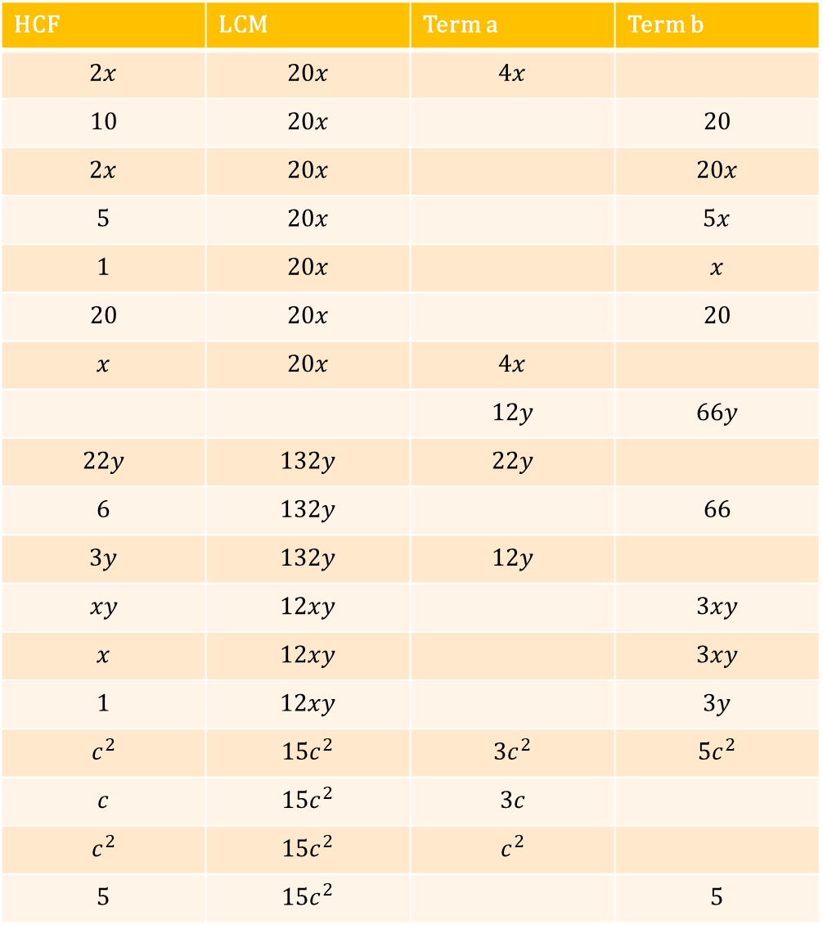
HCF | LCM | Term a | Term b
$$2x$$ | $$20x$$ | $$4x$$
$$10$$ | $$20x$$ |  | $$20$$
$$2x$$ | $$20x$$ |  | $$20x$$
$$5$$ | $$20x$$ |  | $$5x$$
$$1$$ | $$20x$$ |  | $$x$$
$$20$$ | $$20x$$ |  | $$20$$
$$x$$ | $$20x$$ | $$4x$$
 |  | $$12y$$ | $$66y$$
$$22y$$ | $$132y$$ | $$22y$$
$$6$$ | $$132y$$ |  | $$66$$
$$3y$$ | $$132y$$ | $$12y$$
$$xy$$ | $$12xy$$ |  | $$3xy$$
$$x$$ | $$12xy$$ |  | $$3xy$$
$$1$$ | $$12xy$$ |  | $$3y$$
$$c^{2}$$ | $${15c}^{2}$$ | $${3c}^{2}$$ | $${5c}^{2}$$
$$c$$ | $${15c}^{2}$$ | $$3c$$
$$c^{2}$$ | $${15c}^{2}$$ | $$c^{2}$$
$$5$$ | $${15c}^{2}$$ |  | $$5$$

Slide 10
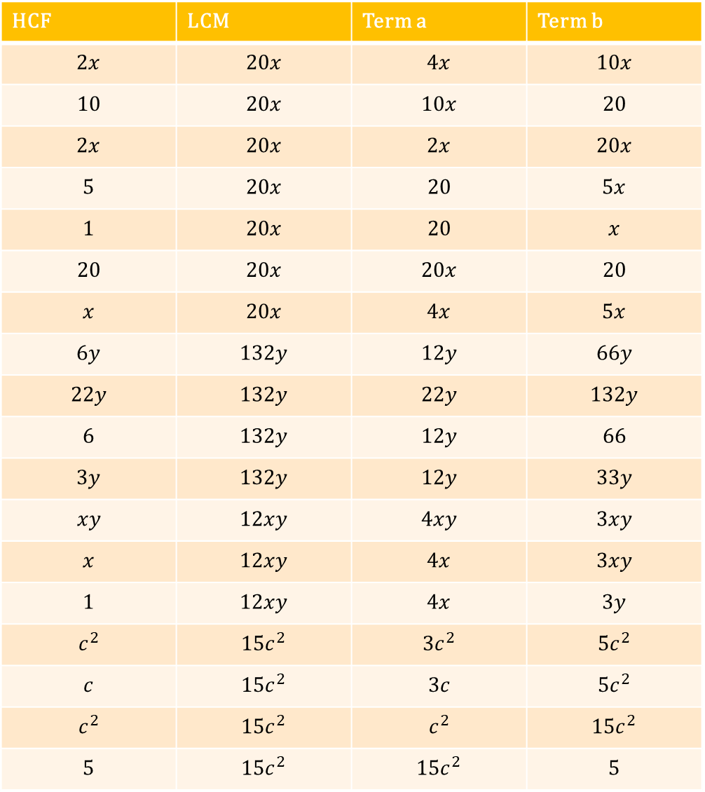
HCF | LCM | Term a | Term b
$$2x$$ | $$20x$$ | $$4x$$ | $$10x$$
$$10$$ | $$20x$$ | $$10x$$ | $$20$$
$$2x$$ | $$20x$$ | $$2x$$ | $$20x$$
$$5$$ | $$20x$$ | $$20$$ | $$5x$$
$$1$$ | $$20x$$ | $$20$$ | $$x$$
$$20$$ | $$20x$$ | $$20x$$ | $$20$$
$$x$$ | $$20x$$ | $$4x$$ | $$5x$$
$$6y$$ | $$132y$$ | $$12y$$ | $$66y$$
$$22y$$ | $$132y$$ | $$22y$$ | $$132y$$
$$6$$ | $$132y$$ | $$12y$$ | $$66$$
$$3y$$ | $$132y$$ | $$12y$$ | $$33y$$
$$xy$$ | $$12xy$$ | $$4xy$$ | $$3xy$$
$$x$$ | $$12xy$$ | $$4x$$ | $$3xy$$
$$1$$ | $$12xy$$ | $$4x$$ | $$3y$$
$$c^{2}$$ | $${15c}^{2}$$ | $${3c}^{2}$$ | $${5c}^{2}$$
$$c$$ | $${15c}^{2}$$ | $$3c$$ | $${5c}^{2}$$
$$c^{2}$$ | $${15c}^{2}$$ | $$c^{2}$$ | $${15c}^{2}$$
$$5$$ | $${15c}^{2}$$ | $${15c}^{2}$$ | $$5$$

