Slide 1
Recurring decimals to fractions
Silent
Teacher
Intelligent Practice
Narration
Your Turn
$$\text{0.}\dot{3}\dot{7}$$
Practice

Slide 2


Worked Example
Your Turn
Convert to a recurring decimal to a fraction
Convert to a recurring decimal to a fraction
$\text{0.3}\dot{7}$
$\text{0.}\dot{3}\dot{7}$
$\text{0.}\dot{3}\dot{7 }×2$
$\text{0.}\dot{3}\dot{7 }×9$
$\text{0.}\dot{3}\dot{7 }×\frac{1}{2}$
$\text{0.}5\dot{2}$
$\text{0.}\dot{5}\dot{2}$
$\text{0.}\dot{5}\dot{2}×2$
$\text{0.}\dot{5}\dot{2}×9$
$\text{0.}\dot{5}\dot{2}×\frac{1}{4}$

Slide 3


Convert to a recurring decimal to a fraction
Convert to a recurring decimal to a fraction
$\text{0.}4\dot{5}$
$\text{0.}\dot{4}\dot{5}$
$\text{0.}\dot{4}\dot{5}×2$
$\text{0.}\dot{4}\dot{5}×9$
$\text{0.}\dot{4}\dot{5}×\frac{1}{5}$
$\text{0.}1\dot{7}$
$\text{0.}\dot{1}\dot{7}$
$\text{0.}\dot{1}\dot{7}×2$
$\text{0.}\dot{1}\dot{7}×9$
$\text{0.}\dot{1}\dot{7}×\frac{1}{17}$

Slide 4


Convert to a recurring decimal to a fraction
Convert to a recurring decimal to a fraction
$\text{0.}5\dot{3}$
$\text{0.}\dot{5}\dot{3}$
$\text{0.}\dot{5}\dot{3}×2$
$\text{0.}\dot{5}\dot{3}×11$
$\text{0.}\dot{5}\dot{3}÷\frac{1}{11}$
$\text{0.}2\dot{7}$
$\text{0.}3\dot{2}\dot{7}$
$\text{0.}3\dot{2}\dot{7}×5$
$\text{0.}3\dot{2}\dot{7}×\frac{11}{2}$
$\text{0.}3\dot{2}\dot{7}×\frac{5}{9}$

Slide 5
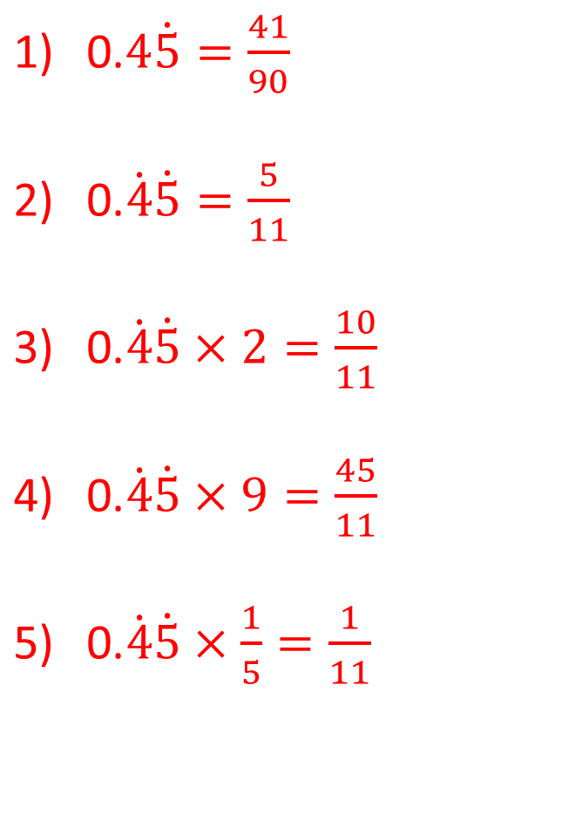
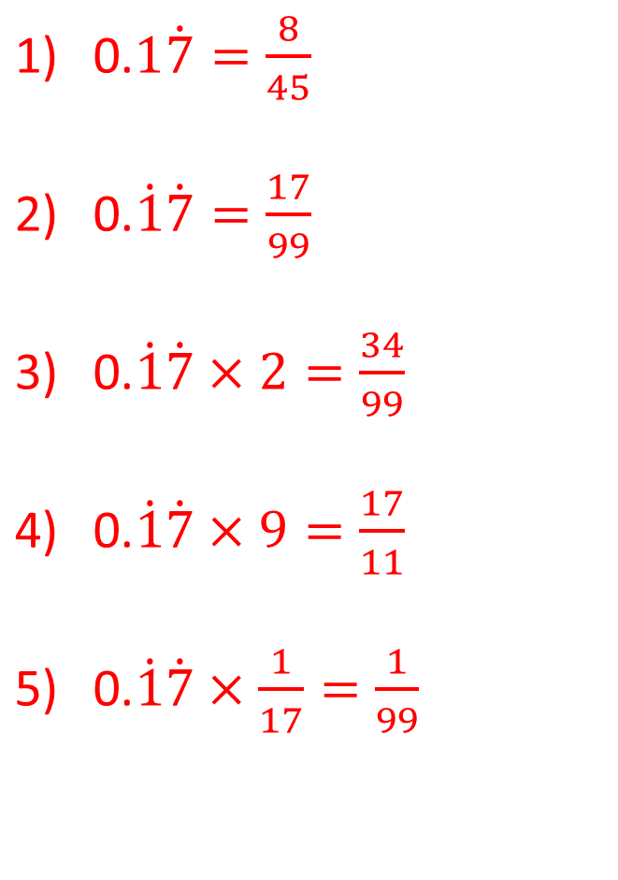
Convert to a recurring decimal to a fraction
Convert to a recurring decimal to a fraction
$\text{0.}4\dot{5}=\frac{41}{90}$
$\text{0.}\dot{4}\dot{5}=\frac{5}{11}$
$\text{0.}\dot{4}\dot{5}×2=\frac{10}{11}$
$\text{0.}\dot{4}\dot{5}×9=\frac{45}{11}$
$\text{0.}\dot{4}\dot{5}×\frac{1}{5}=\frac{1}{11}$
$\text{0.}1\dot{7}=\frac{8}{45}$
$\text{0.}\dot{1}\dot{7}=\frac{17}{99}$
$\text{0.}\dot{1}\dot{7}×2=\frac{34}{99}$
$\text{0.}\dot{1}\dot{7}×9=\frac{17}{11}$
$\text{0.}\dot{1}\dot{7}×\frac{1}{17}=\frac{1}{99}$

Slide 6
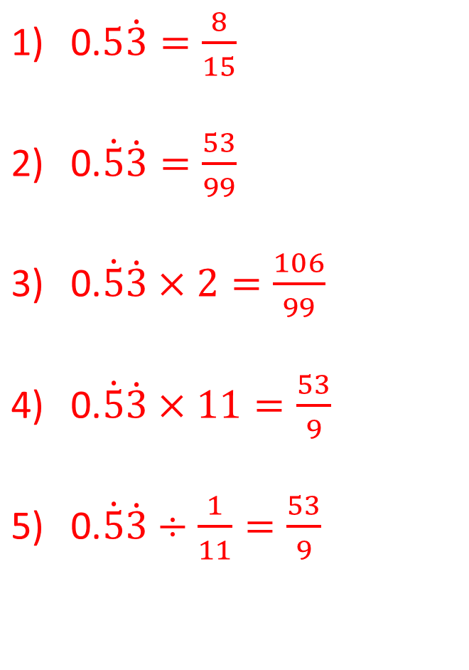
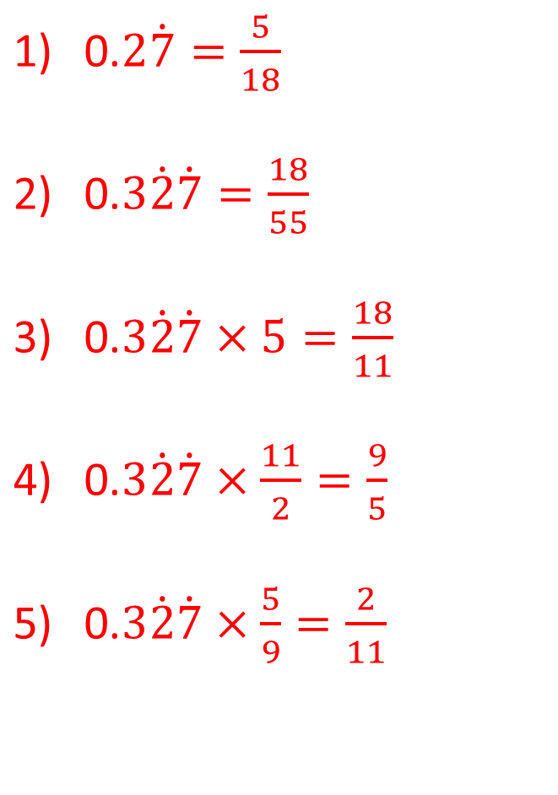
Convert to a recurring decimal to a fraction
Convert to a recurring decimal to a fraction
$\text{0.}5\dot{3}=\frac{8}{15}$
$\text{0.}\dot{5}\dot{3}=\frac{53}{99}$
$\text{0.}\dot{5}\dot{3}×2=\frac{106}{99}$
$\text{0.}\dot{5}\dot{3}×11=\frac{53}{9}$
$\text{0.}\dot{5}\dot{3}÷\frac{1}{11}=\frac{53}{9}$
$\text{0.}2\dot{7}=\frac{5}{18}$
$\text{0.}3\dot{2}\dot{7}=\frac{18}{55}$
$\text{0.}3\dot{2}\dot{7}×5=\frac{18}{11}$
$\text{0.}3\dot{2}\dot{7}×\frac{11}{2}=\frac{9}{5}$
$\text{0.}3\dot{2}\dot{7}×\frac{5}{9}=\frac{2}{11}$

