Slide 1
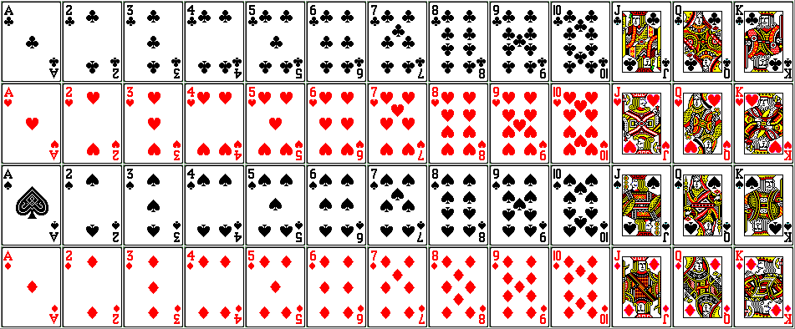
Probability – AND and OR
Silent
Teacher
Intelligent Practice
Narration
Your Turn
Practice

Slide 2
Worked Example
Your Turn
Calculate p(‘less than a 4’)
Calculate p(‘red card OR a 7’)
Calculate p(‘red OR a picture card’)
Calculate p(‘multiple of 2 OR 3’)
Calculate p(‘red card AND a 7’)
Calculate p(‘red AND picture card’)
Calculate p(‘less than a 3’)
Calculate p(‘red card OR a 3’)
Calculate p(‘black OR a picture card’)
Calculate p(‘multiple of 2 OR 5’)
Calculate p(‘red card AND a 3’)
Calculate p(‘black AND picture card’)
@MrTFarahmand

Slide 3
Calculate p(‘red card’)
Calculate p(‘red OR black card’)
Calculate p(‘red card OR a queen’)
Calculate p(‘a queen AND red’)
Calculate p(‘a queen OR multiple of 2’)
Calculate p(‘multiple of 2 OR 3’)
Calculate p(‘factor of 2 OR 3’)
Calculate p(‘not a multiple of 2 AND 3’)
Calculate p(‘less than a 5’)
Calculate p(‘less than a 5 AND prime’)
11) Calculate p(‘red AND black card’)
12) Calculate p(‘prime AND red, OR a picture card’)
@MrTFarahmand

Slide 4
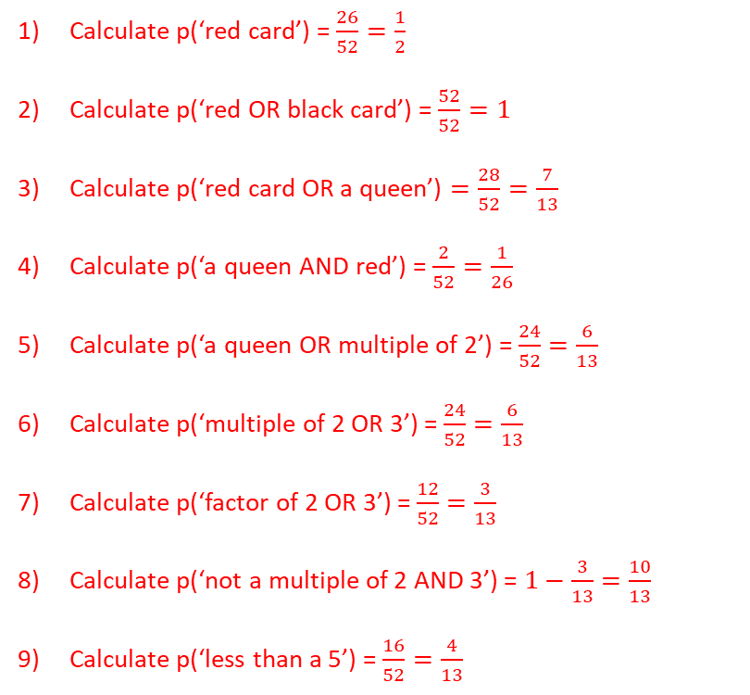
Calculate p(‘red card’) = $\frac{26}{52}=\frac{1}{2}$
Calculate p(‘red OR black card’) = $\frac{52}{52}=1$
Calculate p(‘red card OR a queen’) $=\frac{28}{52}=\frac{7}{13}$
Calculate p(‘a queen AND red’) = $\frac{2}{52}=\frac{1}{26}$
Calculate p(‘a queen OR multiple of 2’) = $\frac{24}{52}=\frac{6}{13}$
Calculate p(‘multiple of 2 OR 3’) = $\frac{24}{52}=\frac{6}{13}$
Calculate p(‘factor of 2 OR 3’) = $\frac{12}{52}=\frac{3}{13}$
Calculate p(‘not a multiple of 2 AND 3’) = $1−\frac{3}{13}=\frac{10}{13}$
Calculate p(‘less than a 5’) = $\frac{16}{52}=\frac{4}{13}$
10) Calculate p(‘less than a 5 AND prime’) = $\frac{8}{52}=\frac{2}{13}$
11) Calculate p(‘red AND black card’) = $\frac{0}{52}=0$
12) Calculate p(‘prime AND red, OR a picture card’) = $\frac{20}{52}=\frac{5}{13}$
@MrTFarahmand

