Slide 1
Ratio: Linear Equations from visual representations
Silent
Teacher
Intelligent Practice
Narration
Your Turn
Practice

Slide 2
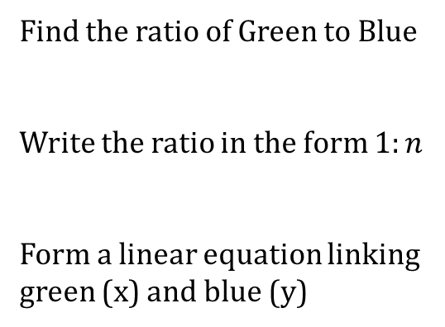
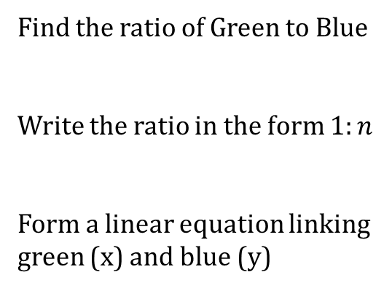
Worked Example
Your Turn
Find the ratio of Green to Blue
Write the ratio in the form $1:n$
Form a linear equation linking green (x) and blue (y)
Find the ratio of Green to Blue
Write the ratio in the form $1:n$
Form a linear equation linking green (x) and blue (y)

Slide 3
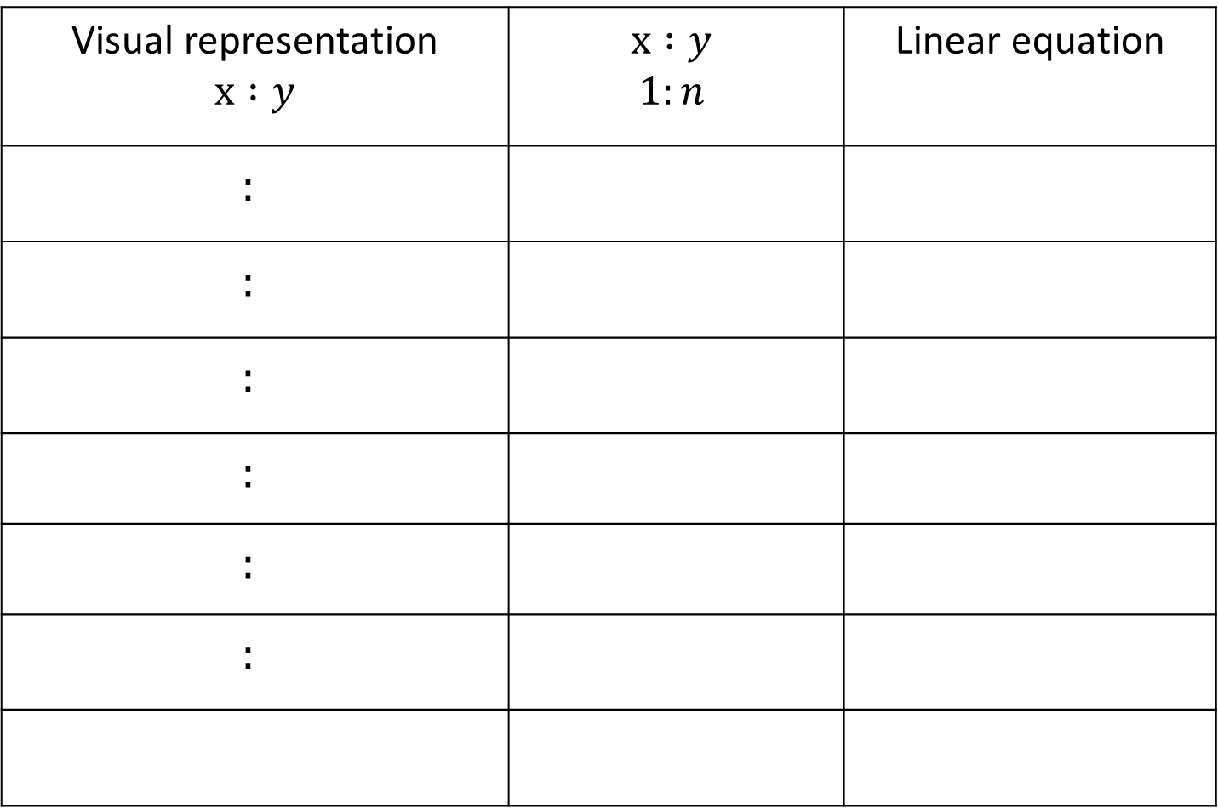
Visual representation $$x :y$$ | $$x :y$$ $$1:n$$ | Linear equation
$$:$$
$$:$$
$$:$$
$$:$$
$$:$$
$$:$$

Slide 4
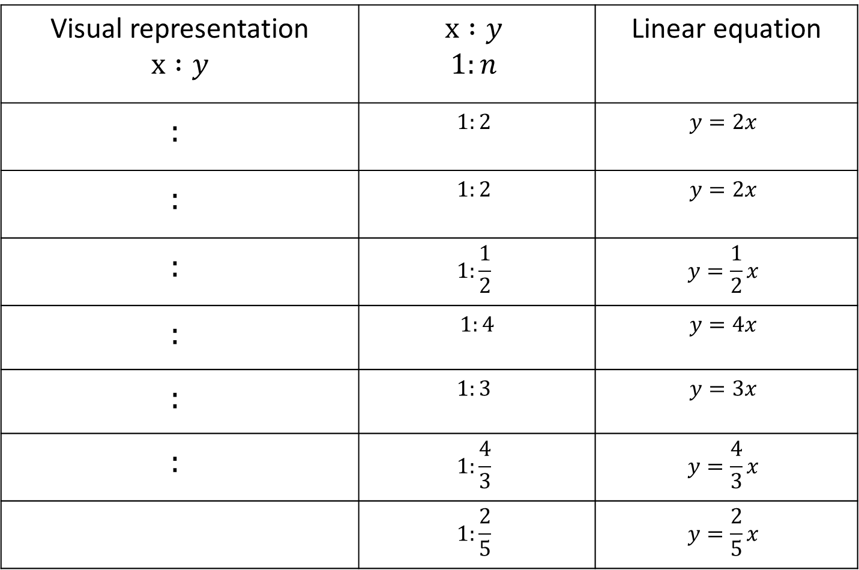
Visual representation $$x :y$$ | $$x :y$$ $$1:n$$ | Linear equation
$$:$$ | $$1:2$$ | $$y=2x$$
$$:$$ | $$1:2$$ | $$y=2x$$
$$:$$ | $$1:\frac{1}{2}$$ | $$y=\frac{1}{2}x$$
$$:$$ | $1:4$ | $$y=4x$$
$$:$$ | $$1:3$$ | $$y=3x$$
$$:$$ | $$1:\frac{4}{3}$$ | $$y=\frac{4}{3}x$$
 | $$1:\frac{2}{5}$$ | $$y=\frac{2}{5}x$$

