Slide 1
Surds: Mixed Operations
Silent
Teacher
Intelligent Practice
Narration
Your Turn
$$\sqrt{8}×\sqrt{4}$$
Practice

Slide 2
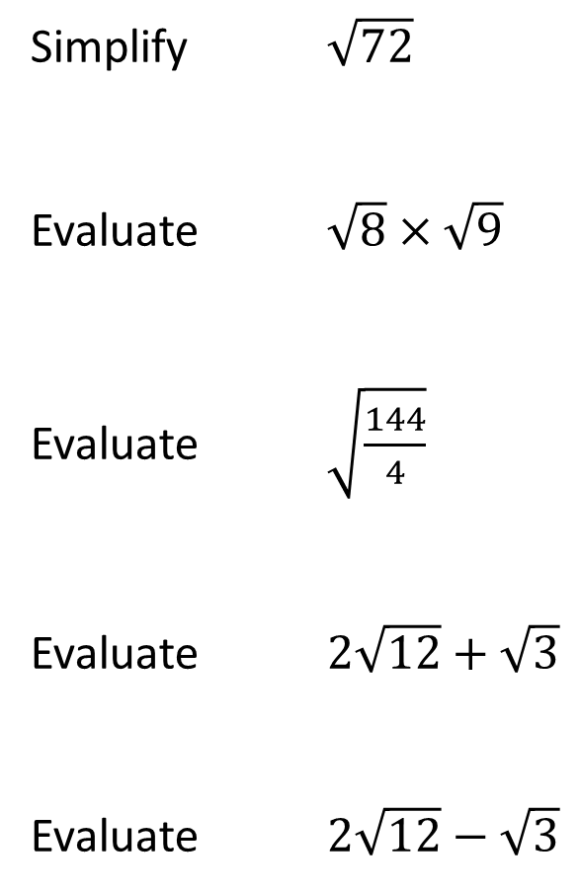
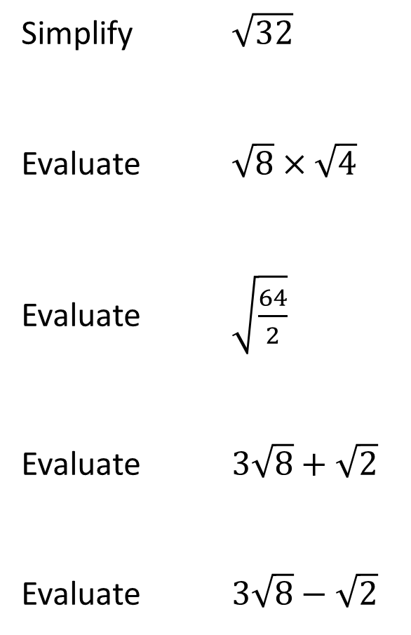
Worked Example
Your Turn
Simplify $\sqrt{32}$
Evaluate $\sqrt{8}×\sqrt{4}$
Evaluate $\sqrt{\frac{64}{2}}$
Evaluate $3\sqrt{8}+\sqrt{2}$
Evaluate $3\sqrt{8}−\sqrt{2}$
Simplify $\sqrt{72}$
Evaluate $\sqrt{8}×\sqrt{9}$
Evaluate $\sqrt{\frac{144}{4}}$
Evaluate $2\sqrt{12}+\sqrt{3}$
Evaluate $2\sqrt{12}−\sqrt{3}$

Slide 3
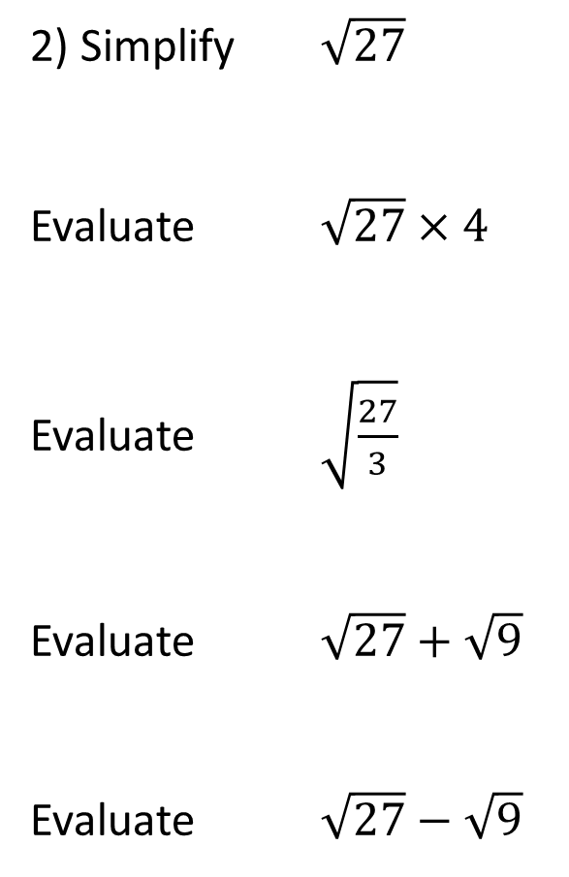
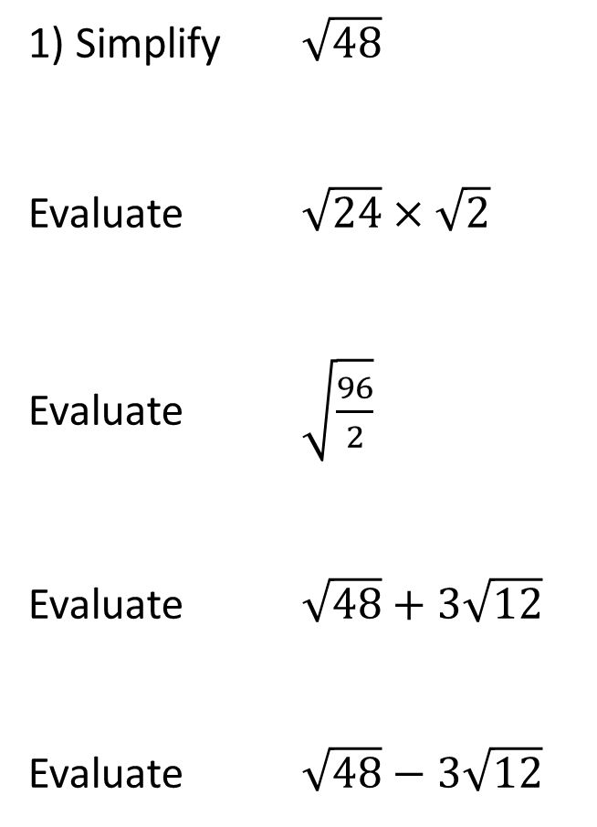
1) Simplify $\sqrt{48}$
Evaluate $\sqrt{24}×\sqrt{2}$
Evaluate $\sqrt{\frac{96}{2}}$
Evaluate $\sqrt{48}+3\sqrt{12}$
Evaluate $\sqrt{48}−3\sqrt{12}$
2) Simplify $\sqrt{27}$
Evaluate $\sqrt{27}×4$
Evaluate $\sqrt{\frac{27}{3}}$
Evaluate $\sqrt{27}+\sqrt{9}$
Evaluate $\sqrt{27}−\sqrt{9}$

Slide 4
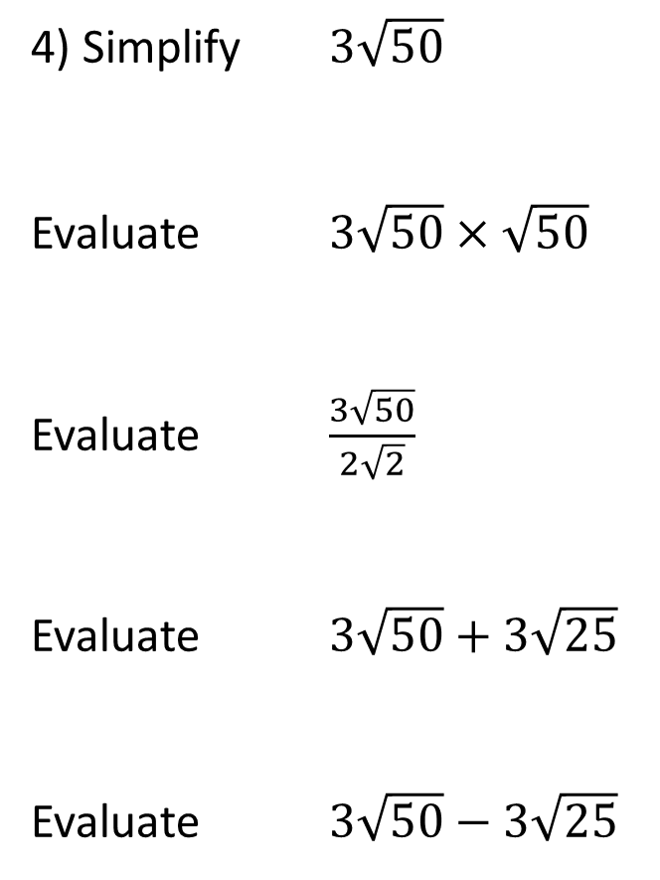
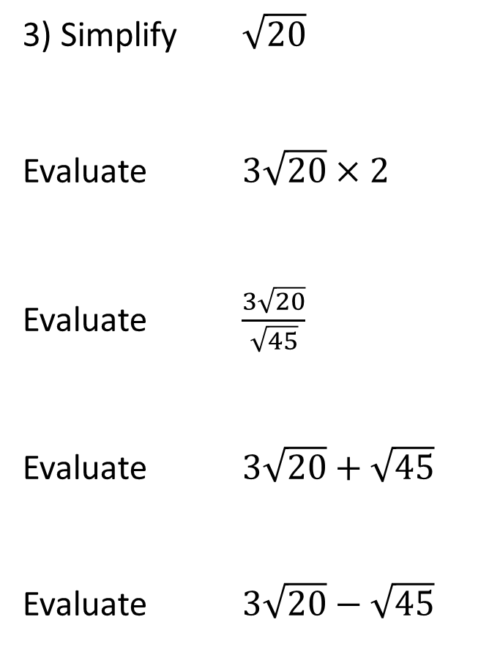
3) Simplify $\sqrt{20}$
Evaluate $3\sqrt{20}×2$
Evaluate $\frac{3\sqrt{20}}{\sqrt{45}}$
Evaluate $3\sqrt{20}+\sqrt{45}$
Evaluate $3\sqrt{20}−\sqrt{45}$
4) Simplify $3\sqrt{50}$
Evaluate $3\sqrt{50}×\sqrt{50}$
Evaluate $\frac{3\sqrt{50}}{2\sqrt{2}}$
Evaluate $3\sqrt{50}+3\sqrt{25}$
Evaluate $3\sqrt{50}−3\sqrt{25}$

Slide 5
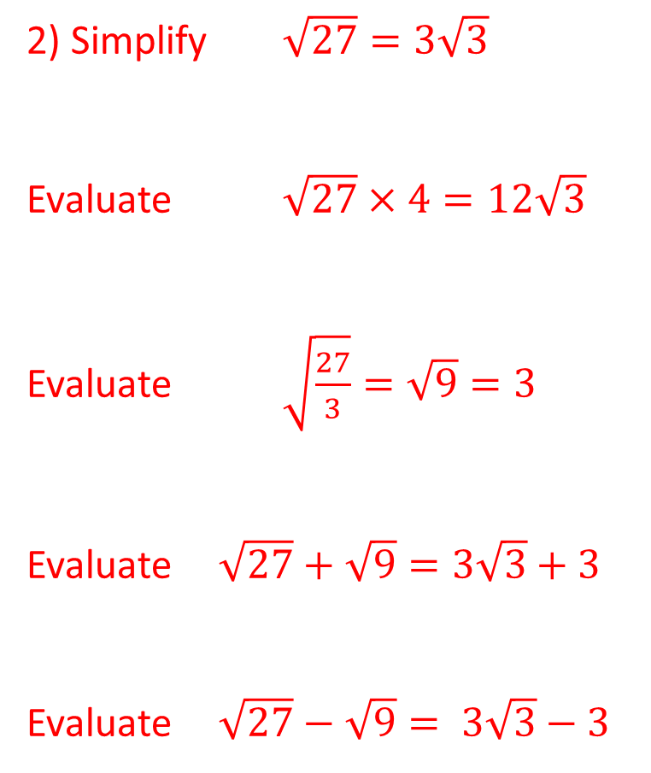
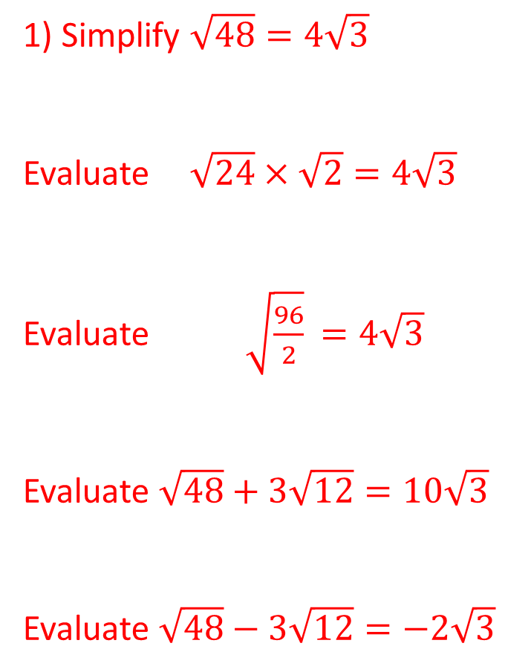
1) Simplify $\sqrt{48}=4\sqrt{3}$
Evaluate $\sqrt{24}×\sqrt{2}=4\sqrt{3}$
Evaluate $\sqrt{\frac{96}{2}}$ $=4\sqrt{3}$
Evaluate $\sqrt{48}+3\sqrt{12}=10\sqrt{3}$
Evaluate $\sqrt{48}−3\sqrt{12}=−2\sqrt{3}$
2) Simplify $\sqrt{27}=3\sqrt{3}$
Evaluate $\sqrt{27}×4=12\sqrt{3}$
Evaluate $\sqrt{\frac{27}{3}}=\sqrt{9}=3$
Evaluate $\sqrt{27}+\sqrt{9}=3\sqrt{3}+3$
Evaluate $\sqrt{27}−\sqrt{9}= 3\sqrt{3}−3$

Slide 6
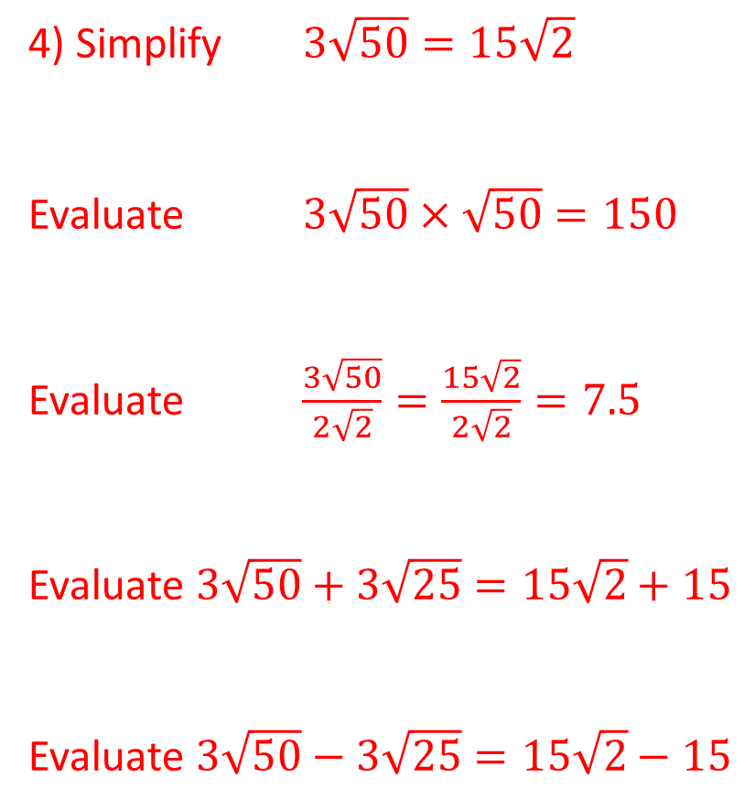
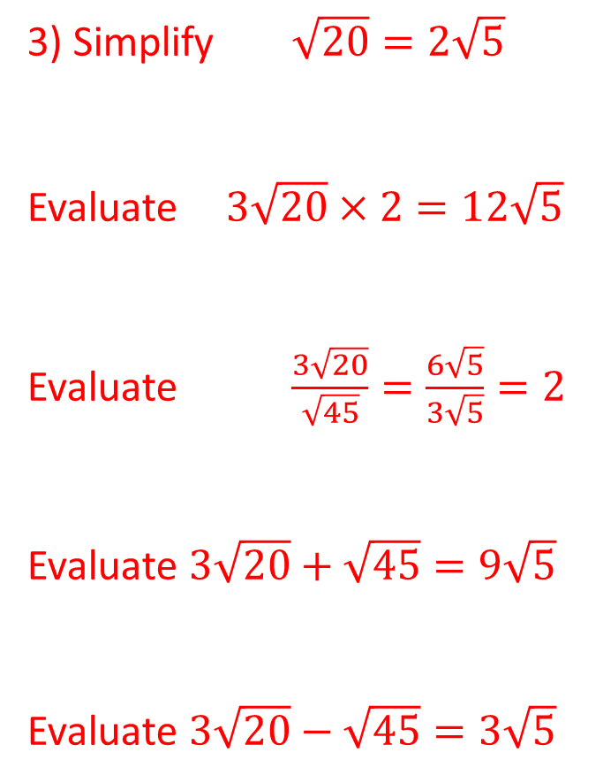
3) Simplify $\sqrt{20}=2\sqrt{5}$
Evaluate $3\sqrt{20}×2=12\sqrt{5}$
Evaluate $\frac{3\sqrt{20}}{\sqrt{45}}=\frac{6\sqrt{5}}{3\sqrt{5}}=2$
Evaluate $3\sqrt{20}+\sqrt{45}=9\sqrt{5}$
Evaluate $3\sqrt{20}−\sqrt{45}=3\sqrt{5}$
4) Simplify $3\sqrt{50}=15\sqrt{2}$
Evaluate $3\sqrt{50}×\sqrt{50}=150$
Evaluate $\frac{3\sqrt{50}}{2\sqrt{2}}=\frac{15\sqrt{2}}{2\sqrt{2}}=7.5$
Evaluate $3\sqrt{50}+3\sqrt{25}=15\sqrt{2}+15$
Evaluate $3\sqrt{50}−3\sqrt{25}=15\sqrt{2}−15$

