Slide 1
Using Product of Prime Factors
Silent
Teacher
Intelligent Practice
Narration
Your Turn
$${420= 2}^{2}×3×5×7$$
$$4200= ?$$
Practice

Slide 2
Worked Example
Your Turn
$${84= 2}^{2}×3×7$$
$${84= 2}^{2}×3×7$$
How is 840 written as its product of prime factors?
How is 504 written as its product of prime factors?
@misslaceymaths

Slide 3
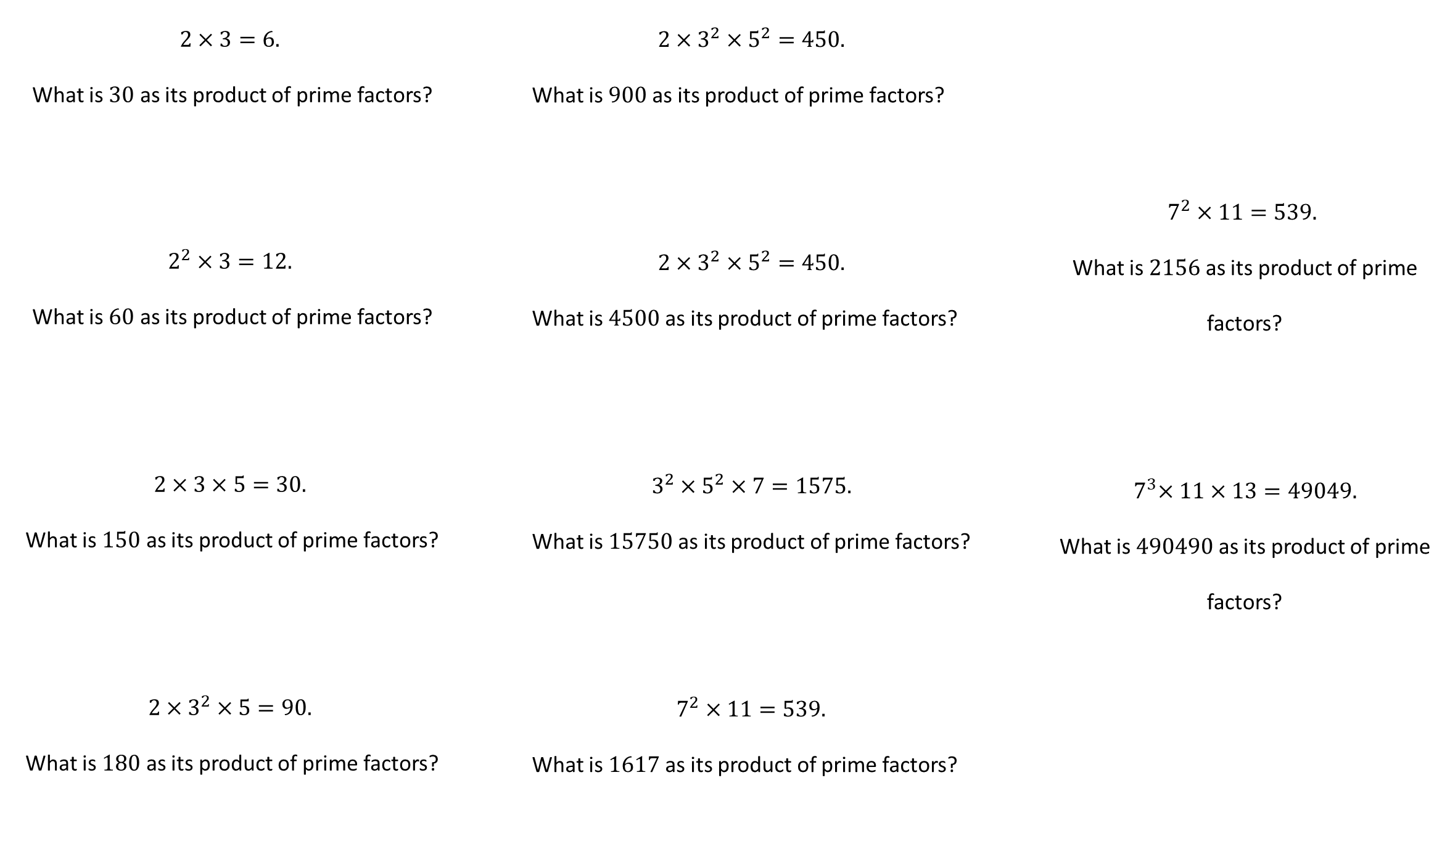
@misslaceymaths

Slide 4
@misslaceymaths

