Slide 1
Find the whole given a fraction
Silent
Teacher
Intelligent Practice
Narration
Your Turn
$$\frac{2}{3}of an amount is 28$$
$$What is the total amount?$$
$$\frac{7}{3}of an amount is 28$$
$$What is the total amount?$$
Practice

Slide 2
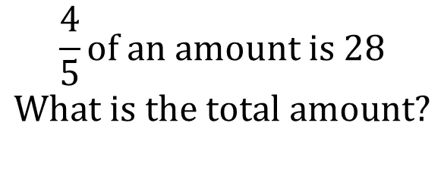
$$\frac{2}{3}of an amount is 28$$
$$What is the total amount?$$
$$\frac{4}{5}of an amount is 28$$
$$What is the total amount?$$
Why is a third of it 14?
@dare_richard

Slide 3
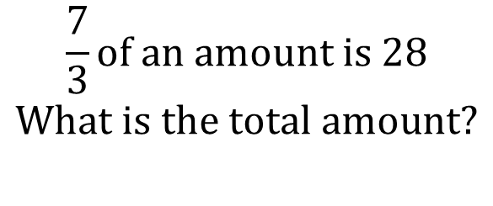
$$\frac{4}{3}of an amount is 28$$
$$What is the total amount?$$
$$\frac{7}{3}of an amount is 28$$
$$What is the total amount?$$
Why is a third of it 7?
@dare_richard

Slide 4
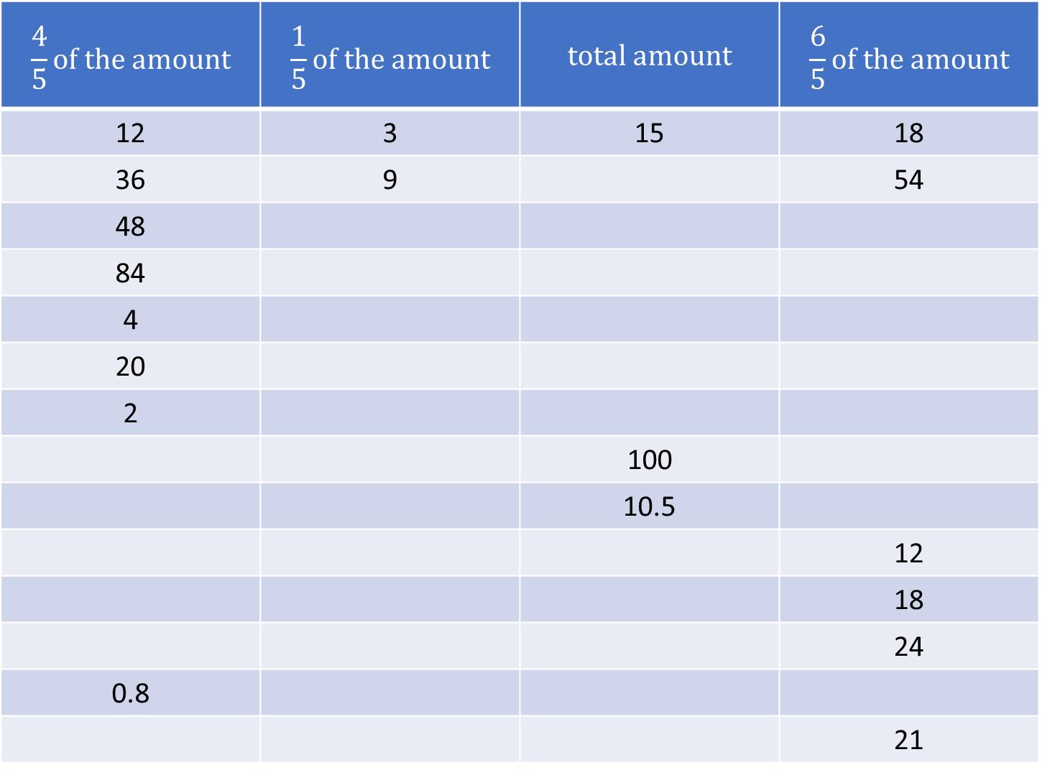
$$\frac{4}{5}of the amount$$ | $$\frac{1}{5}of the amount$$ | $$total amount$$ | $$\frac{6}{5}of the amount$$
12 | 3 | 15 | 18
36 | 9 |  | 54
48
84
4
20
2
 |  | 100
 |  | 10.5
 |  |  | 12
 |  |  | 18
 |  |  | 24
0.8
 |  |  | 21

Slide 5
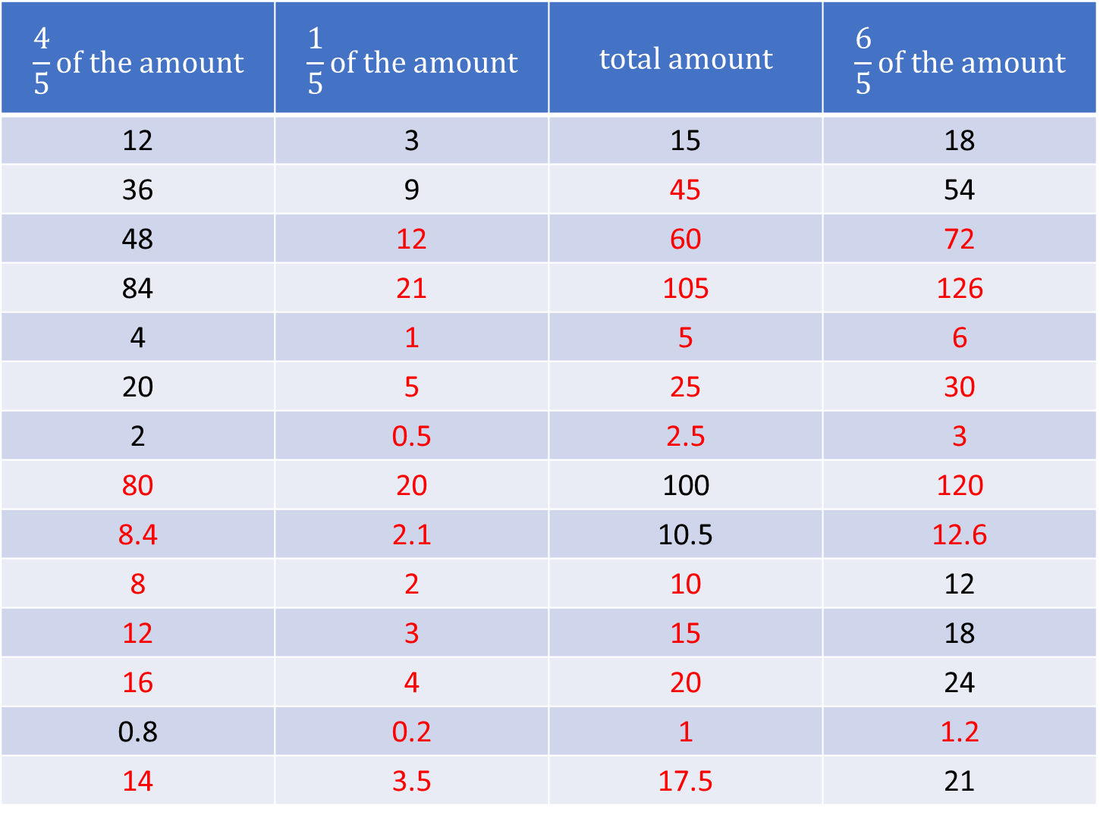
$$\frac{4}{5}of the amount$$ | $$\frac{1}{5}of the amount$$ | $$total amount$$ | $$\frac{6}{5}of the amount$$
12 | 3 | 15 | 18
36 | 9 | 45 | 54
48 | 12 | 60 | 72
84 | 21 | 105 | 126
4 | 1 | 5 | 6
20 | 5 | 25 | 30
2 | 0.5 | 2.5 | 3
80 | 20 | 100 | 120
8.4 | 2.1 | 10.5 | 12.6
8 | 2 | 10 | 12
12 | 3 | 15 | 18
16 | 4 | 20 | 24
0.8 | 0.2 | 1 | 1.2
14 | 3.5 | 17.5 | 21

Slide 6
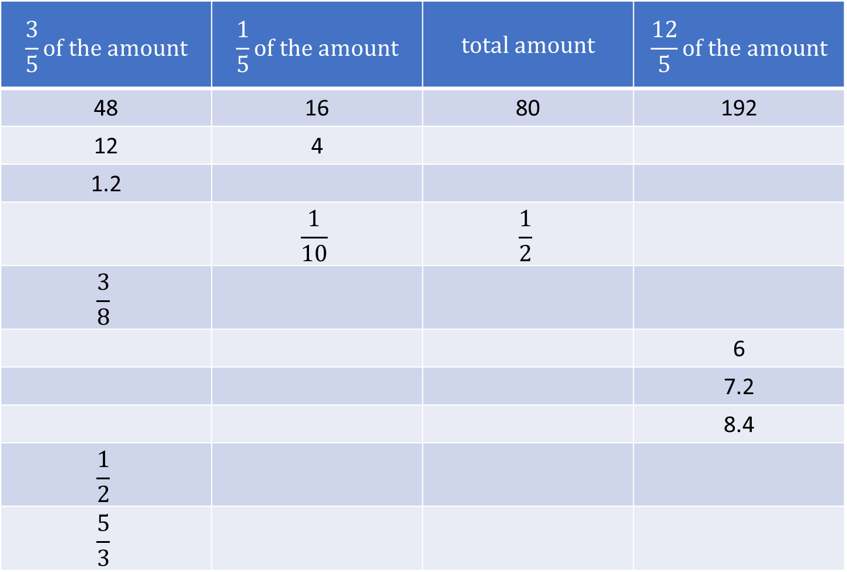
$$\frac{3}{5}of the amount$$ | $$\frac{1}{5}of the amount$$ | $$total amount$$ | $$\frac{12}{5}of the amount$$
48 | 16 | 80 | 192
12 | 4
1.2
 | $$\frac{1}{10}$$ | $$\frac{1}{2}$$
$$\frac{3}{8}$$
 |  |  | 6
 |  |  | 7.2
 |  |  | 8.4
$$\frac{1}{2}$$
$$\frac{5}{3}$$
@dare_richard

Slide 7
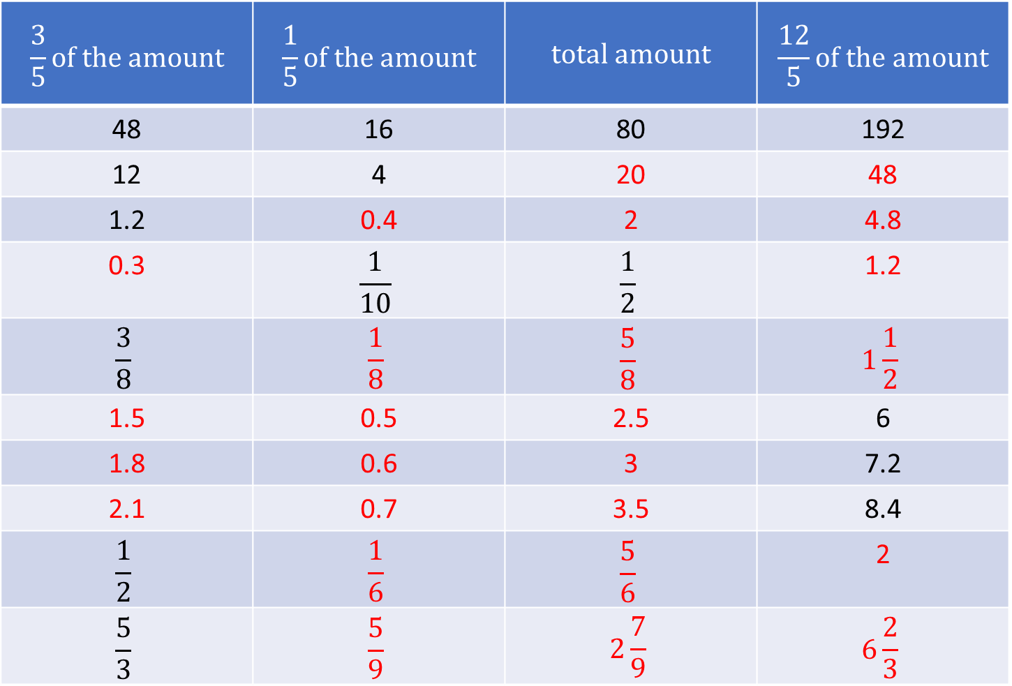
$$\frac{3}{5}of the amount$$ | $$\frac{1}{5}of the amount$$ | $$total amount$$ | $$\frac{12}{5}of the amount$$
48 | 16 | 80 | 192
12 | 4 | 20 | 48
1.2 | 0.4 | 2 | 4.8
0.3 | $$\frac{1}{10}$$ | $$\frac{1}{2}$$ | 1.2
$$\frac{3}{8}$$ | $$\frac{1}{8}$$ | $$\frac{5}{8}$$ | $$1\frac{1}{2}$$
1.5 | 0.5 | 2.5 | 6
1.8 | 0.6 | 3 | 7.2
2.1 | 0.7 | 3.5 | 8.4
$$\frac{1}{2}$$ | $$\frac{1}{6}$$ | $$\frac{5}{6}$$ | 2
$$\frac{5}{3}$$ | $$\frac{5}{9}$$ | $$2\frac{7}{9}$$ | $$6\frac{2}{3}$$
@dare_richard

