Slide 1
Ratios of lengths: areas: volumes
Silent
Teacher
Intelligent Practice
Narration
Your Turn
$${You}^{′}re given the ratio of simlar {shapes}^{′}$$
$$areas. Give the ratio of their volumes.$$
$$Ratio of Lengths$$ | $$Ratio of Areas$$ | $$Ratio of Volumes$$
$$2:5$$ | $$4:25$$ | $$8:125$$
$$5:3$$
$$1:__$$ |  | $$__:1000$$
Practice

Slide 2
$$The ratio of two similar {shapes}^{′}$$
$$side lengths is 1:3 what is the$$
$$ratio of their areas?$$
$$The ratio of two similar {shapes}^{′}$$
$$side lengths is 1:4 what is the$$
$$ratio of their areas?$$
@dare_richard

Slide 3
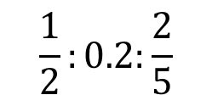
$${You}^{′}re given the ratio of simlar {shapes}^{′}$$
$$side lengths. Give the ratio of their areas.$$
$$1:5$$
$$1:x$$
$$5:1$$
$$0.1:5x$$
$$2:5$$
$$x^{2}:0.5$$
$$1:2:5$$
$$(x+2):π$$
$$2:5:11$$
$$\frac{1}{2}:0.2:\frac{2}{5}$$
$$\sqrt{2}:\sqrt{5}:\sqrt{11}$$
@dare_richard

Slide 4
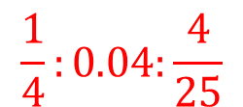
$${You}^{′}re given the ratio of simlar {shapes}^{′}$$
$$side lengths. Give the ratio of their areas.$$
$$1:5$$
$$1:25$$
$$1:x$$
$$1:x^{2}$$
$$5:1$$
$$25:1$$
$$0.1:5x$$
$$0.01:{25x}^{2}$$
$$2:5$$
$$4:25$$
$$x^{2}:0.5$$
$$x^{4}:0.25$$
$$1:2:5$$
$$1:4:25$$
$$(x+2):π$$
$${(x+2)}^{2}:π^{2}$$
$$2:5:11$$
$$4:25:121$$
$$\frac{1}{2}:0.2:\frac{2}{5}$$
$$\frac{1}{4}:0.04:\frac{4}{25}$$
$$\sqrt{2}:\sqrt{5}:\sqrt{11}$$
$$2:5:11$$
@dare_richard

Slide 5
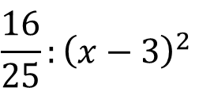
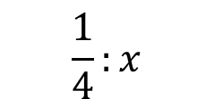
$${You}^{′}re given the ratio of simlar {shapes}^{′}$$
$$areas. Give the ratio of their side lengths.$$
$$1:25$$
$$1:x^{2}$$
$$1:9$$
$$\frac{1}{4}:x$$
$$9:1$$
$$121x^{2}:x^{4}$$
$$4:9$$
$$\frac{16}{25}:{\left(x−3\right)}^{2}$$
$$1:4:9$$
$$x^{2}+22x+121:0.09$$
$$2:5:11$$
$${0.16:x}^{4}+8x^{2}+16$$
@dare_richard

Slide 6
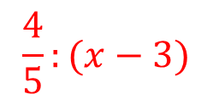
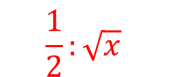
$${You}^{′}re given the ratio of simlar {shapes}^{′}$$
$$areas. Give the ratio of their side lengths.$$
$$1:25$$
$$1:5$$
$$1:x^{2}$$
$$1:x$$
$$1:9$$
$$1:3$$
$$\frac{1}{4}:x$$
$$\frac{1}{2}:\sqrt{x}$$
$$9:1$$
$3:$1
$$121x^{2}:x^{4}$$
$$11x:x^{2}$$
$$4:9$$
$2:$3
$$\frac{16}{25}:{\left(x−3\right)}^{2}$$
$$\frac{4}{5}:(x−3)$$
$$1:4:9$$
$1:$2:3
$$x^{2}+22x+121:0.09$$
$$x+11:0.3$$
$$2:5:11$$
$\sqrt{2}:\sqrt{5}$:$\sqrt{11}$
$${0.16:x}^{4}+8x^{2}+16$$
$$0.4:x^{2}+4$$
@dare_richard

Slide 7
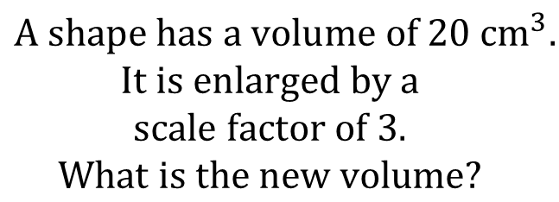
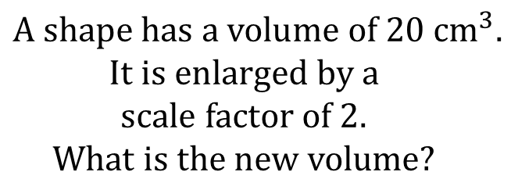
$$A shape has a volume of 20 {cm}^{3}.$$
$$It is enlarged by a$$
$$scale factor of 2.$$
$$What is the new volume?$$
$$A shape has a volume of 20 {cm}^{3}.$$
$$It is enlarged by a$$
$$scale factor of 3.$$
$$What is the new volume?$$
$$The ratio of two similar {shapes}^{′}$$
$$side lengths is 1:3 what is the$$
$$ratio of their volumes?$$
$$The ratio of two similar {shapes}^{′}$$
$$side lengths is 1:4 what is the$$
$$ratio of their volumes?$$
@dare_richard

Slide 8
$${You}^{′}re given the ratio of simlar {shapes}^{′}$$
$$side lengths. Give the ratio of their volumes.$$
$$1:5$$
$$1:x$$
$$1:10$$
$$1:2x$$
$$10:1$$
$$x^{2}:0.5$$
$$2:5$$
$$(x+2):π$$
$$1:2:5$$
$$\frac{1}{2}:0.2:\frac{2}{5}$$
$$2:5:0.1$$
$$\sqrt[3]{1}:\sqrt[3]{2}:\sqrt[3]{5}$$
@dare_richard

Slide 9
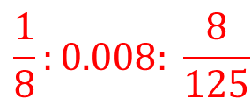
$${You}^{′}re given the ratio of simlar {shapes}^{′}$$
$$side lengths. Give the ratio of their volumes.$$
$$1:5$$
$$1:125$$
$$1:x$$
$$1:x^{3}$$
$$1:10$$
$$1:1000$$
$$1:2x$$
$$1:{8x}^{3}$$
$$10:1$$
$$1000:1$$
$$x^{2}:0.5$$
$$x^{6}:0.125$$
$$2:5$$
$$4:125$$
$$(x+2):π$$
$${(x+2)}^{3}:π^{3}$$
$$1:2:5$$
$$1:8:125$$
$$\frac{1}{2}:0.2:\frac{2}{5}$$
$$\frac{1}{8}:0.008: \frac{8}{125}$$
$$2:5:0.1$$
$8:125$: 0.001
$$\sqrt[3]{1}:\sqrt[3]{2}:\sqrt[3]{5}$$
$1:2$: 5
@dare_richard

Slide 10
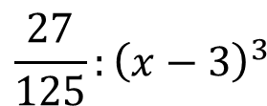
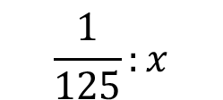
$${You}^{′}re given the ratio of simlar {shapes}^{′}$$
$$volumes. Give the ratio of their side lengths.$$
$$1:125$$
$$1:x^{3}$$
$$1:8$$
$$\frac{1}{125}:x$$
$$8:1$$
$$8x^{3}:x^{6}$$
$$27:1000$$
$$\frac{27}{125}:{\left(x−3\right)}^{3}$$
$$1:64:1000$$
$$π^{3}:x^{\frac{3}{2}}$$
$$0.001:0.064:1$$
@dare_richard

Slide 11
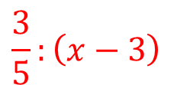
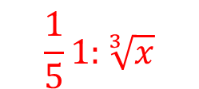
$${You}^{′}re given the ratio of simlar {shapes}^{′}$$
$$volumes. Give the ratio of their side lengths.$$
$$1:125$$
$$1:5$$
$$1:x^{3}$$
$$1:x$$
$$1:8$$
$$1:2$$
$$\frac{1}{125}:x$$
$$\frac{1}{5}1:\sqrt[3]{x}$$
$$8:1$$
$$2:1$$
$$8x^{3}:x^{6}$$
$$2x:x^{2}$$
$$27:1000$$
$$3:10$$
$$\frac{27}{125}:{\left(x−3\right)}^{3}$$
$$\frac{3}{5}:{\left(x−3\right)}^{}$$
$$1:64:1000$$
$$1:4:10$$
$$π^{3}:x^{\frac{3}{2}}$$
$$π:\sqrt{x}$$
$$0.001:0.064:1$$
$$0.1:0.4:1$$
@dare_richard

Slide 12
$$The ratio of two similar {shapes}^{′}$$
$$areas is 9:4 what is the$$
$$ratio of their volumes?$$
$$The ratio of two similar {shapes}^{′}$$
$$areas is 9:16 what is the$$
$$ratio of their volumes?$$
$$The ratio of two similar {shapes}^{′}$$
$$volumes is 8:27 what is the$$
$$ratio of their areas?$$
$$The ratio of two similar {shapes}^{′}$$
$$volumes is 1000:27 what is the$$
$$ratio of their areas?$$
@dare_richard

Slide 13
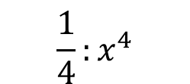
$${You}^{′}re given the ratio of simlar {shapes}^{′}$$
$$areas. Give the ratio of their volumes.$$
$$1:25$$
$$1:x^{2}$$
$$1:9$$
$$\frac{1}{4}:x^{4}$$
$$9:1$$
$$9x^{2}:x$$
$$4:9$$
$\frac{16}{25}:{\left(x−5\right)}^{2}$:8
$$1:4:9$$
$$x^{2}+18x+81:0.0121$$
$100:400:$900
$${x^{\frac{2}{3}}:x}^{4}+4x^{2}+4$$
@dare_richard

Slide 14
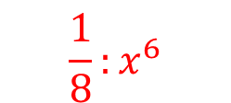
$${You}^{′}re given the ratio of simlar {shapes}^{′}$$
$$areas. Give the ratio of their volumes.$$
$$1:25$$
$$1:125$$
$$1:x^{2}$$
$$1:x^{3}$$
$$1:9$$
$$1:27$$
$$\frac{1}{4}:x^{4}$$
$$\frac{1}{8}:x^{6}$$
$$9:1$$
$$27:1$$
$$9x^{2}:x$$
$$3x^{3}:x^{\frac{3}{2}}$$
$$4:9$$
$$8:27$$
$\frac{16}{25}:{\left(x−5\right)}^{2}$:8
$$\frac{64}{125}:{\left(x−5\right)}^{3}:16\sqrt{2}$$
$$1:4:9$$
$$1:8:27$$
$$x^{2}+18x+81:0.0121$$
$${\left(x+9\right)}^{3}:0.001331$$
$100:400:$900
$${x^{\frac{2}{3}}:x}^{4}+4x^{2}+4$$
$$1000:8000:27000$$
$$x:{\left(x^{2}+2\right)}^{3}$$
@dare_richard

Slide 15
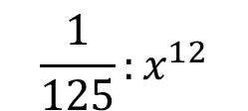
$${You}^{′}re given the ratio of simlar {shapes}^{′}$$
$$volumes. Give the ratio of their areas.$$
$$1:125$$
$$1:x^{3}$$
$$1:8$$
$$\frac{1}{125}:x^{12}$$
$$8:1$$
$$8x^{6}:x^{\frac{3}{2}}$$
$$27:1000$$
$$\frac{27}{125}:{\left(x−3\right)}^{3}$$
$$1:64:1000$$
$$π^{3}:0.001$$
$$0.027:0.064$$
@dare_richard

Slide 16
$${You}^{′}re given the ratio of simlar {shapes}^{′}$$
$$volumes. Give the ratio of their areas.$$
$$1:125$$
$$1:25$$
$$1:x^{3}$$
$$1:x^{2}$$
$$1:8$$
$$1:4$$
$$\frac{1}{125}:x^{12}$$
$$\frac{1}{25}:x^{8}$$
$$8:1$$
$$4:1$$
$$8x^{6}:x^{\frac{3}{2}}$$
$$4x^{4}:x$$
$$27:1000$$
$$9:100$$
$$\frac{27}{125}:{\left(x−3\right)}^{3}$$
$$\frac{9}{25}:{\left(x−3\right)}^{2}$$
$$1:64:1000$$
$$1:16:100$$
$$π^{3}:0.001$$
$$π^{2}:0.01$$
$$0.027:0.064$$
$$0.09:0. 16$$
@dare_richard

Slide 17
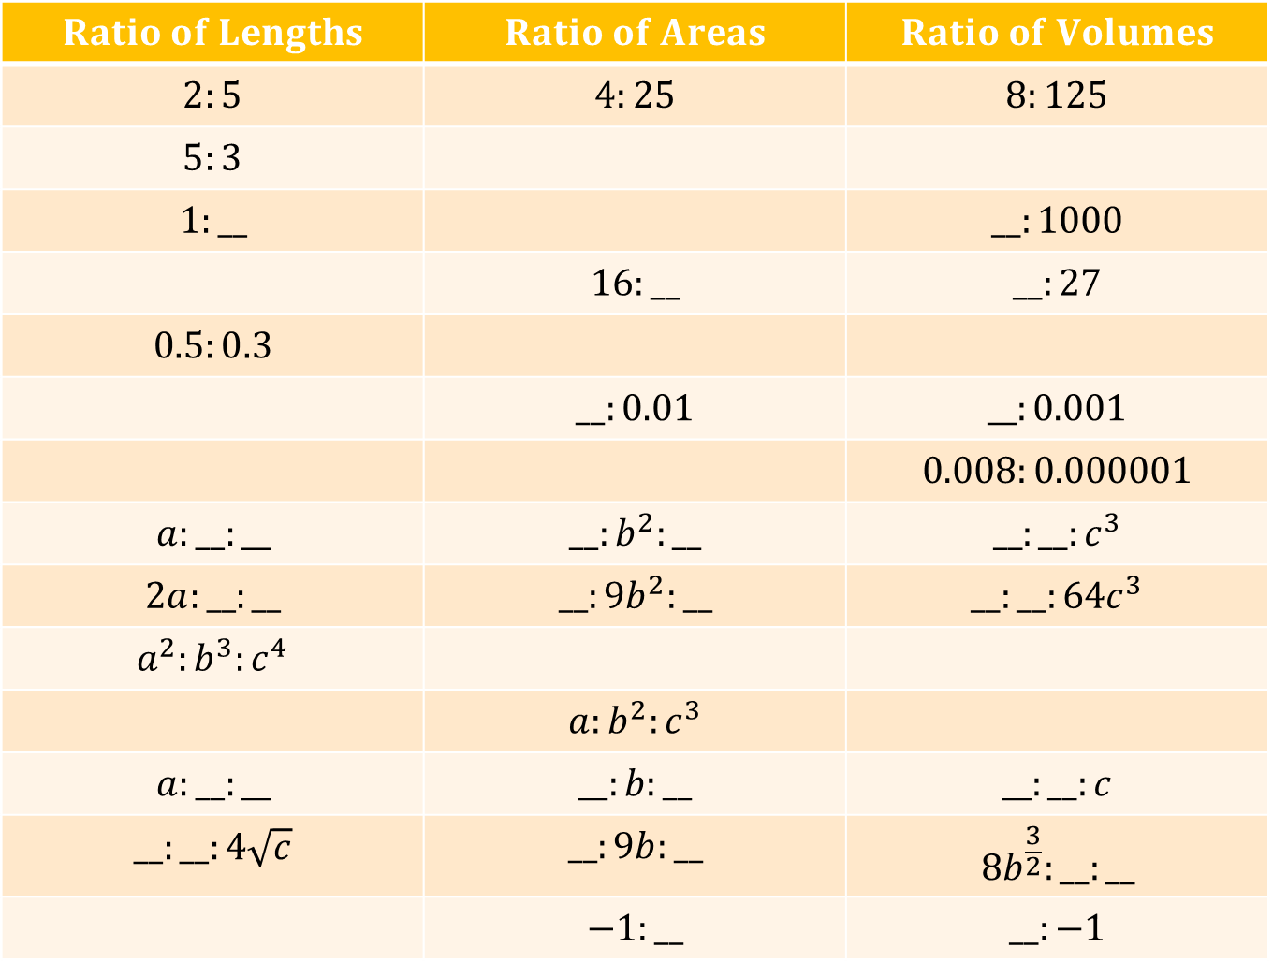
$$Ratio of Lengths$$ | $$Ratio of Areas$$ | $$Ratio of Volumes$$
$$2:5$$ | $$4:25$$ | $$8:125$$
$$5:3$$
$$1:__$$ |  | $$__:1000$$
 | $$16:__$$ | $$__:27$$
$$0.5:0.3$$
 | $$__:0.01$$ | $$__:0.001$$
 |  | $$0.008:0.000001$$
$$a:__:__$$ | $$__:b^{2}:__$$ | $$__:__:c^{3}$$
$$2a:__:__$$ | $$__:{9b}^{2}:__$$ | $$__:__:{64c}^{3}$$
$$a^{2}:b^{3}:c^{4}$$
 | $$a:b^{2}:c^{3}$$
$$a:__:__$$ | $$__:b:__$$ | $$__:__:c$$
$$__:__:4\sqrt{c}$$ | $$__:9b:__$$ | $${8b}^{\frac{3}{2}}:__:__$$
 | $$−1:__$$ | $$__:−1$$
@dare_richard

Slide 18
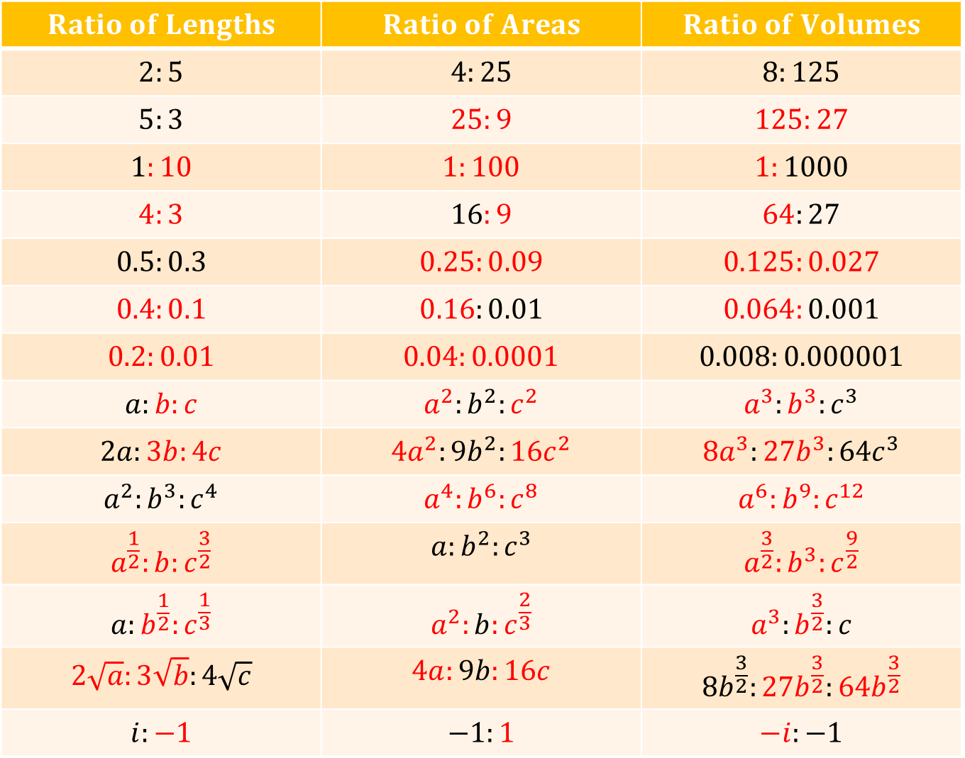
$$Ratio of Lengths$$ | $$Ratio of Areas$$ | $$Ratio of Volumes$$
$$2:5$$ | $$4:25$$ | $$8:125$$
$$5:3$$ | $$25:9$$ | $$125:27$$
$$1:10$$ | $$1:100$$ | $$1:1000$$
$$4:3$$ | $$16:9$$ | $$64:27$$
$$0.5:0.3$$ | $$0.25:0.09$$ | $$0.125:0.027$$
$$0.4:0.1$$ | $$0.16:0.01$$ | $$0.064:0.001$$
$$0.2:0.01$$ | $$0.04:0.0001$$ | $$0.008:0.000001$$
$$a:b:c$$ | $$a^{2}:b^{2}:c^{2}$$ | $$a^{3}:b^{3}:c^{3}$$
$$2a:3b:4c$$ | $${4a}^{2}:{9b}^{2}:{16c}^{2}$$ | $${8a}^{3}:{27b}^{3}:{64c}^{3}$$
$$a^{2}:b^{3}:c^{4}$$ | $$a^{4}:b^{6}:c^{8}$$ | $$a^{6}:b^{9}:c^{12}$$
$$a^{\frac{1}{2}}:b:c^{\frac{3}{2}}$$ | $$a:b^{2}:c^{3}$$ | $$a^{\frac{3}{2}}:b^{3}:c^{\frac{9}{2}}$$
$$a:b^{\frac{1}{2}}:c^{\frac{1}{3}}$$ | $$a^{2}:b:c^{\frac{2}{3}}$$ | $$a^{3}:b^{\frac{3}{2}}:c$$
$$2\sqrt{a}:3\sqrt{b}:4\sqrt{c}$$ | $$4a:9b:16c$$ | $${8b}^{\frac{3}{2}}:{27b}^{\frac{3}{2}}:{64b}^{\frac{3}{2}}$$
$$i:−1$$ | $$−1:1$$ | $$−i:−1$$
@dare_richard

