Slide 1
Recurrence Relations: Fill in the gaps
Silent
Teacher
Intelligent Practice
Narration
Your Turn
Practice

Slide 2


Worked Example
Your Turn
$$u_{n+1}=0.6u_{n}+10, u_{0}=12$$
$$u_{n+1}=0.7u_{n}+10, u_{0}=12$$
State $a$:
State $b$:
Find $u_{1}$:
Find $u_{2}$:
Find limit if it exists:
State $a$:
State $b$:
Find $u_{1}$:
Find $u_{2}$:
Find limit if it exists:

Slide 3
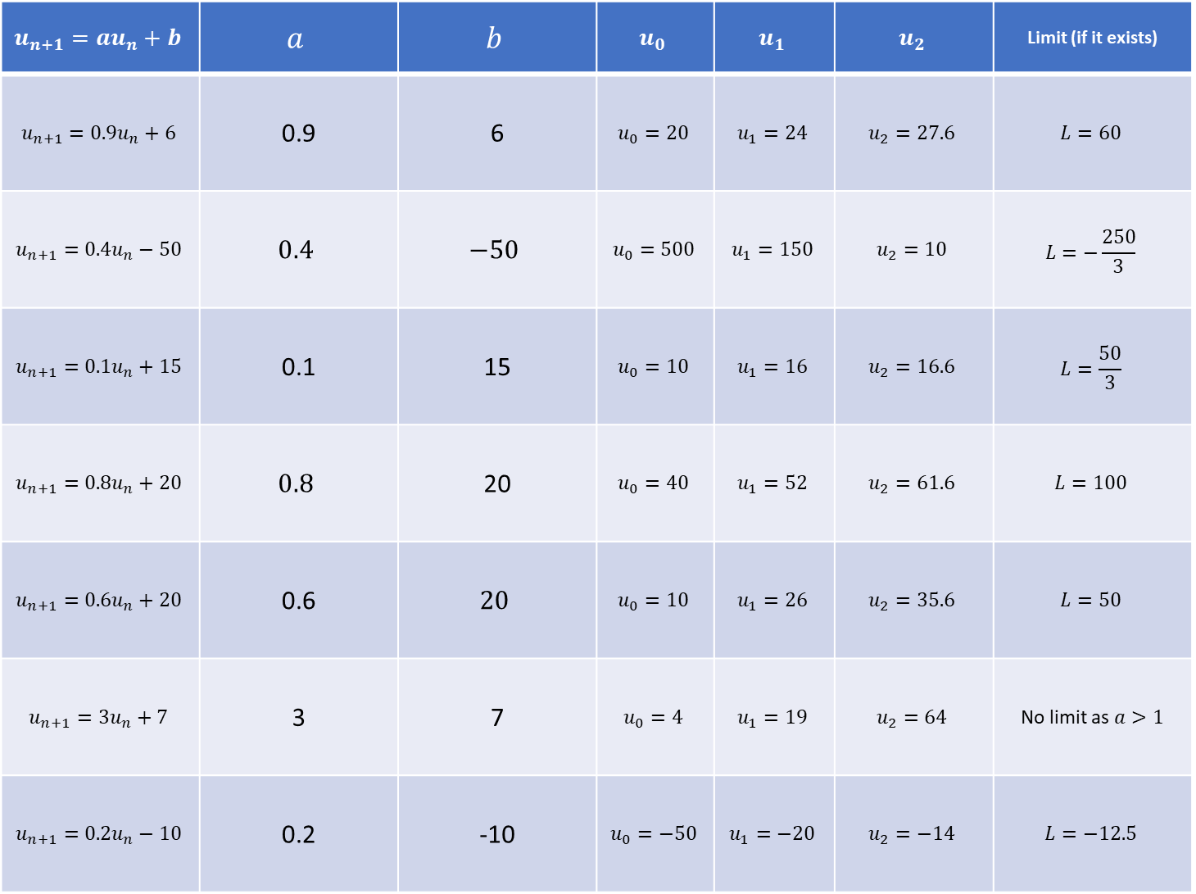
$$u_{n+1}=au_{n}+b$$ | $$a$$ | $$b$$ | $$u_{0}$$ | $$u_{1}$$ | $$u_{2}$$ | Limit (if it exists)
$$u_{n+1}=0.9u_{n}+6$$ | 0.9 | 6 | $$u_{0}=20$$ | $$u_{1}=24$$ | $$u_{2}=27.6$$ | $$L=60$$
$$u_{n+1}=0.4u_{n}−50$$ | $$0.4$$ | $$−50$$ | $$u_{0}=500$$ | $$u_{1}=150$$ | $$u_{2}=10$$ | $$L=−\frac{250}{3}$$
$$u_{n+1}=0.1u_{n}+15$$ | 0.1 | 15 | $$u_{0}=10$$ | $$u_{1}=16$$ | $$u_{2}=16.6$$ | $$L=\frac{50}{3}$$
$$u_{n+1}=0.8u_{n}+20$$ | $$0.8$$ | 20 | $$u_{0}=40$$ | $$u_{1}=52$$ | $$u_{2}=61.6$$ | $$L=100$$
$$u_{n+1}=0.6u_{n}+20$$ | 0.6 | $$20$$ | $$u_{0}=10$$ | $$u_{1}=26$$ | $$u_{2}=35.6$$ | $$L=50$$
$$u_{n+1}=3u_{n}+7$$ | 3 | 7 | $$u_{0}=4$$ | $$u_{1}=19$$ | $$u_{2}=64$$ | No limit as $a>1$
$$u_{n+1}=0.2u_{n}−10$$ | 0.2 | -10 | $$u_{0}=−50$$ | $$u_{1}=−20$$ | $$u_{2}=−14$$ | $$L=−12.5$$
1.
2.
3.
4.
5.
6.
7.

Slide 4
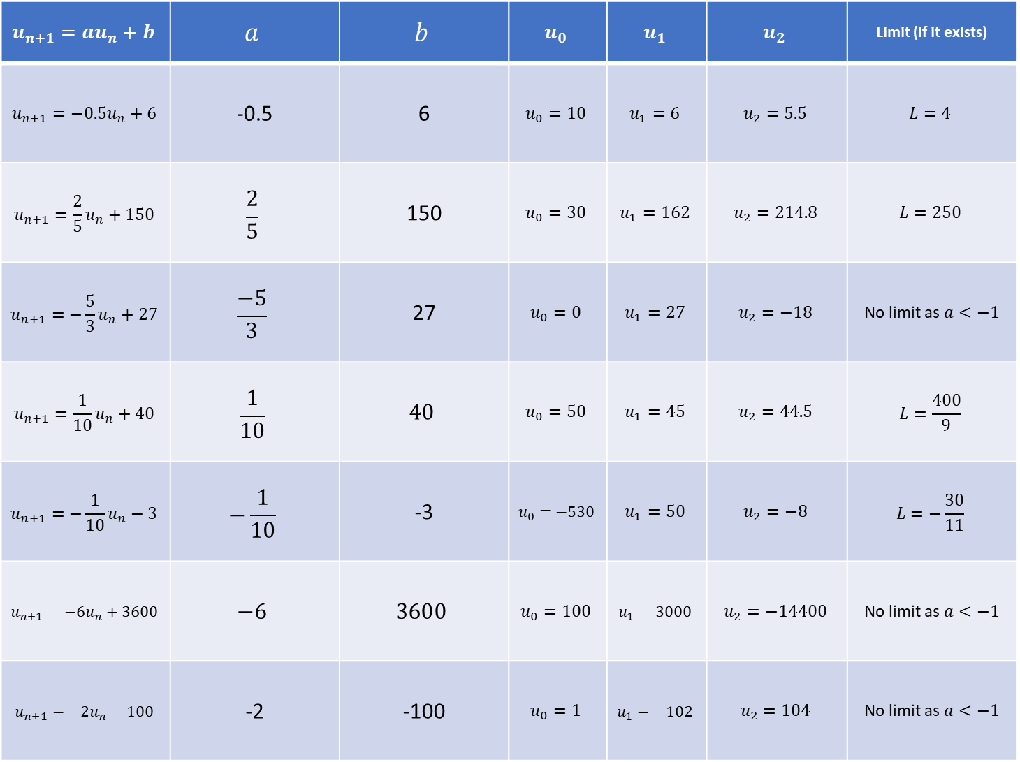
$$u_{n+1}=au_{n}+b$$ | $$a$$ | $$b$$ | $$u_{0}$$ | $$u_{1}$$ | $$u_{2}$$ | Limit (if it exists)
$$u_{n+1}=−0.5u_{n}+6$$ | -0.5 | 6 | $$u_{0}=10$$ | $$u_{1}=6$$ | $$u_{2}=5.5$$ | $$L=4$$
$$u_{n+1}=\frac{2}{5}u_{n}+150$$ | $$\frac{2}{5}$$ | 150 | $$u_{0}=30$$ | $$u_{1}=162$$ | $$u_{2}=214.8$$ | $$L=250$$
$$u_{n+1}=−\frac{5}{3}u_{n}+27$$ | $$\frac{−5}{3}$$ | 27 | $$u_{0}=0$$ | $$u_{1}=27$$ | $$u_{2}=−18$$ | No limit as $a<−1$
$$u_{n+1}=\frac{1}{10}u_{n}+40$$ | $$\frac{1}{10}$$ | $$40$$ | $$u_{0}=50$$ | $$u_{1}=45$$ | $$u_{2}=44.5$$ | $$L=\frac{400}{9}$$
$$u_{n+1}=−\frac{1}{10}u_{n}−3$$ | $$−\frac{1}{10}$$ | -3 | $$u_{0}=−530$$ | $$u_{1}=50$$ | $$u_{2}=−8$$ | $$L=−\frac{30}{11}$$
$$u_{n+1}=−6u_{n}+3600$$ | $$−6$$ | $$3600$$ | $$u_{0}=100$$ | $$u_{1}=3000$$ | $$u_{2}=−14400$$ | No limit as $a<−1$
$$u_{n+1}=−2u_{n}−100$$ | -2 | -100 | $$u_{0}=1$$ | $$u_{1}=−102$$ | $$u_{2}=104$$ | No limit as $a<−1$
8.
9.
10.
11.
12.
13.
14.

Slide 5
$$u_{n+1}=au_{n}+b$$ | $$a$$ | $$b$$ | $$u_{0}$$ | $$u_{1}$$ | $$u_{2}$$ | Limit (if it exists)
$$u_{n+1}=0.9u_{n}+6$$ | 0.9 | 6 | $$u_{0}=20$$ | $$u_{1}=24$$ | $$u_{2}=27.6$$ | $$L=60$$
$$u_{n+1}=0.4u_{n}−50$$ | $$0.4$$ | $$−50$$ | $$u_{0}=500$$ | $$u_{1}=150$$ | $$u_{2}=10$$ | $$L=−\frac{250}{3}$$
$$u_{n+1}=0.1u_{n}+15$$ | 0.1 | 15 | $$u_{0}=10$$ | $$u_{1}=16$$ | $$u_{2}=16.6$$ | $$L=\frac{50}{3}$$
$$u_{n+1}=0.8u_{n}+20$$ | $$0.8$$ | 20 | $$u_{0}=40$$ | $$u_{1}=52$$ | $$u_{2}=61.6$$ | $$L=100$$
$$u_{n+1}=0.6u_{n}+20$$ | 0.6 | $$20$$ | $$u_{0}=10$$ | $$u_{1}=26$$ | $$u_{2}=35.6$$ | $$L=50$$
$$u_{n+1}=3u_{n}+7$$ | 3 | 7 | $$u_{0}=4$$ | $$u_{1}=19$$ | $$u_{2}=64$$ | No limit as $a>1$
$$u_{n+1}=0.2u_{n}−10$$ | 0.2 | -10 | $$u_{0}=−50$$ | $$u_{1}=−20$$ | $$u_{2}=−14$$ | $$L=−12.5$$
1.
2.
3.
4.
5.
6.
7.

Slide 6
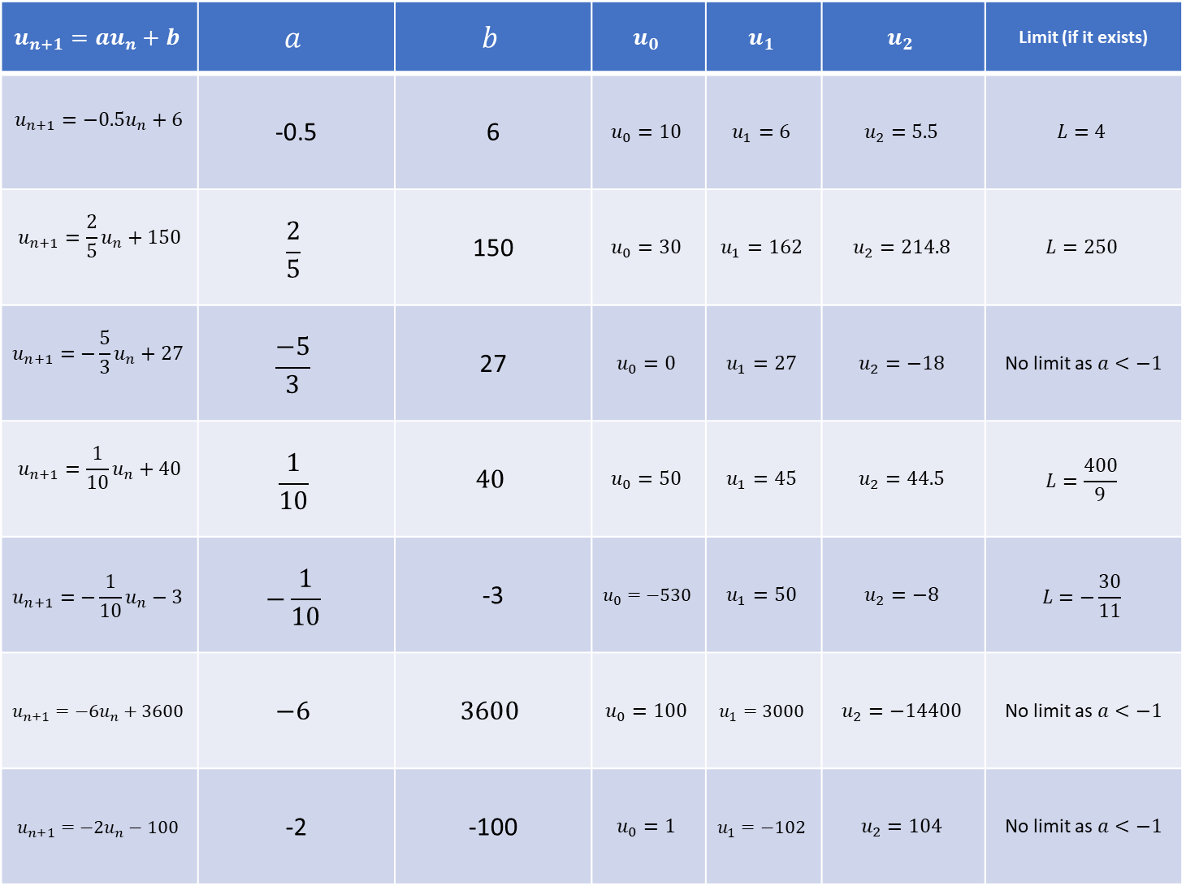
$$u_{n+1}=au_{n}+b$$ | $$a$$ | $$b$$ | $$u_{0}$$ | $$u_{1}$$ | $$u_{2}$$ | Limit (if it exists)
$$u_{n+1}=−0.5u_{n}+6$$ | -0.5 | 6 | $$u_{0}=10$$ | $$u_{1}=6$$ | $$u_{2}=5.5$$ | $$L=4$$
$$u_{n+1}=\frac{2}{5}u_{n}+150$$ | $$\frac{2}{5}$$ | 150 | $$u_{0}=30$$ | $$u_{1}=162$$ | $$u_{2}=214.8$$ | $$L=250$$
$$u_{n+1}=−\frac{5}{3}u_{n}+27$$ | $$\frac{−5}{3}$$ | 27 | $$u_{0}=0$$ | $$u_{1}=27$$ | $$u_{2}=−18$$ | No limit as $a<−1$
$$u_{n+1}=\frac{1}{10}u_{n}+40$$ | $$\frac{1}{10}$$ | $$40$$ | $$u_{0}=50$$ | $$u_{1}=45$$ | $$u_{2}=44.5$$ | $$L=\frac{400}{9}$$
$$u_{n+1}=−\frac{1}{10}u_{n}−3$$ | $$−\frac{1}{10}$$ | -3 | $$u_{0}=−530$$ | $$u_{1}=50$$ | $$u_{2}=−8$$ | $$L=−\frac{30}{11}$$
$$u_{n+1}=−6u_{n}+3600$$ | $$−6$$ | $$3600$$ | $$u_{0}=100$$ | $$u_{1}=3000$$ | $$u_{2}=−14400$$ | No limit as $a<−1$
$$u_{n+1}=−2u_{n}−100$$ | -2 | -100 | $$u_{0}=1$$ | $$u_{1}=−102$$ | $$u_{2}=104$$ | No limit as $a<−1$
8.
9.
10.
11.
12.
13.
14.

