Slide 1
Simplify fractions using a given number to divide
Silent
Teacher
Intelligent Practice
Narration
Your Turn
Simplify this fraction by dividing by 2
$$\frac{8}{24}=$$
Can it be simplified further?
Practice

Slide 2
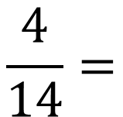
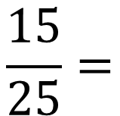
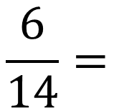
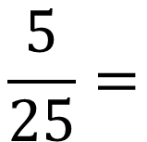
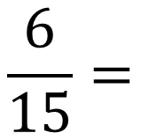
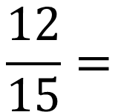
Worked Example
Your Turn
Simplify this fraction by dividing by 2
Simplify this fraction by dividing by 2
$$\frac{6}{14}=$$
$$\frac{4}{14}=$$
Simplify this fraction by dividing by 3
Simplify this fraction by dividing by 3
$$\frac{12}{15}=$$
$$\frac{6}{15}=$$
Simplify this fraction by dividing by 5
Simplify this fraction by dividing by 5
$$\frac{5}{25}=$$
$$\frac{15}{25}=$$

Slide 3
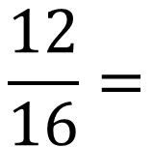
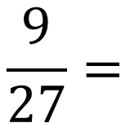
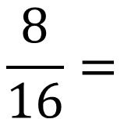
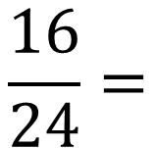
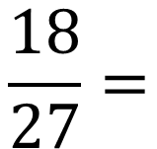
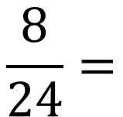
Worked Example
Your Turn
Simplify this fraction by dividing by 2
Simplify this fraction by dividing by 2
Can it be simplified further?
Can it be simplified further?
$$\frac{8}{16}=$$
$$\frac{12}{16}=$$
Simplify this fraction by dividing by 2
Simplify this fraction by dividing by 2
Can it be simplified further?
Can it be simplified further?
$$\frac{8}{24}=$$
$$\frac{16}{24}=$$
Simplify this fraction by dividing by the largest number possible
Simplify this fraction by dividing by the largest number possible
$$\frac{9}{27}=$$
$$\frac{18}{27}=$$

Slide 4
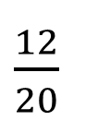
Simplify these fractions by dividing by 4
6)
$\frac{12}{36}$
1)
$\frac{8}{20}$
Simplify these fractions by dividing by 8
Can they be simplified further?
2)
$\frac{12}{20}$
$\frac{16}{48}$
7)
3)
$\frac{16}{20}$
$\frac{24}{48}$
8)
Simplify these fractions by dividing by 6.
Can they be simplified further?
$\frac{32}{64}$
9)
4)
$\frac{6}{24}$
Simplify this fraction by dividing by 16
10)
$\frac{32}{48}$
5)
$\frac{18}{24}$

Slide 5
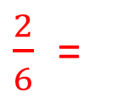
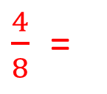
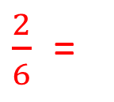
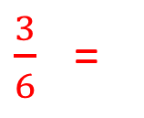
Simplify these fractions by dividing by 4
6)
$\frac{12}{36}$
$\frac{2}{6}$ =
$\frac{1}{3}$
1)
$\frac{8}{20}$
$\frac{2}{5}$
Simplify these fractions by dividing by 8
Can they be simplified further?
2)
$\frac{12}{20}$
$\frac{3}{5}$
$\frac{16}{48}$
$\frac{2}{6}$ =
$\frac{1}{3}$
7)
3)
$\frac{16}{20}$
$\frac{4}{5}$
$\frac{24}{48}$
$\frac{3}{6}$ =
$\frac{1}{2}$
8)
Simplify these fractions by dividing by 6.
Can they be simplified further?
$\frac{32}{64}$
$\frac{4}{8}$ =
$\frac{1}{2}$
9)
4)
$\frac{6}{24}$
$\frac{1}{4}$
Simplify this fraction by dividing by 16
10)
$\frac{32}{48}$
$\frac{2}{3}$
5)
$\frac{18}{24}$
$\frac{3}{4}$

