Slide 1
Linking Function Machines with Substitution and Solving Equations
Silent
Teacher
Intelligent Practice
Narration
Your Turn
INPUT
OUTPUT
$$13$$
x3
+1
INPUT
OUTPUT
x3
+1
$$13$$
$$y=3x+1$$
Find the value of $y$ when $x=13$
Practice
Find the value of $x$ when $y=13$

Slide 2
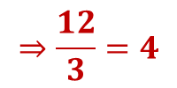
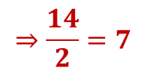
Worked Example
Your Turn
INPUT
OUTPUT
INPUT
OUTPUT
$$13$$
$$×3$$
$$+1$$
$$40$$
$$13$$
$$×2$$
$$−1$$
$$25$$
$$3(13)+1$$
$$=40$$
$$2\left(13\right)−1$$
$$=25$$
INPUT
OUTPUT
INPUT
OUTPUT
$$4$$
$$×3$$
$$+1$$
$$13$$
$$7$$
$$×2$$
$$−1$$
$$13$$
$$⇒\frac{12}{3}=4$$
$$⇒\frac{14}{2}=7$$
$$13−1=12$$
$$13+1=14$$
$$y=3x+1$$
$$y=2x−1$$
Find the value of $y$ when $x=13$
Find the value of $y$ when $x=13$
$$y=3(13)+1$$
$$y=2\left(13\right)−1$$
$$y=40$$
$$y=25$$
Find the value of $x$ when $y=13$
Find the value of $x$ when $y=13$
$$13=3x+1$$
$$13=2x−1$$
$$12=3x$$
$$14=2x$$
$$4=x$$
$$7=x$$
@MrDraperMaths
Notes:
This example problem pair focuses on the similar structure to substation and solving of equations with previous work on function machines.

Slide 3
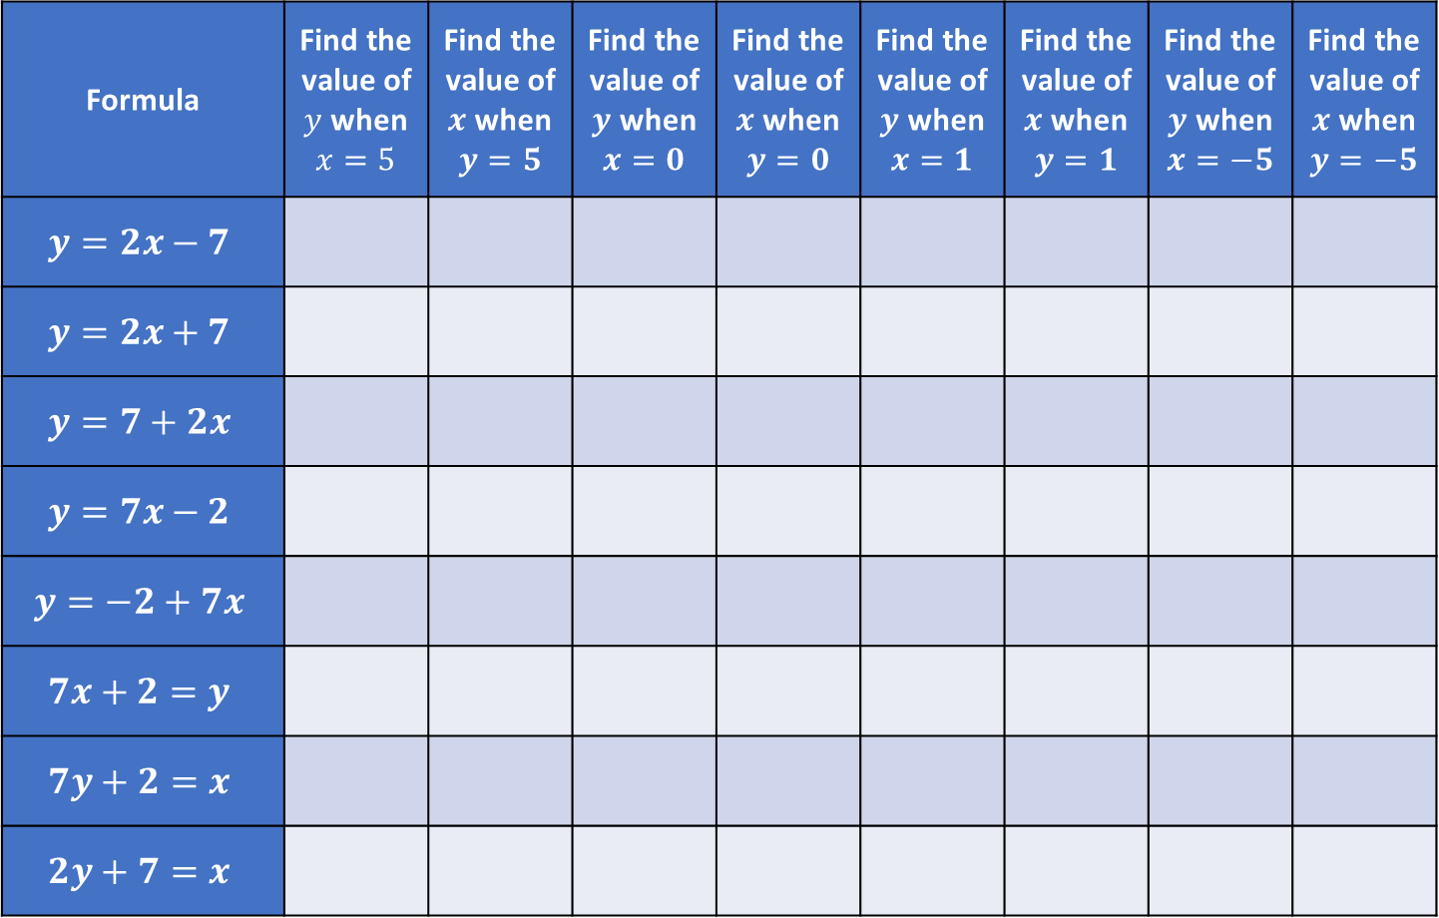
Formula | Find the value of $y$ when $x=5$ | Find the value of $x$ when $y=5$ | Find the value of $y$ when $x=0$ | Find the value of $x$ when $y=0$ | Find the value of $y$ when $x=1$ | Find the value of $x$ when $y=1$ | Find the value of $y$ when $x=−5$ | Find the value of $x$ when $y=−5$
$$y=2x−7$$
$$y=2x+7$$
$$y=7+2x$$
$$y=7x−2$$
$$y=−2+7x$$
$$7x+2=y$$
$$7y+2=x$$
$$2y+7=x$$
@MrDraperMaths
Notes:
This task only uses numerical inputs and outputs.

Slide 4
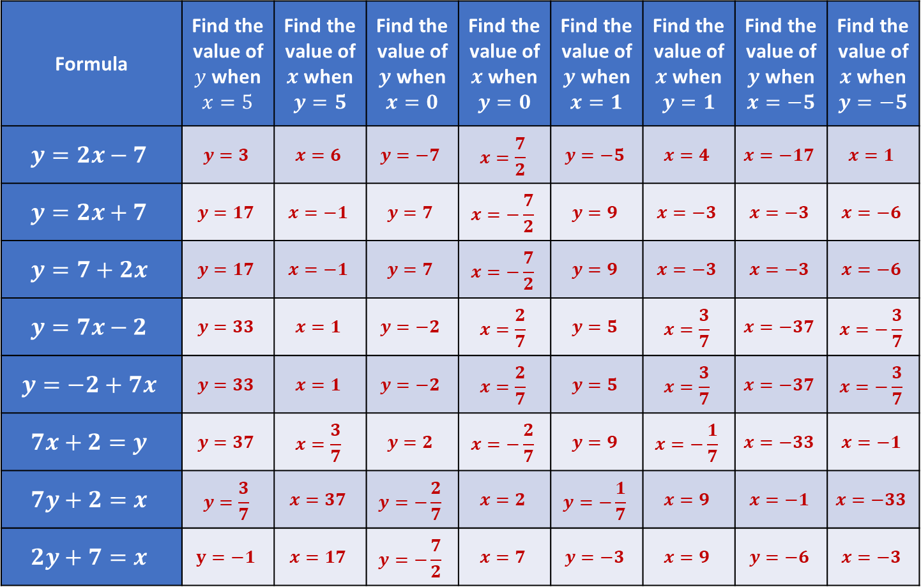
Formula | Find the value of $y$ when $x=5$ | Find the value of $x$ when $y=5$ | Find the value of $y$ when $x=0$ | Find the value of $x$ when $y=0$ | Find the value of $y$ when $x=1$ | Find the value of $x$ when $y=1$ | Find the value of $y$ when $x=−5$ | Find the value of $x$ when $y=−5$
$$y=2x−7$$ | $$y=3$$ | $$x=6$$ | $$y=−7$$ | $$x=\frac{7}{2}$$ | $$y=−5$$ | $$x=4$$ | $$x=−17$$ | $$x=1$$
$$y=2x+7$$ | $$y=17$$ | $$x=−1$$ | $$y=7$$ | $$x=−\frac{7}{2}$$ | $$y=9$$ | $$x=−3$$ | $$x=−3$$ | $$x=−6$$
$$y=7+2x$$ | $$y=17$$ | $$x=−1$$ | $$y=7$$ | $$x=−\frac{7}{2}$$ | $$y=9$$ | $$x=−3$$ | $$x=−3$$ | $$x=−6$$
$$y=7x−2$$ | $$y=33$$ | $$x=1$$ | $$y=−2$$ | $$x=\frac{2}{7}$$ | $$y=5$$ | $$x=\frac{3}{7}$$ | $$x=−37$$ | $$x=−\frac{3}{7}$$
$$y=−2+7x$$ | $$y=33$$ | $$x=1$$ | $$y=−2$$ | $$x=\frac{2}{7}$$ | $$y=5$$ | $$x=\frac{3}{7}$$ | $$x=−37$$ | $$x=−\frac{3}{7}$$
$$7x+2=y$$ | $$y=37$$ | $$x=\frac{3}{7}$$ | $$y=2$$ | $$x=−\frac{2}{7}$$ | $$y=9$$ | $$x=−\frac{1}{7}$$ | $$x=−33$$ | $$x=−1$$
$$7y+2=x$$ | $$y=\frac{3}{7}$$ | $$x=37$$ | $$y=−\frac{2}{7}$$ | $$x=2$$ | $$y=−\frac{1}{7}$$ | $$x=9$$ | $$x=−1$$ | $$x=−33$$
$$2y+7=x$$ | $$y=−1$$ | $$x=17$$ | $$y=−\frac{7}{2}$$ | $$x=7$$ | $$y=−3$$ | $$x=9$$ | $$y=−6$$ | $$x=−3$$
@MrDraperMaths
Notes:
This task only uses numerical inputs and outputs.

