Slide 1
Percentages: Simple Interest – What is the rate of interest?
Silent
Teacher
Intelligent Practice
Narration
Your Turn
£1000 is invested.
The value after 10 years is £1200.
What is the simple rate of interest?
Practice

Slide 2
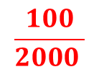
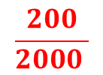
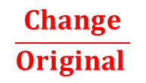
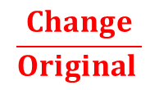
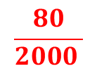
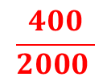
Worked Example
Your Turn
£2000 is invested for 1 year.
£2000 is invested for 1 year.
The value after 1 year is £2200.
The value after 1 year is £2400.
What is the simple rate of interest?
What is the simple rate of interest?
$$\frac{Change}{Original }$$
$$\frac{200}{2000 }$$
=
$$\frac{Change}{Original }$$
$$\frac{400}{2000 }$$
=
$$10\%$$
=
=
$$20\%$$
£2000 is invested for 2 years.
£2000 is invested for 5 years.
The value after 2 years is £2200.
The value after 5 years is £2400.
What is the simple rate of interest?
What is the simple rate of interest?
$£200$ divided by 2 years = £100
$£400$ divided by 5 years = £80
$$\frac{Change}{Original }$$
$$\frac{100}{2000 }$$
=
$$\frac{Change}{Original }$$
$$\frac{80}{2000 }$$
=
=
$$5\%$$
=
$$4\%$$

Slide 3
1)
£1000 is invested. The value after 1 year is £1200. What is the simple rate of interest?
2)
£1000 is invested. The value after 2 years is £1200. What is the simple rate of interest?
3)
£1000 is invested. The value after 5 years is £1200. What is the simple rate of interest?
4)
£1000 is invested. The value after 10 years is £1500. What is the simple rate of interest?
5)
£1000 is invested. The value after 10 years is £1200. What is the simple rate of interest?
6)
£1000 is invested. The value after 10 years is £1100. What is the simple rate of interest?
7)
£1000 is invested. The value after 10 years is £1050. What is the simple rate of interest?

Slide 4
1)
£1000 is invested. The value after 1 year is £1200. What is the simple rate of interest?
20%
2)
£1000 is invested. The value after 2 years is £1200. What is the simple rate of interest?
10%
3)
£1000 is invested. The value after 5 years is £1200. What is the simple rate of interest?
4%
4)
£1000 is invested. The value after 10 years is £1500. What is the simple rate of interest?
5%
5)
£1000 is invested. The value after 10 years is £1200. What is the simple rate of interest?
2%
6)
£1000 is invested. The value after 10 years is £1100. What is the simple rate of interest?
1%
7)
£1000 is invested. The value after 10 years is £1050. What is the simple rate of interest?
0.5%

