Slide 1
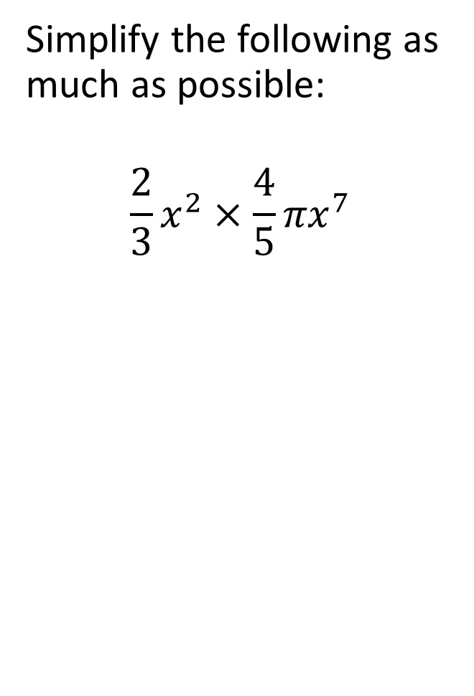
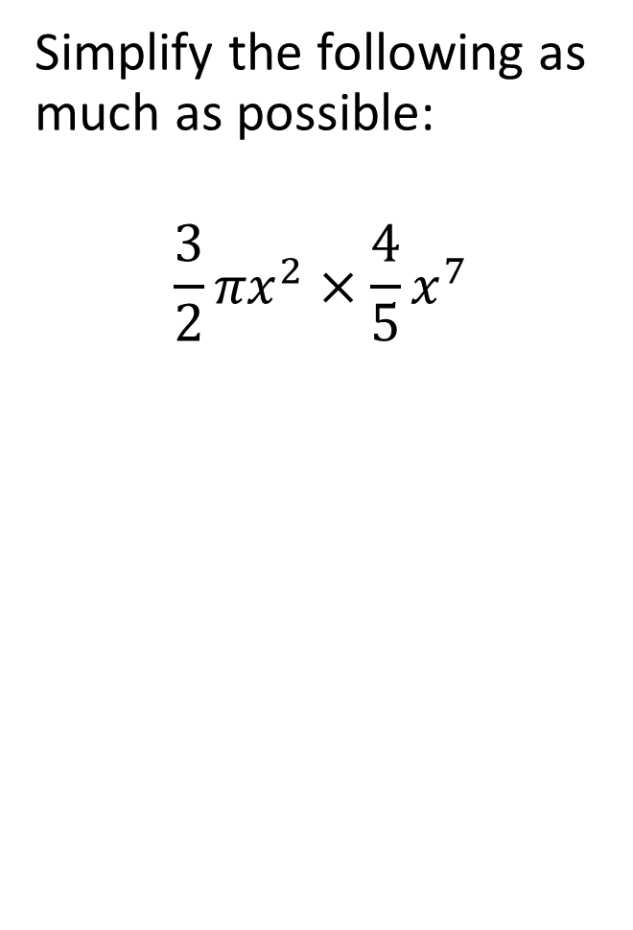
Simplify the following as much as possible:
$$\frac{2}{3}x^{2}×\frac{4}{5}{πx}^{7}$$
Simplify the following as much as possible:
$$\frac{3}{2}{πx}^{2}×\frac{4}{5}x^{7}$$
What happens to the fractions (coefficients of x)?
What happens to the indices of x?
What happens to pi?

Slide 2
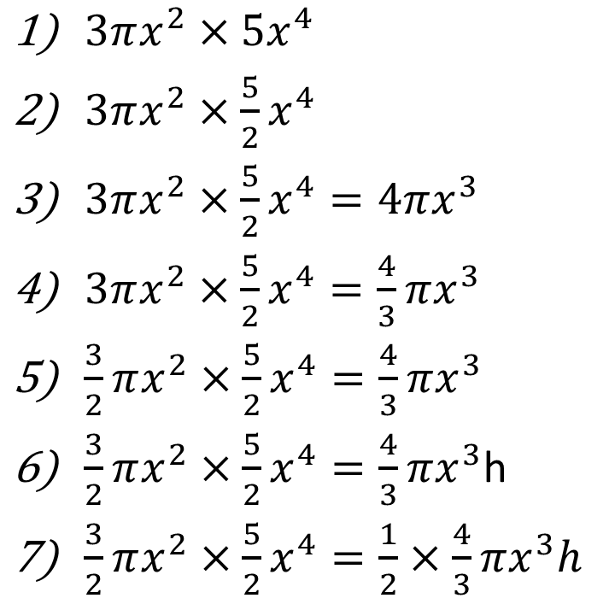
Simplify the following as much as possible. Where possible find the value of x or rearrange to make h the subject
$3πx^{2}×5x^{4}$
$3πx^{2}×\frac{5}{2}x^{4}$
$3πx^{2}×\frac{5}{2}x^{4}=4πx^{3}$
$3πx^{2}×\frac{5}{2}x^{4}=\frac{4}{3}πx^{3}$
$\frac{3}{2}πx^{2}×\frac{5}{2}x^{4}=\frac{4}{3}πx^{3}$
$\frac{3}{2}πx^{2}×\frac{5}{2}x^{4}=\frac{4}{3}πx^{3}$h
$\frac{3}{2}πx^{2}×\frac{5}{2}x^{4}=\frac{1}{2}×\frac{4}{3}πx^{3}h$

Slide 3
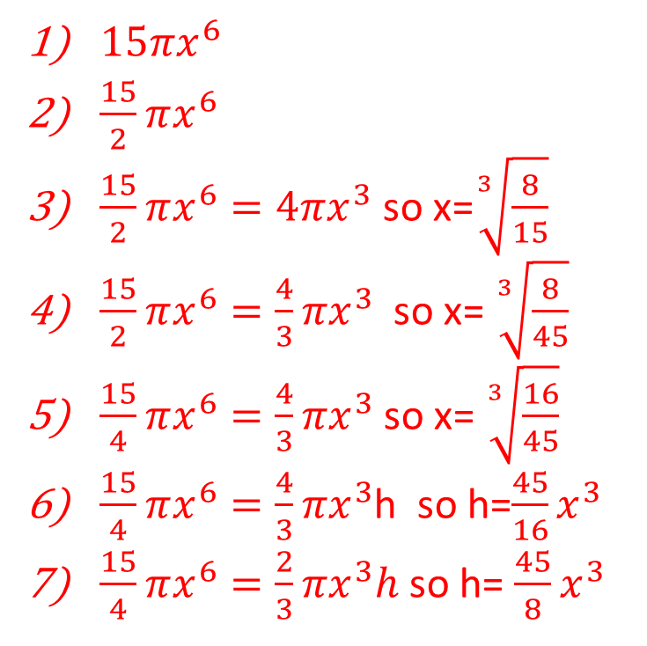
Simplify the following as much as possible. Where possible find the value of x or rearrange to make h the subject
$3πx^{2}×5x^{4}$
$3πx^{2}×\frac{5}{2}x^{4}$
$3πx^{2}×\frac{5}{2}x^{4}=4πx^{3}$
$3πx^{2}×\frac{5}{2}x^{4}=\frac{4}{3}πx^{3}$
$\frac{3}{2}πx^{2}×\frac{5}{2}x^{4}=\frac{4}{3}πx^{3}$
$\frac{3}{2}πx^{2}×\frac{5}{2}x^{4}=\frac{4}{3}πx^{3}$h
$\frac{3}{2}πx^{2}×\frac{5}{2}x^{4}=\frac{1}{2}×\frac{4}{3}πx^{3}h$
$15πx^{6}$
$\frac{15}{2}πx^{6}$
$\frac{15}{2}πx^{6}=4πx^{3}$ so x=$\sqrt[3]{\frac{8}{15}}$
$\frac{15}{2}πx^{6}=\frac{4}{3}πx^{3}$ so x= $\sqrt[3]{\frac{8}{45}}$
$\frac{15}{4}πx^{6}=\frac{4}{3}πx^{3}$ so x= $\sqrt[3]{\frac{16}{45}}$
$\frac{15}{4}πx^{6}=\frac{4}{3}πx^{3}$h so h=$\frac{45}{16}x^{3}$
$\frac{15}{4}πx^{6}=\frac{2}{3}πx^{3}h$ so h= $\frac{45}{8}x^{3}$

