Slide 1
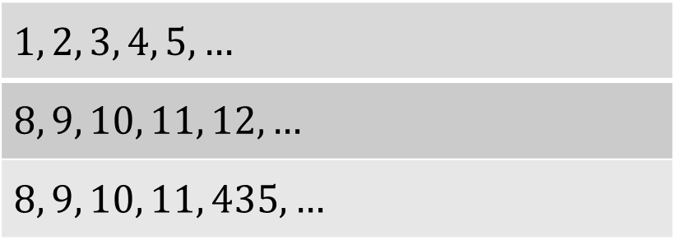
Ascending, descending, neither?
True/false
Reflect
Your Turn
$$1, 2, 3, 4, 5,…$$
$$8, 9, 10, 11, 12,…$$
$$8, 9, 10, 11, 435,…$$
Rule

Slide 2
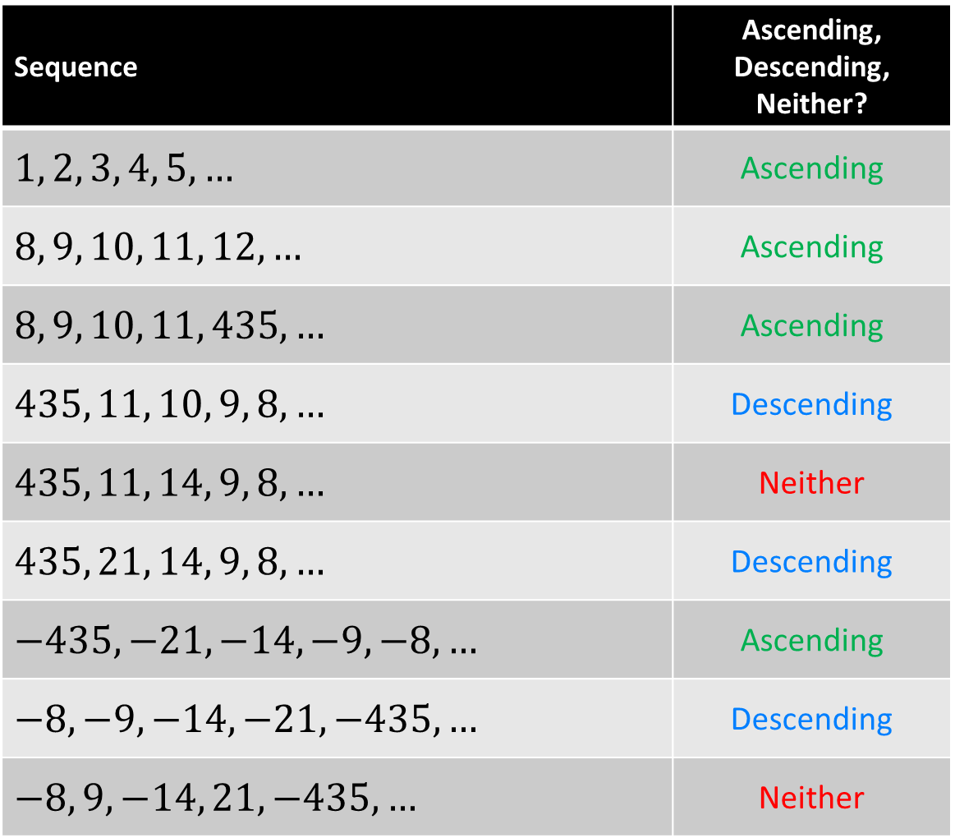
Sequence | Ascending, Descending, Neither?
$$1, 2, 3, 4, 5,…$$ | Ascending
$$8, 9, 10, 11, 12,…$$ | Ascending
$$8, 9, 10, 11, 435,…$$ | Ascending
$$435, 11, 10, 9, 8,…$$ | Descending
$$435, 11, 14, 9, 8,…$$ | Neither
$$435, 21, 14, 9, 8,…$$ | Descending
$$−435, −21, −14, −9, −8,…$$ | Ascending
$$−8, −9, −14, −21, −435,…$$ | Descending
$$−8, 9, −14, 21, −435,…$$ | Neither

Slide 3
Sequence | Ascending, Descending, Neither?
$$1, 2, 3, 4, 5,…$$ | Ascending
$$8, 9, 10, 11, 12,…$$ | Ascending
$$8, 9, 10, 11, 435,…$$ | Ascending
$$435, 11, 10, 9, 8,…$$ | Descending
$$435, 11, 14, 9, 8,…$$ | Neither
$$435, 21, 14, 9, 8,…$$ | Descending
$$−435, −21, −14, −9, −8,…$$ | Ascending
$$−8, −9, −14, −21, −435,…$$ | Descending
$$−8, 9, −14, 21, −435,…$$ | Neither

Slide 4
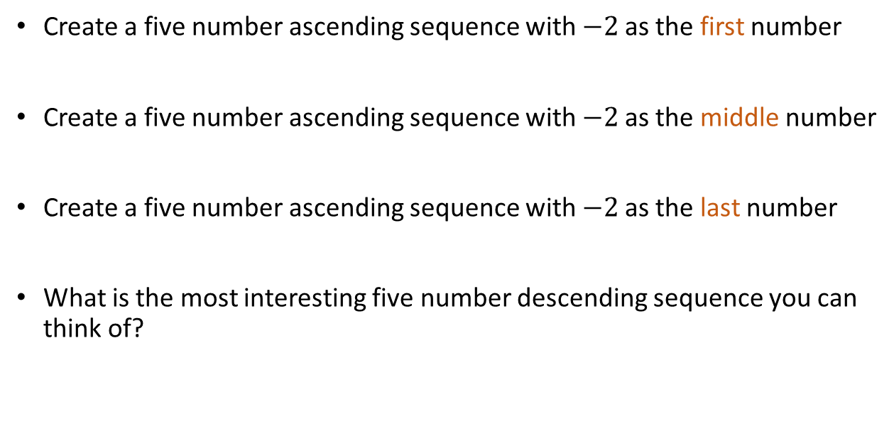
Challenge
Create a five number ascending sequence with $−2$as the first number
Create a five number ascending sequence with $−2$as the middle number
Create a five number ascending sequence with $−2$as the last number
What is the most interesting five number descending sequence you can think of?

