Slide 1
Co-ordinates of Turning Point from Completing the Square
Silent
Teacher
Intelligent Practice
Narration
Your Turn
$$y=x^{2}+6x+11$$
$$y=x^{2}+7x+11$$
$$y=x^{2}+8x+11$$
Practice

Slide 2
Worked Example
Your Turn
Find the co-ordinates of the turning point
Find the co-ordinates of the turning point
$$y=x^{2}−6x−11$$
$$y=x^{2}−6x+11$$

Slide 3
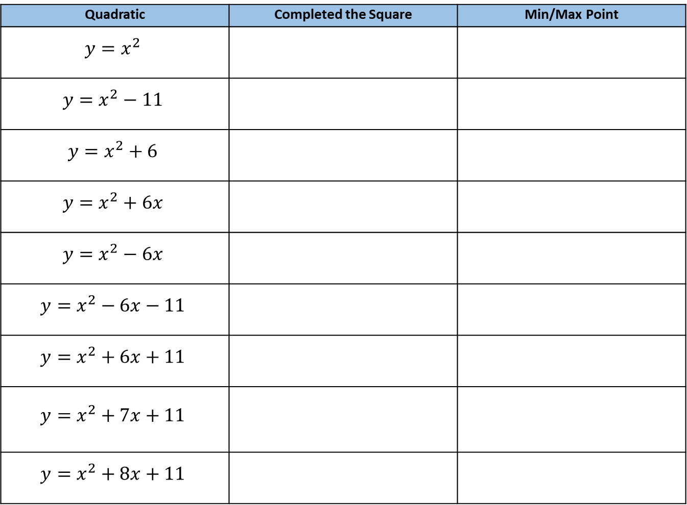
Quadratic | Completed the Square | Min/Max Point
$$y=x^{2}$$
$$y=x^{2}−11$$
$$y=x^{2}+6$$
$$y=x^{2}+6x$$
$$y=x^{2}−6x$$
$$y=x^{2}−6x−11$$
$$y=x^{2}+6x+11$$
$$y=x^{2}+7x+11$$
$$y=x^{2}+8x+11$$

Slide 4
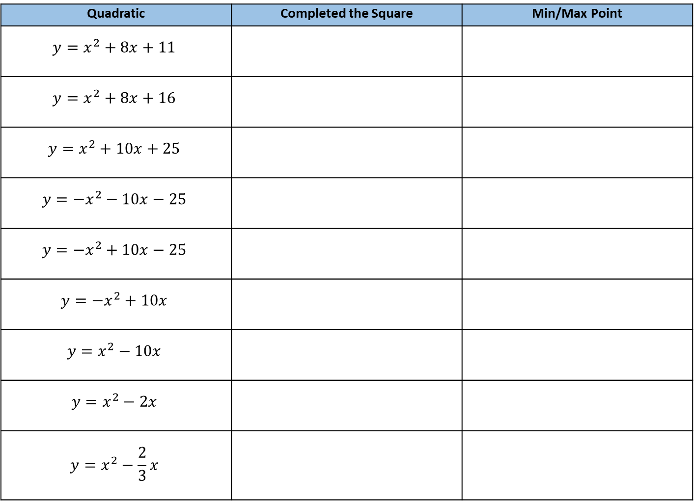
Quadratic | Completed the Square | Min/Max Point
$$y=x^{2}+8x+11$$
$$y=x^{2}+8x+16$$
$$y=x^{2}+10x+25$$
$$y=−x^{2}−10x−25$$
$$y=−x^{2}+10x−25$$
$$y=−x^{2}+10x$$
$$y=x^{2}−10x$$
$$y=x^{2}−2x$$
$$y=x^{2}−\frac{2}{3}x$$

Slide 5
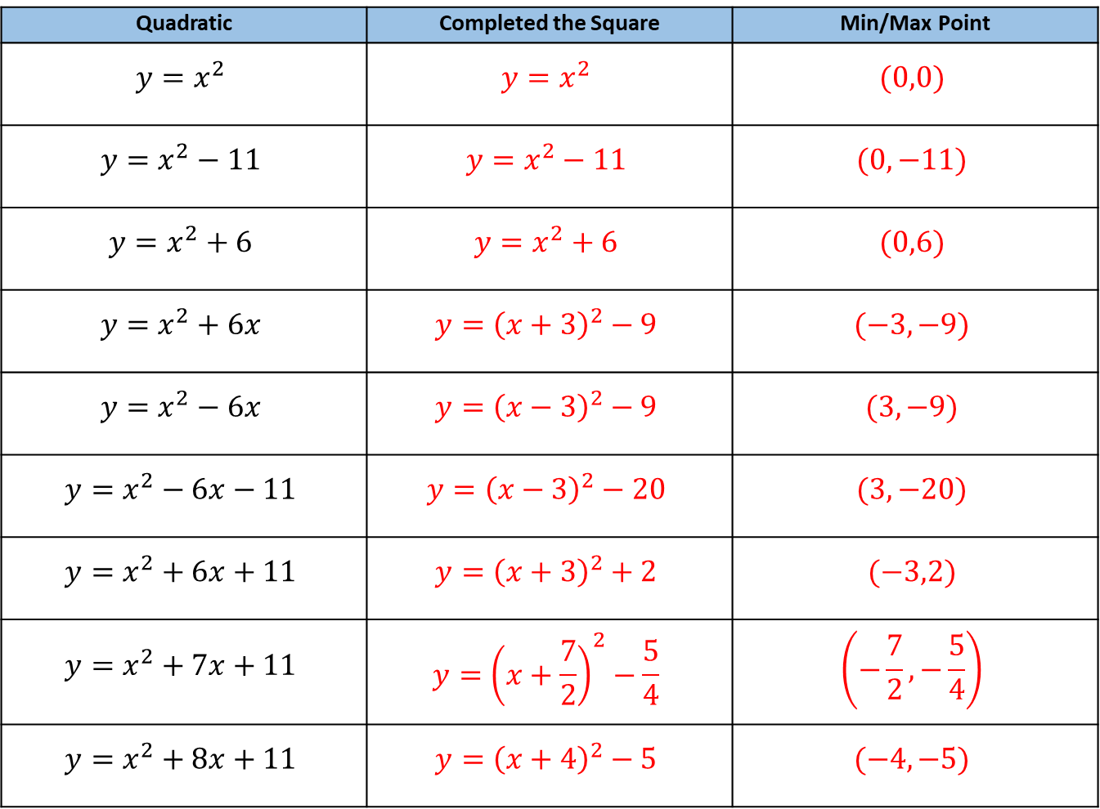
Quadratic | Completed the Square | Min/Max Point
$$y=x^{2}$$ | $$y=x^{2}$$ | $$(0,0)$$
$$y=x^{2}−11$$ | $$y=x^{2}−11$$ | $$(0,−11)$$
$$y=x^{2}+6$$ | $$y=x^{2}+6$$ | $$(0,6)$$
$$y=x^{2}+6x$$ | $$y={\left(x+3\right)}^{2}−9$$ | $$(−3,−9)$$
$$y=x^{2}−6x$$ | $$y={\left(x−3\right)}^{2}−9$$ | $$(3,−9)$$
$$y=x^{2}−6x−11$$ | $$y={\left(x−3\right)}^{2}−20$$ | $$(3,−20)$$
$$y=x^{2}+6x+11$$ | $$y={\left(x+3\right)}^{2}+2$$ | $$(−3,2)$$
$$y=x^{2}+7x+11$$ | $$y={\left(x+\frac{7}{2}\right)}^{2}−\frac{5}{4}$$ | $$\left(−\frac{7}{2},−\frac{5}{4}\right)$$
$$y=x^{2}+8x+11$$ | $$y={\left(x+4\right)}^{2}−5$$ | $$(−4, −5)$$

Slide 6
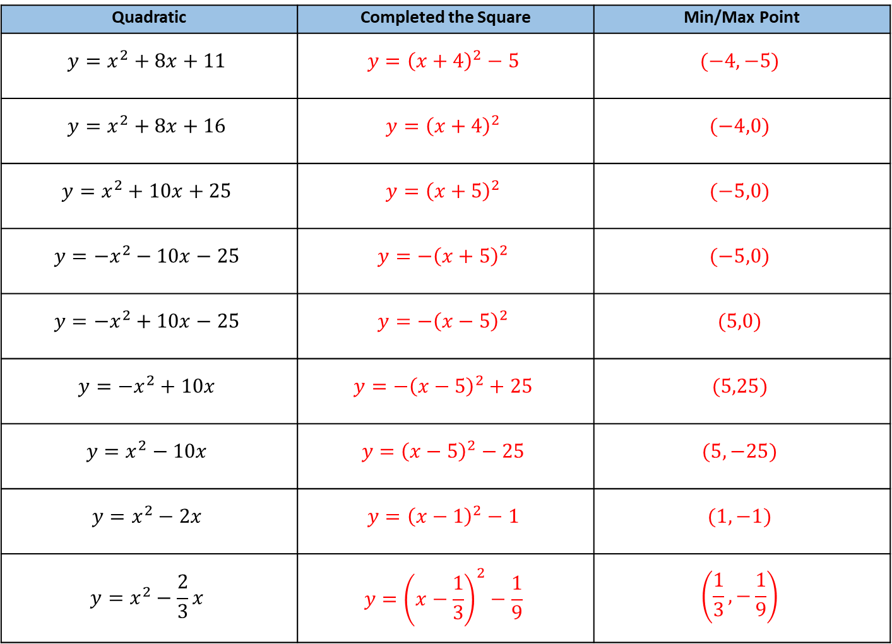
Quadratic | Completed the Square | Min/Max Point
$$y=x^{2}+8x+11$$ | $$y={\left(x+4\right)}^{2}−5$$ | $$(−4, −5)$$
$$y=x^{2}+8x+16$$ | $$y={\left(x+4\right)}^{2}$$ | $$(−4,0)$$
$$y=x^{2}+10x+25$$ | $$y={\left(x+5\right)}^{2}$$ | $$(−5,0)$$
$$y=−x^{2}−10x−25$$ | $$y={−\left(x+5\right)}^{2}$$ | $$(−5,0)$$
$$y=−x^{2}+10x−25$$ | $$y={−\left(x−5\right)}^{2}$$ | $$(5,0)$$
$$y=−x^{2}+10x$$ | $$y={−\left(x−5\right)}^{2}+25$$ | $$(5,25)$$
$$y=x^{2}−10x$$ | $$y={\left(x−5\right)}^{2}−25$$ | $$(5,−25)$$
$$y=x^{2}−2x$$ | $$y={\left(x−1\right)}^{2}−1$$ | $$(1,−1)$$
$$y=x^{2}−\frac{2}{3}x$$ | $$y={\left(x−\frac{1}{3}\right)}^{2}−\frac{1}{9}$$ | $$\left(\frac{1}{3},−\frac{1}{9}\right)$$

