Slide 1
Simplifying Algebraic Expressions: Addition and Multiplication
Silent
Teacher
Intelligent Practice
Narration
Your Turn
$$4x+5x=$$
$$4x×5x=$$
$$4x×5y=$$
Practice
$$4x+5y=$$

Slide 2
Simplify if possible:
Simplify if possible:
$$4x×3$$
$$4y×3y$$
$$4x×3y$$
$$4×3y$$
@MrGibbons

Slide 3
Simplify if possible:
Simplify if possible:
$$4x+3y$$
$$4y+3y$$
$$4x+3x$$
$$4+3y$$
@MrGibbons

Slide 4
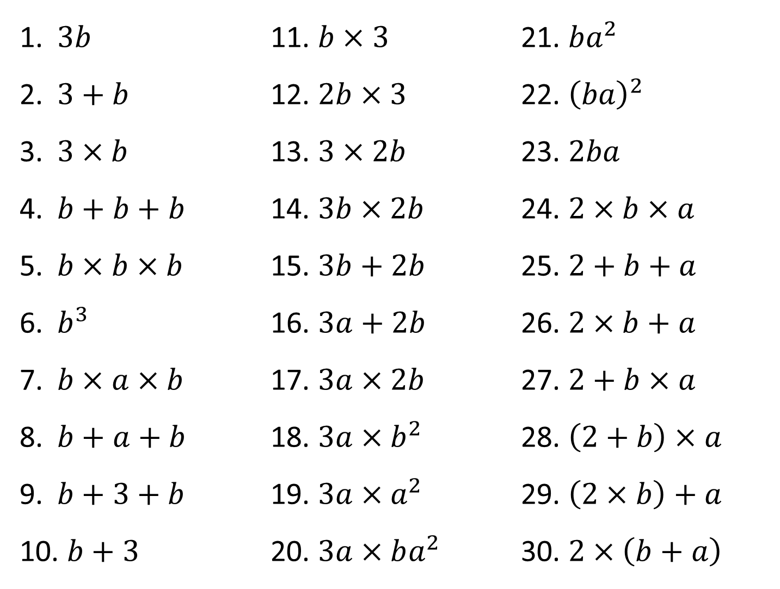
$3b$
$3+b$
$3×b$
$b+b+b$
$b×b×b$
$b^{3}$
$b×a×b$
$b+a+b$
$b+3+b$
$b+3$
$b×3$
$2b×3$
$3×2b$
$3b×2b$
$3b+2b$
$3a+2b$
$3a×2b$
$3a×b^{2}$
$3a×a^{2}$
$3a×ba^{2}$
$ba^{2}$
${\left(ba\right)}^{2}$
$2ba$
$2×b×a$
$2+b+a$
$2×b+a$
$2+b×a$
$\left(2+b\right)×a$
$\left(2×b\right)+a$
$2×\left(b+a\right)$
@MrGibbons

Slide 5





















$3b$
$3b$
$3+b$
$3×b$
$b+b+b$
$b×b×b$
$b^{3}$
$b×a×b$
$b+a+b$
$b+3+b$
$b+3$
$b×3$
$2b×3$
$3×2b$
$3b×2b$
$3b+2b$
$3a+2b$
$3a×2b$
$3a×b^{2}$
$3a×a^{2}$
$3a×ba^{2}$
$ba^{2}$
${\left(ba\right)}^{2}$
$2ba$
$2×b×a$
$2+b+a$
$2×b+a$
$2+b×a$
$\left(2+b\right)×a$
$\left(2×b\right)+a$
$2×\left(b+a\right)$
$3b$
$a^{2}b$
$3+b$
$6b$
$a^{2}b^{2}$
$3b$
$6b$
$2ab$
$3b$
$6b^{2}$
$2ab$
$$b^{3}$$
$5b$
$2+a+b$
$b^{3}$
$3a+2b$
$a+2b$
$ab^{2}$
$6ab$
$2+ab$
$3ab^{2}$
$a+2b$
$a\left(2+b\right)$ or $2a+ab$
$3a^{3}$
$3+2b$
$a+2b$
$3+b$
$3a^{3}b$
$2\left(a+b\right)$ or $2a+2b$
@MrGibbons

