Slide 1
Sketching Quadratics From Factorised Form
Silent
Teacher
Intelligent Practice
Narration
Your Turn
Sketch each quadratic showing the roots and y-intercept
$$(x−1)\left(x−3\right)=0$$
$$(x+1)\left(x−3\right)=0$$
$$(1−x)\left(x−3\right)=0$$
Practice
Interactive Solutions:
https://www.desmos.com/calculator/hfebg8hk83
Notes:
Full solutions can be found in the desmos page: https://www.desmos.com/calculator/hfebg8hk83

Slide 2
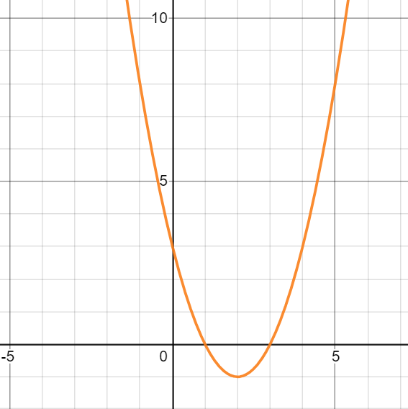
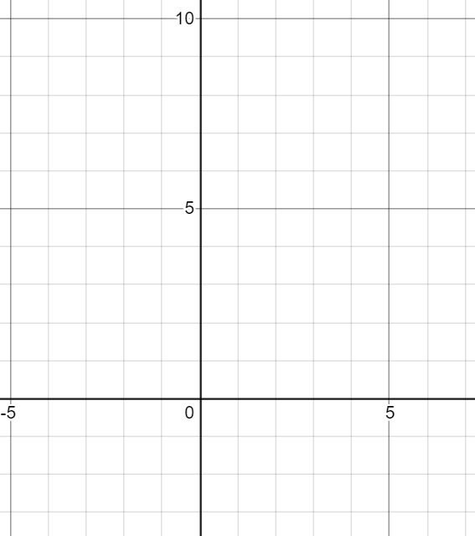
Worked Example
Your Turn
Sketch each quadratic showing the roots and y-intercept
$$(x−1)\left(x−3\right)=0$$
$$x^{2}−4x+3 =0$$
$$x=1 and x=3$$
$$y−intercept at 3$$
$$Positive coefficient of x^{2}$$
(0,3)
x
x
x
(3,0)
(1,0)
@MrDraperMaths
Notes:
Worked Example development using the structure of factorised forms and general forms of a quadratic. (This task was designed as a primer before factorising quadratics and completing the square and as such turning points do not feature.)

Slide 3
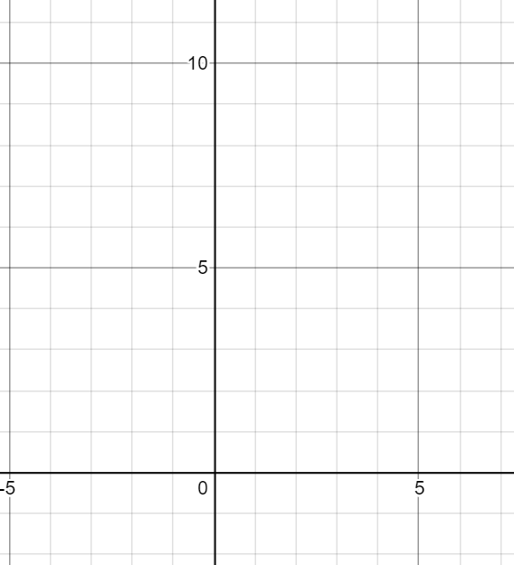
Worked Example
Your Turn
Sketch each quadratic showing the roots and y-intercept
Sketch each quadratic showing the roots and y-intercept
$$(x−1)\left(x−3\right)=0$$
$$(x−2)\left(x−4\right)=0$$
$$x^{2}−4x+3 =0$$
$$x=1 and x=3$$
$$y−intercept at 3$$
$$Positive coefficient of x^{2}$$
(0,3)
x
x
x
(3,0)
(1,0)
@MrDraperMaths
Notes:
Worked Example development

Slide 4
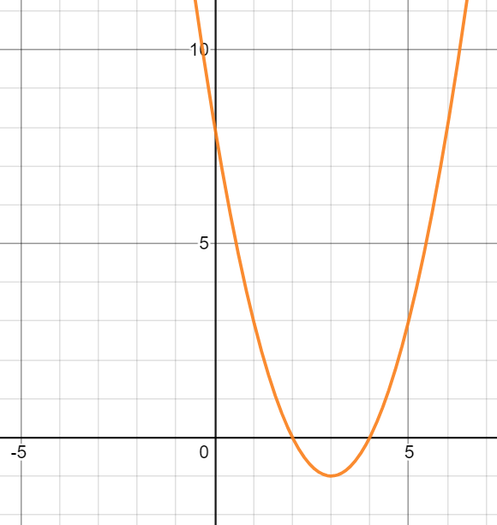
Worked Example
Your Turn
Sketch each quadratic showing the roots and y-intercept
Sketch each quadratic showing the roots and y-intercept
$$(x−1)\left(x−3\right)=0$$
$$(x−2)\left(x−4\right)=0$$
$$x^{2}−4x+3 =0$$
$$x^{2}−6x+8=0$$
$$x=1 and x=3$$
$$y−intercept at 3$$
$$Positive coefficient of x^{2}$$
x
(0,8)
(0,3)
x
x
x
x
x
(3,0)
(1,0)
(4,0)
(4,0)
@MrDraperMaths
Notes:
Worked Example development

Slide 5
Sketch each quadratic showing the roots and y-intercept
$$(x−5)\left(x−1\right)=0$$
$$\left(\frac{1}{2}x+5\right)\left(x+1\right)=0$$
$${\left(x+1\right)}^{2}=0$$
$$(x+5)\left(x−1\right)=0$$
$$\left(\frac{x}{2}+5\right)\left(x+1\right)=0$$
$${\left(x−1\right)}^{2}=0$$
$$(x+5)\left(x+1\right)=0$$
$$(2x+5)\left(x+1\right)=0$$
$${\left(1−x\right)}^{2}=0$$
$$(5+x)\left(x+1\right)=0$$
$$(2x+5)\left(\frac{1}{2}x+1\right)=0$$
$${\left(2−x\right)}^{2}=0$$
$$(5−x)\left(x+1\right)=0$$
$$x\left(\frac{1}{2}x+1\right)=0$$
$${\left(\frac{1}{2}x+1\right)}^{2}=0$$
$$(5−x)\left(1−x\right)=0$$
@MrDraperMaths
Notes:
Answer templates are on the next 4 pages. These tasks have been designed to develop noticing and fluency with recognising structurally equivalent properties of quadratic graphs from their algebraic representation.

Slide 6
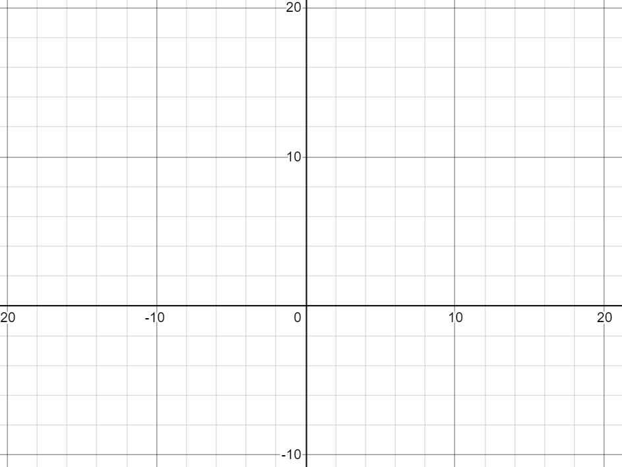
@MrDraperMaths

Slide 7
@MrDraperMaths

Slide 8
@MrDraperMaths

Slide 9
@MrDraperMaths

Slide 10
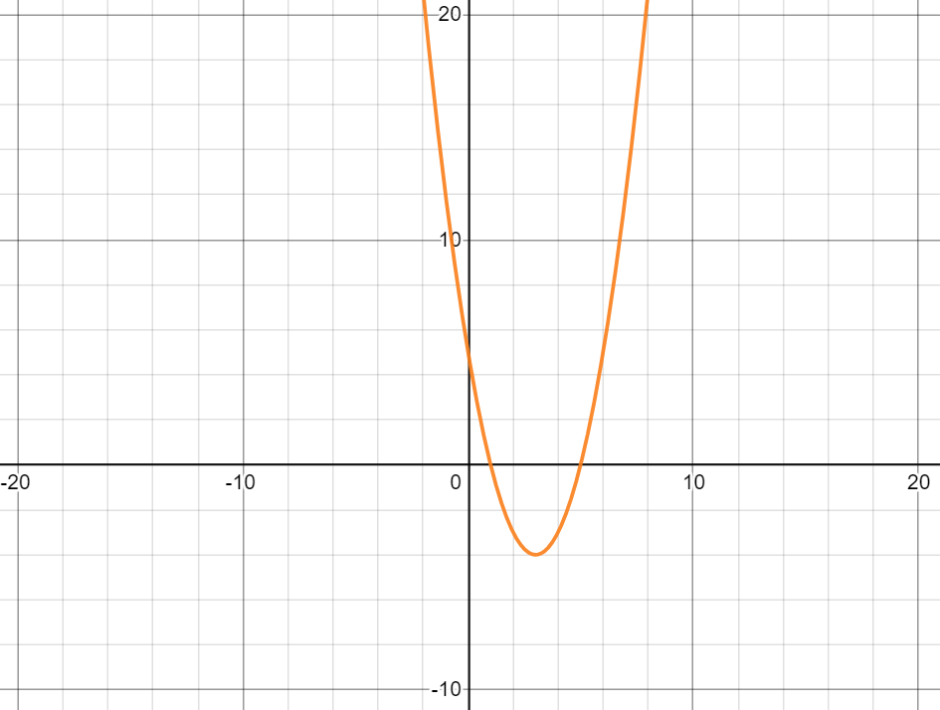
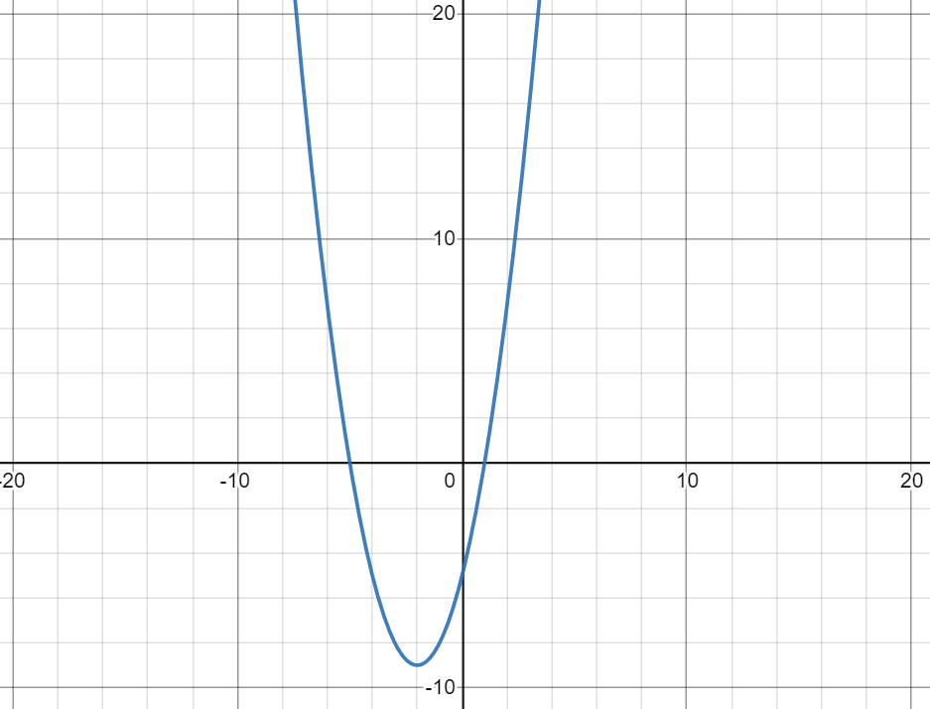
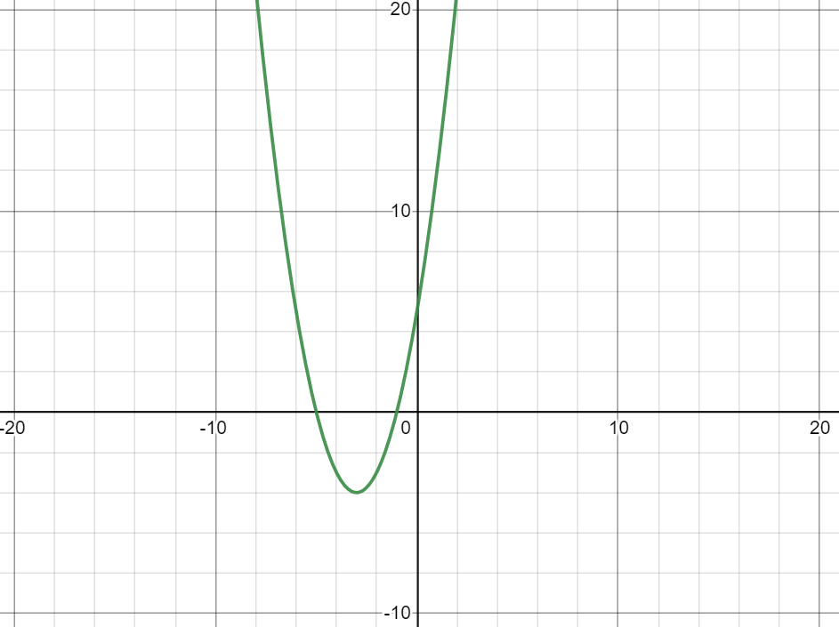
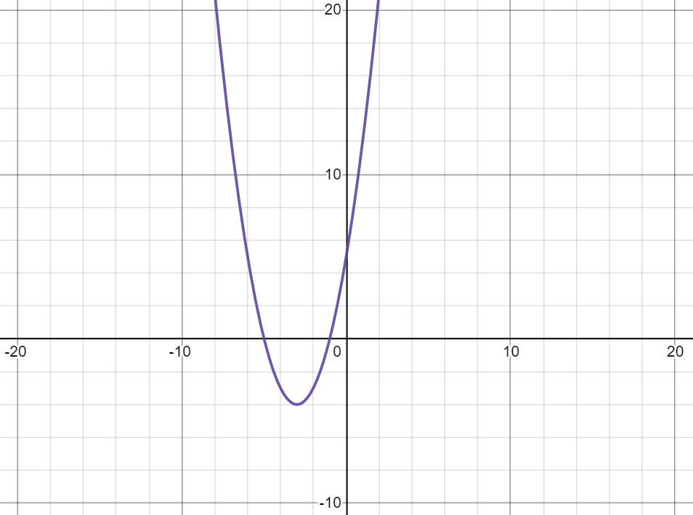
$$(x−5)\left(x−1\right)=0$$
$$(x+5)\left(x−1\right)=0$$
$(0, 5$)
$(−5, 0$)
$(1, 0$)
$(1, 0$)
$(5, 0$)
$(0, −5$)
$$(x+5)\left(x+1\right)=0$$
$$(5+x)\left(x+1\right)=0$$
$(0, 5$)
$(0, 5$)
$(−5, 0$)
$(−1, 0$)
$(−5, 0$)
$(−1, 0$)
@MrDraperMaths

Slide 11
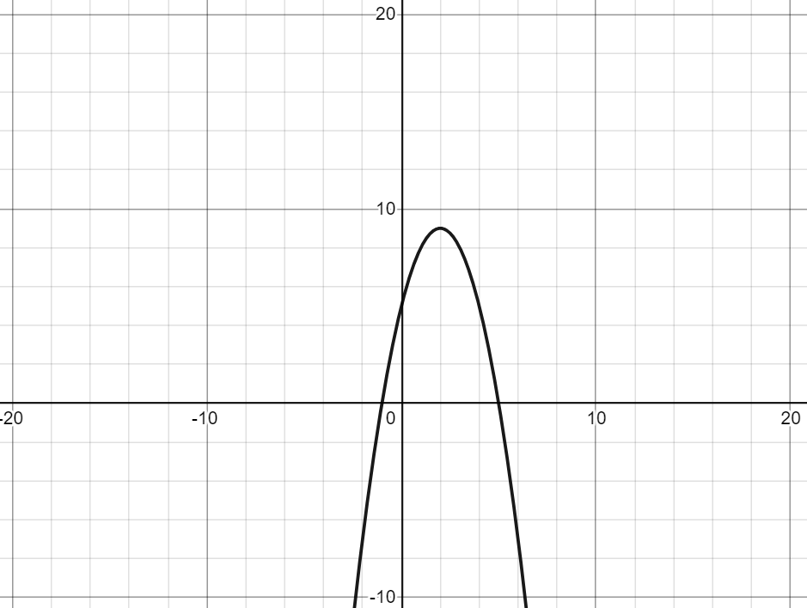
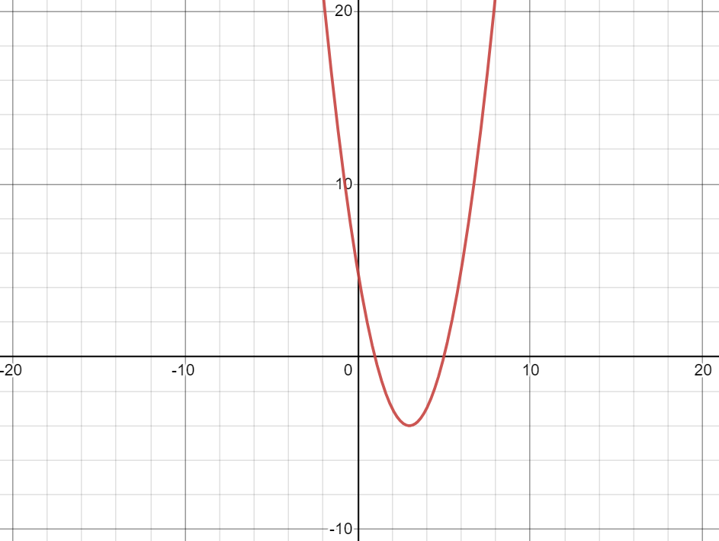
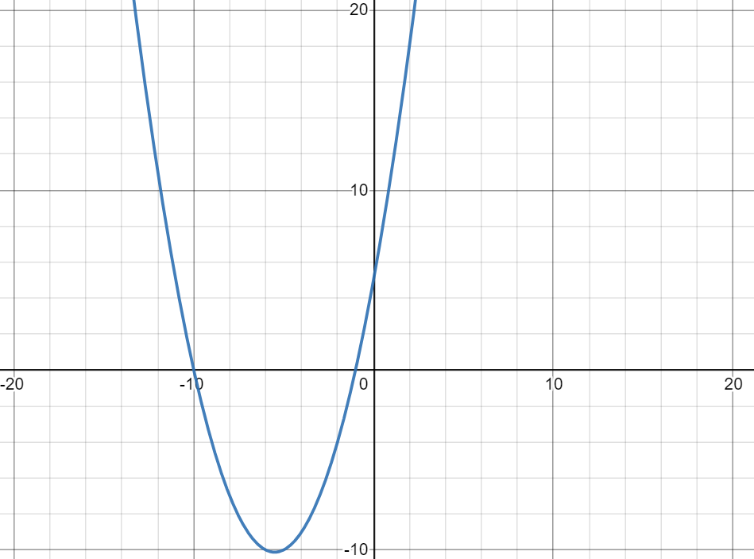
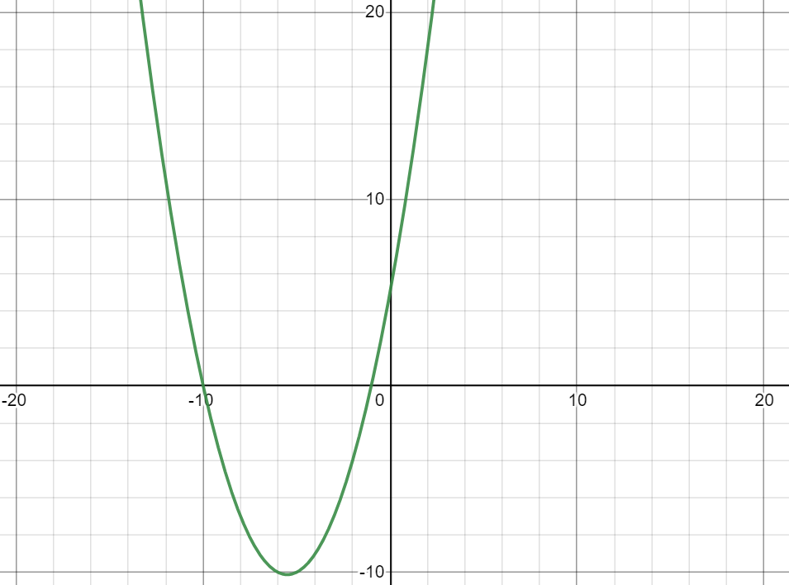
$$(5−x)\left(x+1\right)=0$$
$$(5−x)\left(1−x\right)=0$$
$(0, 5$)
$(0, 5$)
$(5, 0$)
$(−1, 0$)
$(5, 0$)
$(1, 0$)
$$\left(\frac{1}{2}x+5\right)\left(x+1\right)=0$$
$$\left(\frac{x}{2}+5\right)\left(x+1\right)=0$$
$(0, 5$)
$(0, 5$)
$(−1, 0$)
$(−10, 0$)
$(−1, 0$)
$(−10, 0$)
@MrDraperMaths

Slide 12
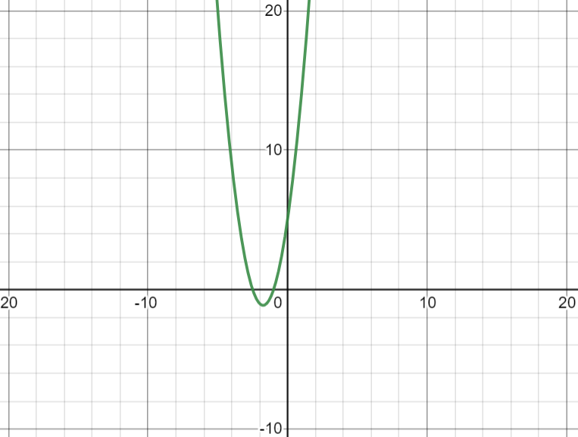
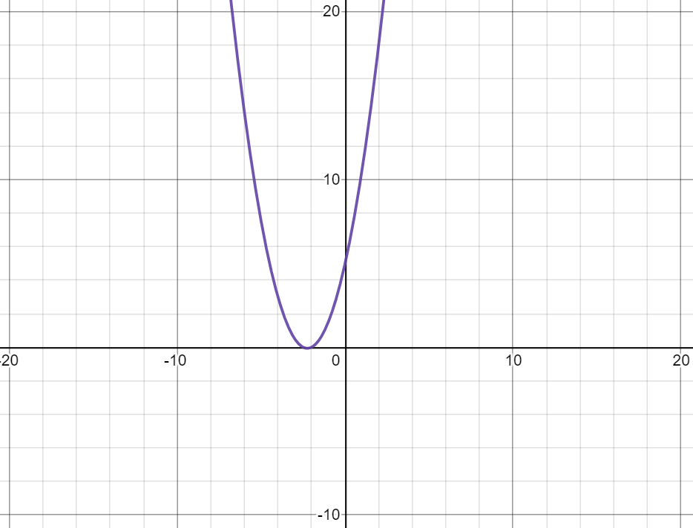
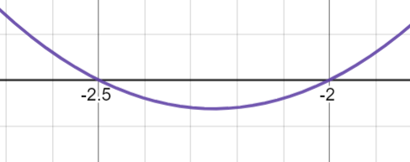
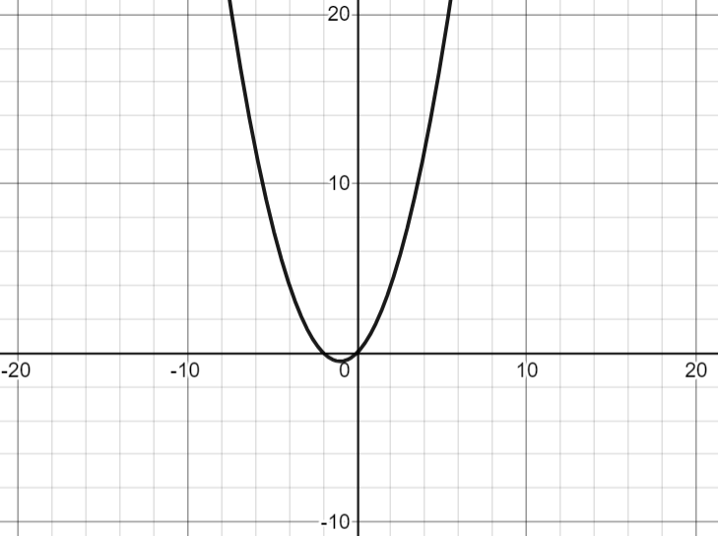
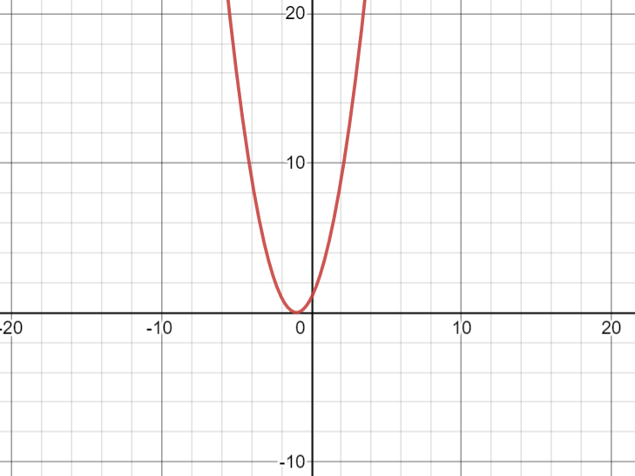
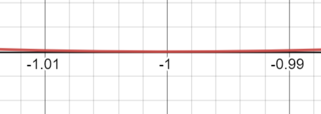


$$(2x+5)\left(\frac{1}{2}x+1\right)=0$$
$$(2x+5)\left(x+1\right)=0$$
$(0, 5$)
$(0, 5$)
$$(−\frac{5}{2}, 0)$$
$(−1, 0$)
$$(−\frac{5}{2}, 0)$$
$(−2, 0$)
$$x\left(\frac{1}{2}x+1\right)=0$$
$${\left(x+1\right)}^{2}=0$$
$(0, 0$)
$(0, 1$)
$(−2, 0$)
$(0, 0$)
$(−1, 0$)
@MrDraperMaths
Notes:
Difficult to see roots are shown zoomed in.

Slide 13
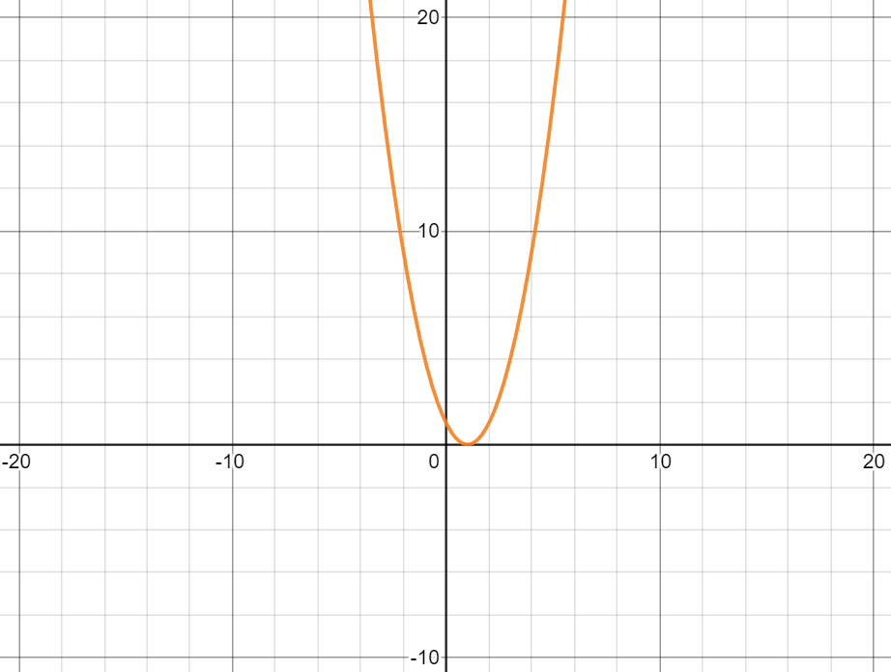
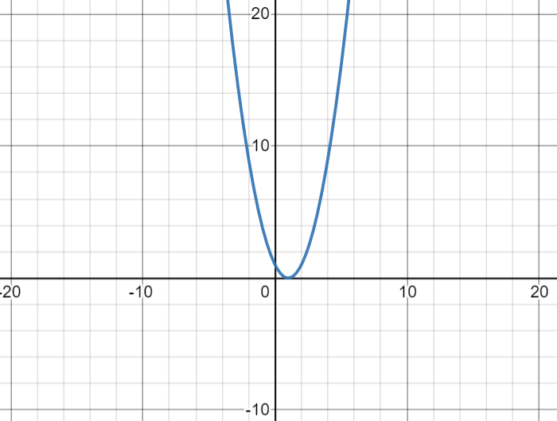
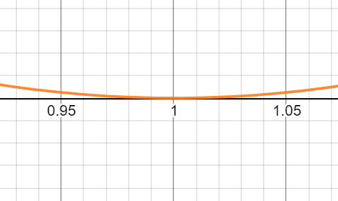
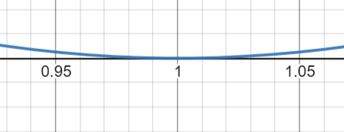
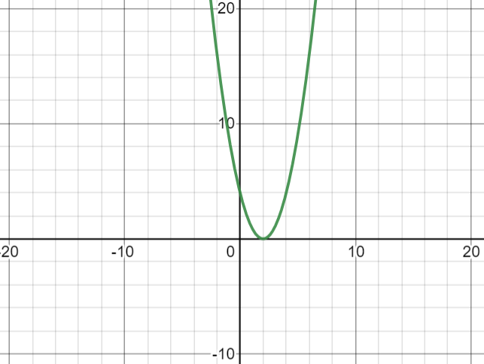
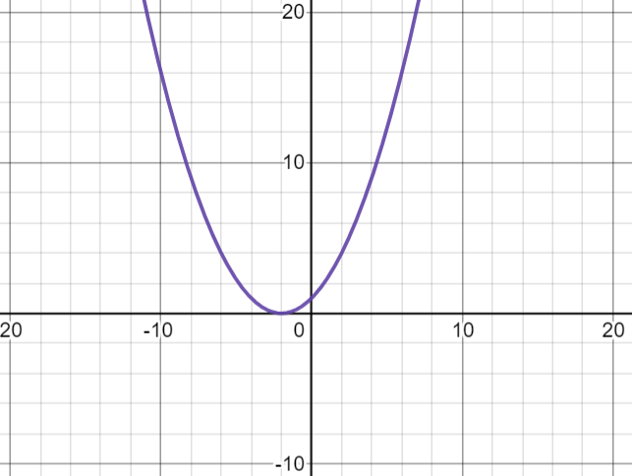

$${\left(x−1\right)}^{2}=0$$
$${\left(1−x\right)}^{2}=0$$
$(0, 1$)
$(0, 1$)
$(1, 0$)
$(1, 0$)
$${\left(\frac{1}{2}x+1\right)}^{2}=0$$
$${\left(2−x\right)}^{2}=0$$
$(0, 4$)
$(0, 1$)
$(−2, 0$)
$(2, 0$)
@MrDraperMaths
Notes:
Difficult to see roots are shown zoomed in.

