Slide 1
Rounding and Estimating: Estimating with Significant Figures
Silent
Teacher
Intelligent Practice
Narration
Your Turn
By writing each number correct to 1 significant figure, find an estimation for these calculations
$$11+12$$
$$10+10$$
=$20$
$$54−12$$
$$50−10$$
=$40$

Slide 2
Worked Example
Your Turn
By writing each number correct to 1 significant figure, find an estimation for these calculations
$$11+12$$
$$21+22$$
$$10+10$$
=$20$
$$20+20$$
=$40$
$$54−12$$
$$46−12$$
$$50−10$$
=$40$
=$40$
$$50−10$$
$$5.4−1.2$$
$$4.6−1.2$$
$$5−1$$
=$4$
=$4$
$$5−1$$
$$5.4×2.4$$
$$4.6×2.4$$
=$10$
$$5×2$$
=$10$
$$5×2$$

Slide 3
By writing each number correct to 1 significant figure, find an estimation for these calculations
1)
$$18+12$$
5)
$$4.8×1.5$$
2)
$$48+15$$
6)
$$4.8×15$$
3)
$$484+15$$
7)
$$4.8×150$$
4)
$$4.8−1.5$$
8)
$$4.88×15.5$$

Slide 4
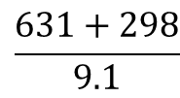
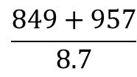
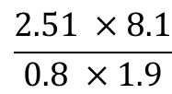
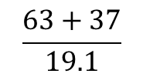
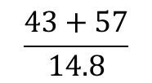
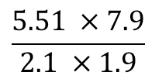
Worked Example
Your Turn
By writing each number correct to 1 significant figure, find an estimation for these calculations
$$\frac{63+37}{19.1}$$
$$\frac{43+57}{14.8}$$
$$\frac{631+298}{9.1}$$
$$\frac{849+957}{8.7}$$
$$\frac{5.51 ×7.9}{2.1 ×1.9}$$
$$\frac{2.51 ×8.1}{0.8 ×1.9}$$

Slide 5
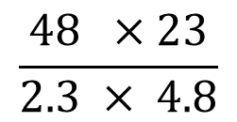
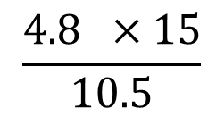
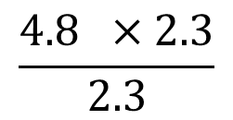
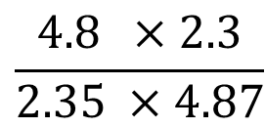
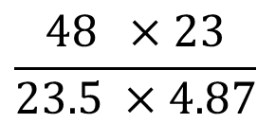
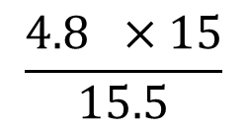
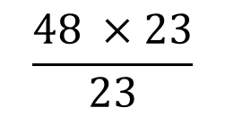
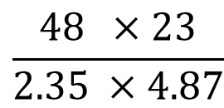
By writing each number correct to 1 significant figure, find an estimation for these calculations
1)
$$\frac{4.8 ×15}{10.5}$$
5)
$$\frac{48 ×23}{2.3 × 4.8}$$
2)
$$\frac{4.8 ×15}{15.5}$$
6)
$$\frac{48 ×23}{2.35 ×4.87}$$
3)
$$\frac{4.8 ×2.3}{2.3}$$
7)
$$\frac{48 ×23}{23.5 ×4.87}$$
4)
$$\frac{48 ×23}{23}$$
8)
$$\frac{4.8 ×2.3}{2.35 ×4.87}$$

Slide 6
By writing each number correct to 1 significant figure, find an estimation for these calculations
1)
$$18+12$$
5)
$$4.8×1.5$$
$$20+10=30$$
$$5×2=10$$
2)
$$48+15$$
6)
$$4.8×15$$
$$50+20=70$$
$5×20=100$
3)
$$484+15$$
7)
$$4.8×150$$
$500+20=520$
$5×200=1000$
4)
$$4.8−1.5$$
8)
$$4.88×15.5$$
$$5−2=3$$
$$5×20=100$$

Slide 7
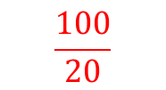
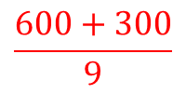
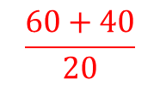
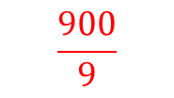
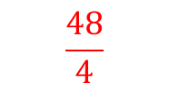
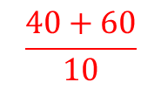
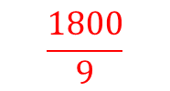
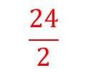
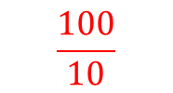
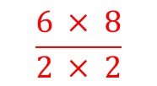
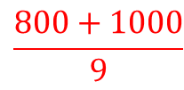
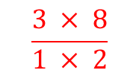
Worked Example
Your Turn
By writing each number correct to 1 significant figure, find an estimation for these calculations
$$\frac{63+37}{19.1}$$
$$\frac{60+40}{20}$$
$$\frac{100}{20}$$
$$5$$
$$\frac{43+57}{14.8}$$
$$\frac{40+60}{10}$$
$$\frac{100}{10}$$
$$10$$
$$\frac{631+298}{9.1}$$
$$\frac{600+300}{9}$$
$$\frac{900}{9}$$
$$100$$
$$\frac{849+957}{8.7}$$
$$\frac{800+1000}{9}$$
$$\frac{1800}{9}$$
$$200$$
$$\frac{5.51 ×7.9}{2.1 ×1.9}$$
$$\frac{6 × 8}{2 × 2}$$
$$\frac{48}{4}$$
$$12$$
$$\frac{2.51 ×8.1}{0.8 ×1.9}$$
$$\frac{3 × 8}{1 × 2}$$
$$\frac{24}{2}$$
$$12$$

Slide 8
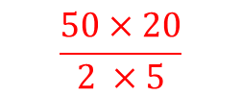
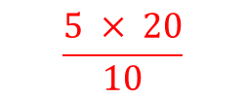
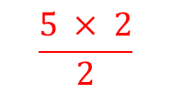
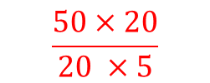
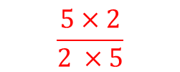
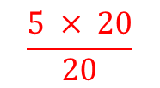
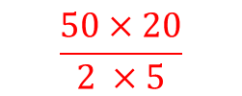
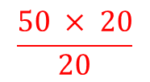
By writing each number correct to 1 significant figure, find an estimation for these calculations
1)
$$\frac{4.8 ×15}{10.5}$$
5)
$$\frac{5 × 20}{10}$$
$$\frac{48 ×23}{2.3 × 4.8}$$
$$\frac{50×20}{2 ×5}$$
$$10$$
$$100$$
2)
$$\frac{4.8 ×15}{15.5}$$
$$\frac{5 × 20}{20}$$
6)
$$\frac{48 ×23}{2.35 ×4.87}$$
$$5$$
$$\frac{50×20}{2 ×5}$$
$$100$$
3)
$$\frac{4.8 ×2.3}{2.3}$$
$$\frac{5 × 2}{2}$$
7)
$$\frac{48 ×23}{23.5 ×4.87}$$
$$5$$
$$\frac{50×20}{20 ×5}$$
$$10$$
4)
$$\frac{48 ×23}{23}$$
8)
$$\frac{4.8 ×2.3}{2.35 ×4.87}$$
$$\frac{50 × 20}{20}$$
$$50$$
$$\frac{5×2}{2 ×5}$$
$$1$$

