Slide 1
Compound Interest: Fill in the gaps
(round answers to 2 decimal places)
Silent
Teacher
Intelligent Practice
Narration
Your Turn
Yearly percentage change | Original Amount | Amount after 5 years | $$\text{Amount} \text{after}\text{ 10 }\text{years}$$
10% | £20 | £32.21 | £51.87
Practice

Slide 2
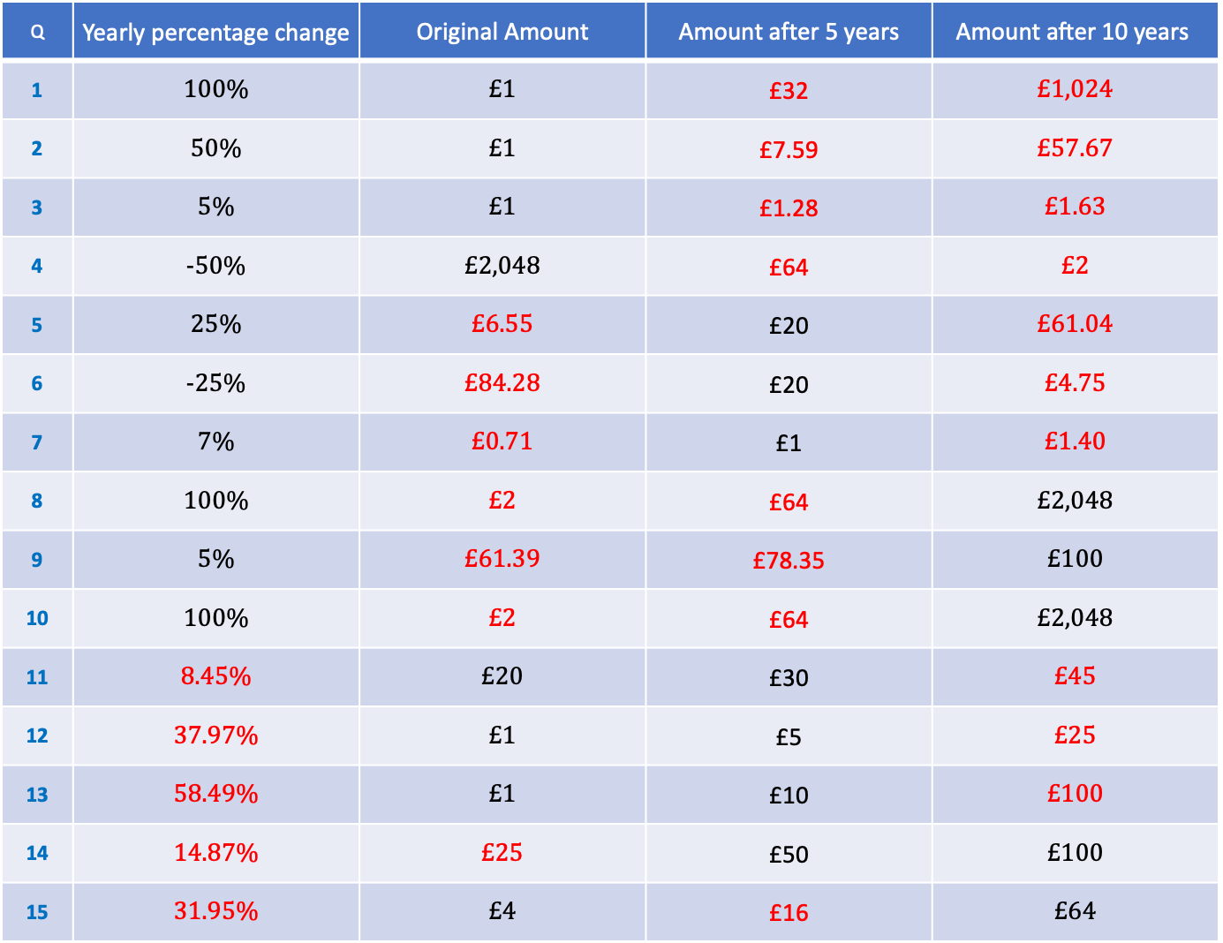
Q | Yearly percentage change | Original Amount | Amount after 5 years | $$\text{Amount} \text{after}\text{ 10 }\text{years}$$
1 | 100% | £1 | £32 | £1,024
2 | 50% | £1 | £7.59 | £57.67
3 | 5% | £1 | £1.28 | £1.63
4 | -50% | £2,048 | £64 | £2
5 | 25% | £6.55 | £20 | £61.04
6 | -25% | £84.28 | £20 | £4.75
7 | 7% | £0.71 | £1 | £1.40
8 | 100% | £2 | £64 | £2,048
9 | 5% | £61.39 | £78.35 | £100
10 | 100% | £2 | £64 | £2,048
11 | 8.45% | £20 | £30 | £45
12 | 37.97% | £1 | £5 | £25
13 | 58.49% | £1 | £10 | £100
14 | 14.87% | £25 | £50 | £100
15 | 31.95% | £4 | £16 | £64

Slide 3
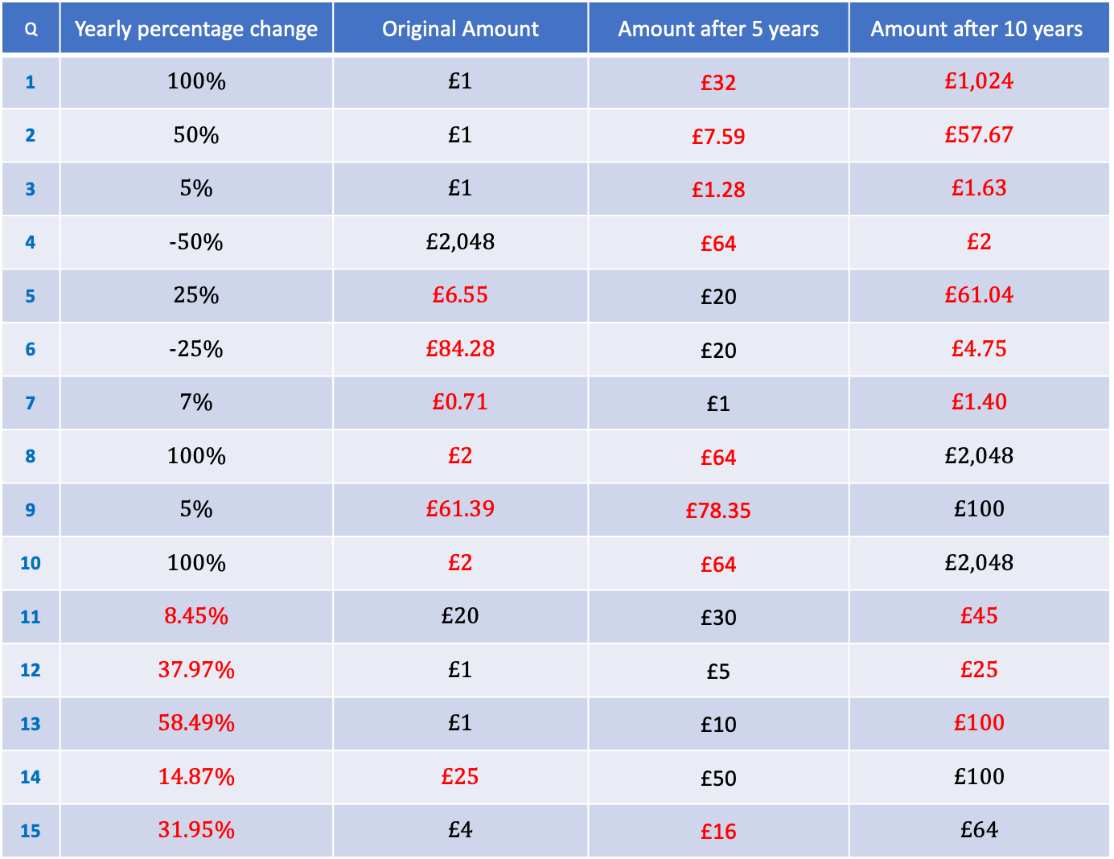
Q | Yearly percentage change | Original Amount | Amount after 5 years | $$\text{Amount} \text{after}\text{ 10 }\text{years}$$
1 | 100% | £1 | £32 | £1,024
2 | 50% | £1 | £7.59 | £57.67
3 | 5% | £1 | £1.28 | £1.63
4 | -50% | £2,048 | £64 | £2
5 | 25% | £6.55 | £20 | £61.04
6 | -25% | £84.28 | £20 | £4.75
7 | 7% | £0.71 | £1 | £1.40
8 | 100% | £2 | £64 | £2,048
9 | 5% | £61.39 | £78.35 | £100
10 | 100% | £2 | £64 | £2,048
11 | 8.45% | £20 | £30 | £45
12 | 37.97% | £1 | £5 | £25
13 | 58.49% | £1 | £10 | £100
14 | 14.87% | £25 | £50 | £100
15 | 31.95% | £4 | £16 | £64

