Slide 1
Limiting value of a sequence
Silent
Teacher
Intelligent Practice
Narration
Your Turn
$$As n→∞, \frac{1}{n}→ ?$$
$$As n→∞, \frac{2n+3}{5n}→ ?$$
Practice

Slide 2


Worked Example
Your Turn
As $n→∞$:
As $n→∞$:
$$\frac{5}{n}→$$
$$\frac{3n^{2}}{n}→$$
$$\frac{4n}{3n+1}→$$
$$\frac{8}{n}→$$
$$\frac{n^{2}}{n}→$$
$$\frac{7n}{2n+1}→$$
@DCol_Maths

Slide 3

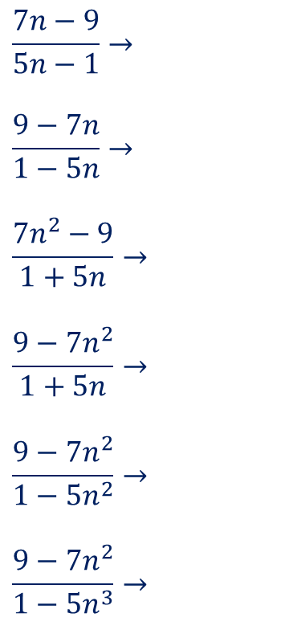
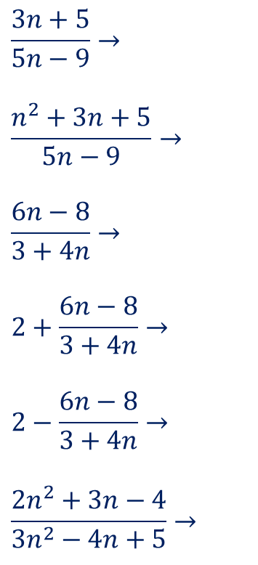
As $n→∞$:
$$\frac{1}{n}→$$
$$\frac{2}{3n}→$$
$$\frac{2n}{3n}→$$
$$\frac{2n^{2}}{3n}→$$
$$\frac{7n}{5n+1}→$$
$$\frac{7n+8}{5n−1}→$$
$$\frac{7n−9}{5n−1}→$$
$$\frac{9−7n}{1−5n}→$$
$$\frac{7n^{2}−9}{1+5n}→$$
$$\frac{9−7n^{2}}{1+5n}→$$
$$\frac{9−7n^{2}}{1−5n^{2}}→$$
$$\frac{9−7n^{2}}{1−5n^{3}}→$$
$$\frac{3n+5}{5n−9}→$$
$$\frac{n^{2}+3n+5}{5n−9}→$$
$$\frac{6n−8}{3+4n}→$$
$$2+\frac{6n−8}{3+4n}→$$
$$2−\frac{6n−8}{3+4n}→$$
$$\frac{2n^{2}+3n−4}{3n^{2}−4n+5}→$$
@DCol_Maths

Slide 4
As $n→∞$:
$$\frac{1}{n}→$$
$$\frac{2}{3n}→$$
$$\frac{2n}{3n}→$$
$$\frac{2n^{2}}{3n}→$$
$$\frac{7n}{5n+1}→$$
$$\frac{7n+8}{5n−1}→$$
$$\frac{7n−9}{5n−1}→$$
$$\frac{9−7n}{1−5n}→$$
$$\frac{7n^{2}−9}{1+5n}→$$
$$\frac{9−7n^{2}}{1+5n}→$$
$$\frac{9−7n^{2}}{1−5n^{2}}→$$
$$\frac{9−7n^{2}}{1−5n^{3}}→$$
$$\frac{7}{5}$$
$$\frac{7}{5}$$
$$∞$$
$$−∞$$
$$\frac{7}{5}$$
0
$$\frac{3}{5}$$
$$∞$$
$$\frac{3}{2}$$
$$\frac{7}{2}$$
$$\frac{1}{2}$$
$$\frac{2}{3}$$
0
0
$$\frac{2}{3}$$
$$∞$$
$$\frac{7}{5}$$
$$\frac{7}{5}$$
$$\frac{3n+5}{5n−9}→$$
$$\frac{n^{2}+3n+5}{5n−9}→$$
$$\frac{6n−8}{3+4n}→$$
$$2+\frac{6n−8}{3+4n}→$$
$$2−\frac{6n−8}{3+4n}→$$
$$\frac{2n^{2}+3n−4}{3n^{2}−4n+5}→$$
@DCol_Maths

