Slide 1
Complete a Frequency Tree
Silent
Teacher
Intelligent Practice
Narration
Your Turn
Visit
Gender
Field
25
Girl
30
River
5
60
Field
15
Boy
30
Practice
River
15

Slide 2
Teacher example
Your turn
Complete the frequency tree below
Complete the frequency tree below
Visit
Visit
Gender
Field
Gender
Field
25
10
Girl
30
Girl
40
River
5
30
River
50
100
Field
5
Field
45
Boy
Boy
20
60
River
15
River
15

Slide 3
Complete the frequency trees below
Visit
Visit
1.
2.
Gender
Field
Gender
Field
1
49
Girl
50
Girl
River
9
River
50
Field
Field
19
25
Boy
Boy
50
River
River

Slide 4
Complete the frequency trees below
Visit
Visit
1.
2.
Gender
Field
Gender
Field
1
49
Girl
50
Girl
10
1
River
9
River
100
50
Field
Field
19
25
Boy
Boy
50
40
River
25
River
21

Slide 5
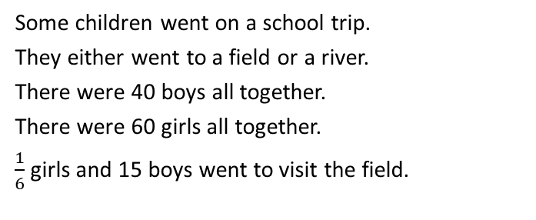
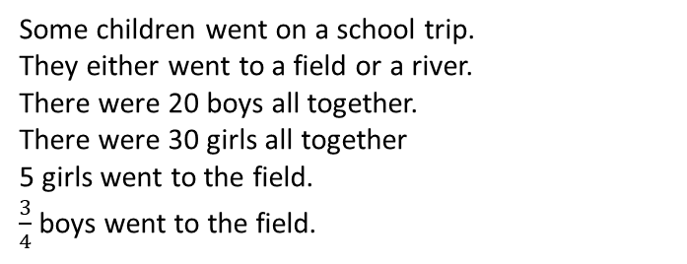
Teacher example
Your turn
Use the information to complete the frequency tree
Use the information to complete the frequency tree
Visit
Visit
Gender
Field
5
Gender
Field
10
Girl
30
Girl
60
River
25
50
River
50
100
Field
15
Field
15
Boy
20
Boy
40
River
5
25
River
Some children went on a school trip.
They either went to a field or a river.
There were 20 boys all together.
There were 30 girls all together
5 girls went to the field.
$\frac{3}{4}$ boys went to the field.
Some children went on a school trip.
They either went to a field or a river.
There were 40 boys all together.
There were 60 girls all together.
$\frac{1}{6}$ girls and 15 boys went to visit the field.

Slide 6
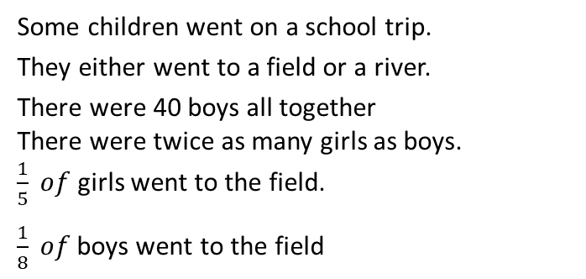
Use the information to complete the frequency trees
1.
2.
Visit
Visit
Gender
Field
Gender
Field
Girl
40
Girl
River
River
Field
Field
Boy
Boy
40
River
River
Some children went on a school trip.
They either went to a field or a river.
There were 40 girls all together
There were half as many girls as boys.
One quarter of girls went to the field.
Three quarter of boys went to the field.
Some children went on a school trip.
They either went to a field or a river.
There were 40 boys all together
There were twice as many girls as boys.
$\frac{1}{5} of$ girls went to the field.
$\frac{1}{8} of$boys went to the field

Slide 7
Use the information to complete the frequency trees
1.
2.
Visit
Visit
Gender
Field
10
Gender
Field
16
Girl
40
Girl
80
River
30
64
River
120
120
Field
60
Field
5
Boy
80
Boy
40
River
20
35
River
Some children went on a school trip.
They either went to a field or a river.
There were 40 girls all together
There were half as many girls as boys.
One quarter of girls went to the field.
Three quarter of boys went to the field.
Some children went on a school trip.
They either went to a field or a river.
There were 40 boys all together
There were twice as many girls as boys.
$\frac{1}{5} of$ girls went to the field.
$\frac{1}{8} of$boys went to the field

Slide 8
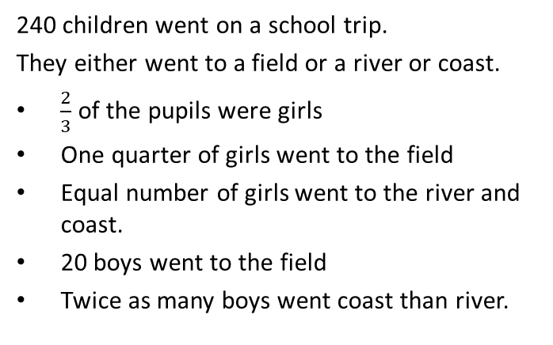
Use the information to complete the frequency trees
3.
240 children went on a school trip.
They either went to a field or a river or coast.
$\frac{2}{3}$ of the pupils were girls
One quarter of girls went to the field
Equal number of girls went to the river and coast.
20 boys went to the field
Twice as many boys went coast than river.
Visit
Gender
Field
River
Coast
Girl
240
Field
Boy
River
Coast

Slide 9
Use the information to complete the frequency trees
3.
240 children went on a school trip.
They either went to a field or a river or coast.
$\frac{2}{3}$ of the pupils were girls
One quarter of girls went to the field
Equal number of girls went to the river and coast.
20 boys went to the field
Twice as many boys went coast than river.
Visit
Field
40
Gender
160
River
60
Coast
Girl
60
240
Field
20
Boy
River
80
20
Coast
40

