Slide 1
Rearranging formula: Fill in the gaps
Silent
Teacher
Intelligent Practice
Narration
Your Turn
$$a=b+c$$
Practice

Slide 2
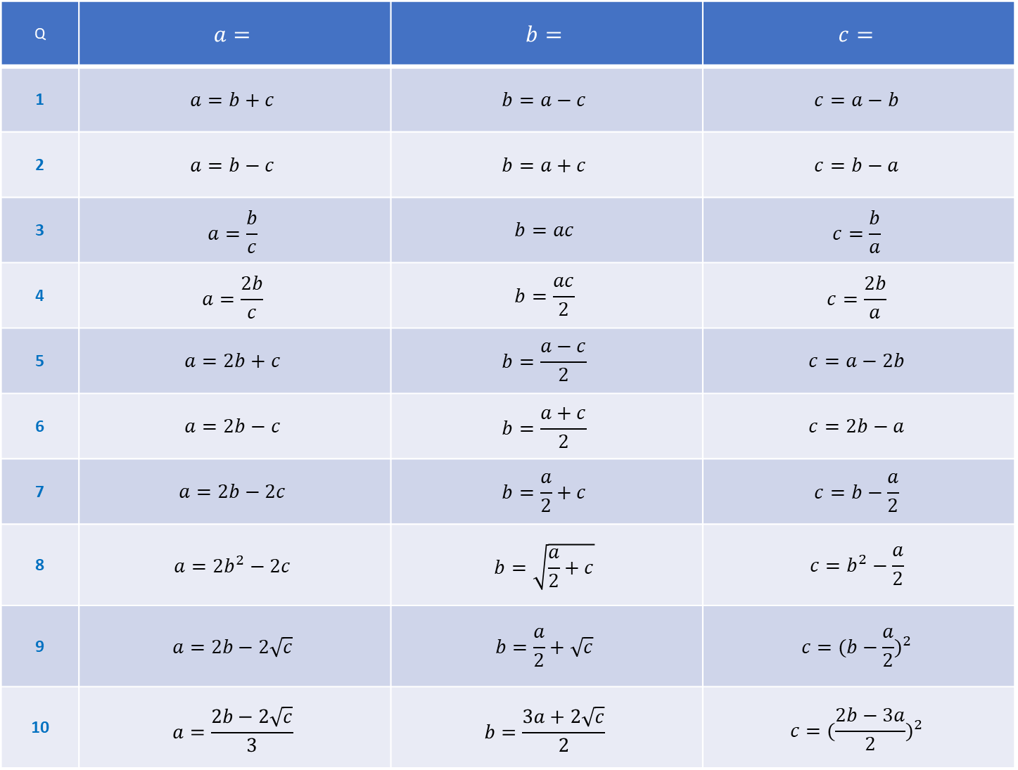
Q | $$a=$$ | $$b=$$ | $$c=$$
1 | $$a=b+c$$ | $$b=a−c$$ | $$c=a−b$$
2 | $$a=b−c$$ | $$b=a+c$$ | $$c=b−a$$
3 | $$a=\frac{b}{c}$$ | $$b=ac$$ | $$c=\frac{b}{a}$$
4 | $$a=\frac{2b}{c}$$ | $$b=\frac{ac}{2}$$ | $$c=\frac{2b}{a}$$
5 | $$a=2b+c$$ | $$b=\frac{a−c}{2}$$ | $$c=a−2b$$
6 | $$a=2b−c$$ | $$b=\frac{a+c}{2}$$ | $$c=2b−a$$
7 | $$a=2b−2c$$ | $$b=\frac{a}{2}+c$$ | $$c=b−\frac{a}{2}$$
8 | $$a=2b^{2}−2c$$ | $$b=\sqrt{\frac{a}{2}+c}$$ | $$c=b^{2}−\frac{a}{2}$$
9 | $$a=2b−2\sqrt{c}$$ | $$b=\frac{a}{2}+\sqrt{c}$$ | $$c={(b−\frac{a}{2})}^{2}$$
10 | $$a=\frac{2b−2\sqrt{c}}{3}$$ | $$b=\frac{3a+2\sqrt{c}}{2}$$ | $$c={(\frac{2b−3a}{2})}^{2}$$

Slide 3
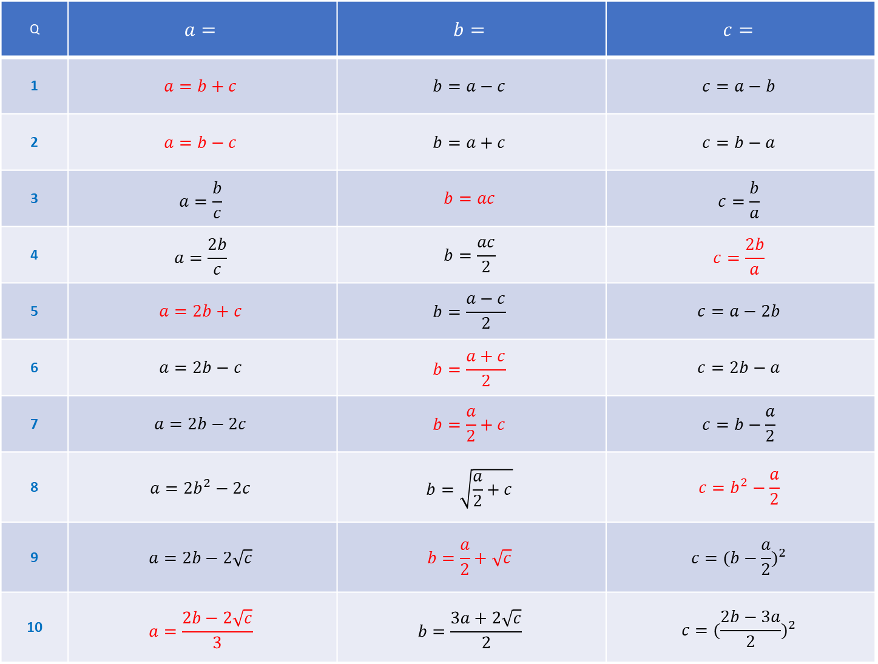
Q | $$a=$$ | $$b=$$ | $$c=$$
1 | $$a=b+c$$ | $$b=a−c$$ | $$c=a−b$$
2 | $$a=b−c$$ | $$b=a+c$$ | $$c=b−a$$
3 | $$a=\frac{b}{c}$$ | $$b=ac$$ | $$c=\frac{b}{a}$$
4 | $$a=\frac{2b}{c}$$ | $$b=\frac{ac}{2}$$ | $$c=\frac{2b}{a}$$
5 | $$a=2b+c$$ | $$b=\frac{a−c}{2}$$ | $$c=a−2b$$
6 | $$a=2b−c$$ | $$b=\frac{a+c}{2}$$ | $$c=2b−a$$
7 | $$a=2b−2c$$ | $$b=\frac{a}{2}+c$$ | $$c=b−\frac{a}{2}$$
8 | $$a=2b^{2}−2c$$ | $$b=\sqrt{\frac{a}{2}+c}$$ | $$c=b^{2}−\frac{a}{2}$$
9 | $$a=2b−2\sqrt{c}$$ | $$b=\frac{a}{2}+\sqrt{c}$$ | $$c={(b−\frac{a}{2})}^{2}$$
10 | $$a=\frac{2b−2\sqrt{c}}{3}$$ | $$b=\frac{3a+2\sqrt{c}}{2}$$ | $$c={(\frac{2b−3a}{2})}^{2}$$

