Slide 1
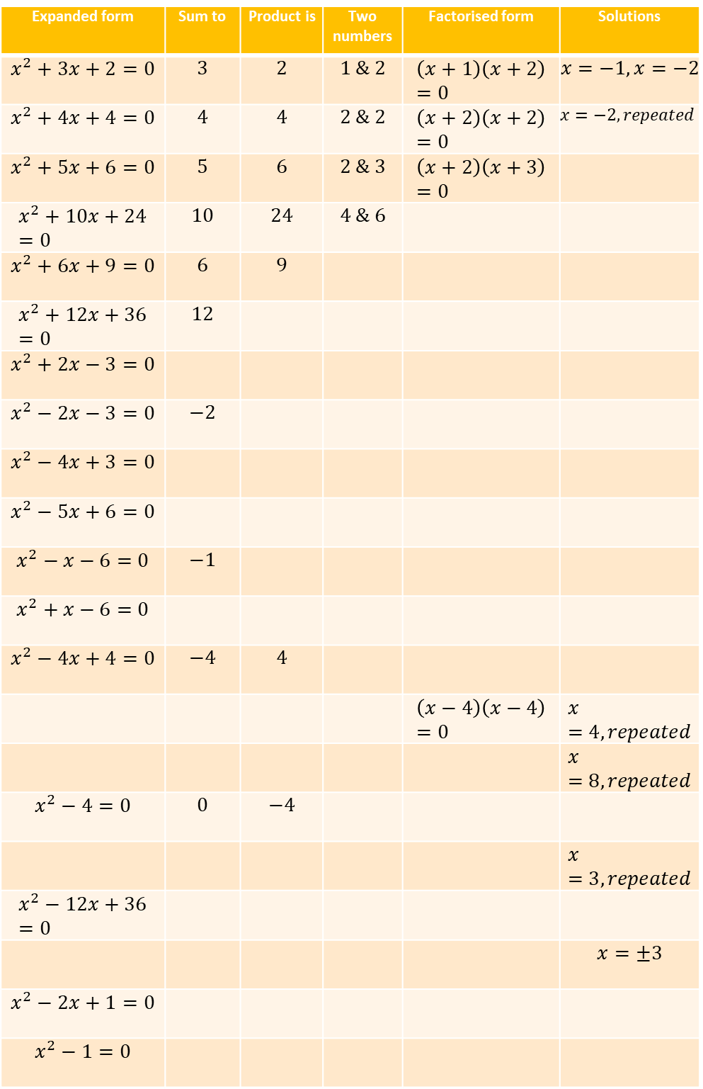
Expanded form | Sum to | Product is | Two numbers | Factorised form | Solutions
$$x^{2}+3x+2=0$$ | $$3$$ | $$2$$ | $$1 \& 2$$ | $$\left(x+1\right)\left(x+2\right)=0$$ | $$x=−1, x=−2$$
$$x^{2}+4x+4=0$$ | $$4$$ | $$4$$ | $$2 \& 2$$ | $$\left(x+2\right)\left(x+2\right)=0$$ | $$x=−2, repeated$$
$$x^{2}+5x+6=0$$ | $$5$$ | $$6$$ | $$2 \& 3$$ | $$\left(x+2\right)\left(x+3\right)=0$$
$$x^{2}+10x+24=0$$ | $$10$$ | $$24$$ | $$4 \& 6$$
$$x^{2}+6x+9=0$$ | $$6$$ | $$9$$
$$x^{2}+12x+36=0$$ | $$12$$
$$x^{2}+2x−3=0$$
$$x^{2}−2x−3=0$$ | $$−2$$
$$x^{2}−4x+3=0$$
$$x^{2}−5x+6=0$$
$$x^{2}−x−6=0$$ | $$−1$$
$$x^{2}+x−6=0$$
$$x^{2}−4x+4=0$$ | $$−4$$ | $$4$$
 |  |  |  | $$\left(x−4\right)\left(x−4\right)=0$$ | $$x=4, repeated$$
 |  |  |  |  | $$x=8, repeated$$
$$x^{2}−4=0$$ | $$0$$ | $$−4$$
 |  |  |  |  | $$x=3, repeated$$
$$x^{2}−12x+36=0$$
 |  |  |  |  | $$x=±3$$
$$x^{2}−2x+1=0$$
$$x^{2}−1=0$$
1
2
3
4
5
6
7
8
9
10
11
12
13
14
15
16
17
18
19
20
21
@dare_richard

Slide 2
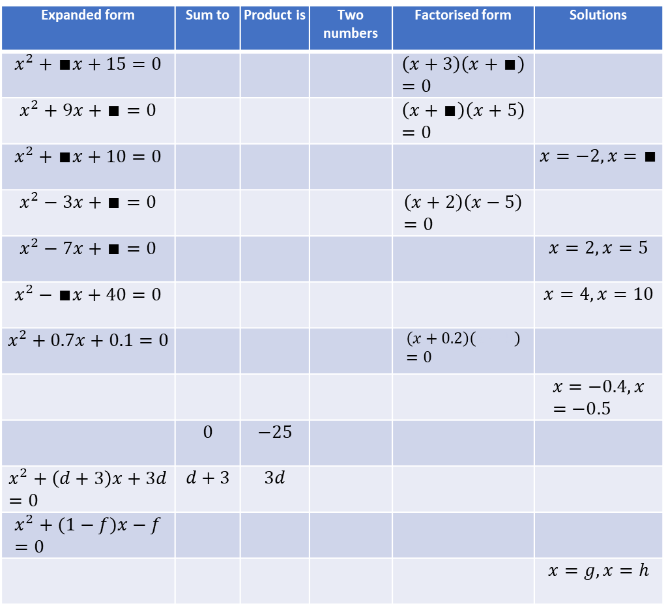
Expanded form | Sum to | Product is | Two numbers | Factorised form | Solutions
$$x^{2}+∎x+15=0$$ |  |  |  | $$\left(x+3\right)\left(x+∎\right)=0$$
$$x^{2}+9x+∎=0$$ |  |  |  | $$\left(x+∎\right)\left(x+5\right)=0$$
$$x^{2}+∎x+10=0$$ |  |  |  |  | $$x=−2,x=∎$$
$$x^{2}−3x+∎=0$$ |  |  |  | $$\left(x+2\right)\left(x−5\right)=0$$
$$x^{2}−7x+∎=0$$ |  |  |  |  | $$x=2, x=5$$
$$x^{2}−∎x+40=0$$ |  |  |  |  | $$x=4, x=10$$
$$x^{2}+0.7x+0.1=0$$ |  |  |  | $$\left(x+0.2\right)\left(x−5\right)=0$$
 |  |  |  |  | $$x=−0.4, x=−0.5$$
 | $$0$$ | $$−25$$
$$x^{2}+\left(d+3\right)x+3d=0$$ | $$d+3$$ | $$3d$$
$$x^{2}+(1−f)x−f=0$$
 |  |  |  |  | $$x=g, x=h$$
1
2
3
4
5
6
7
8
9
10
11
12
@dare_richard

Slide 3
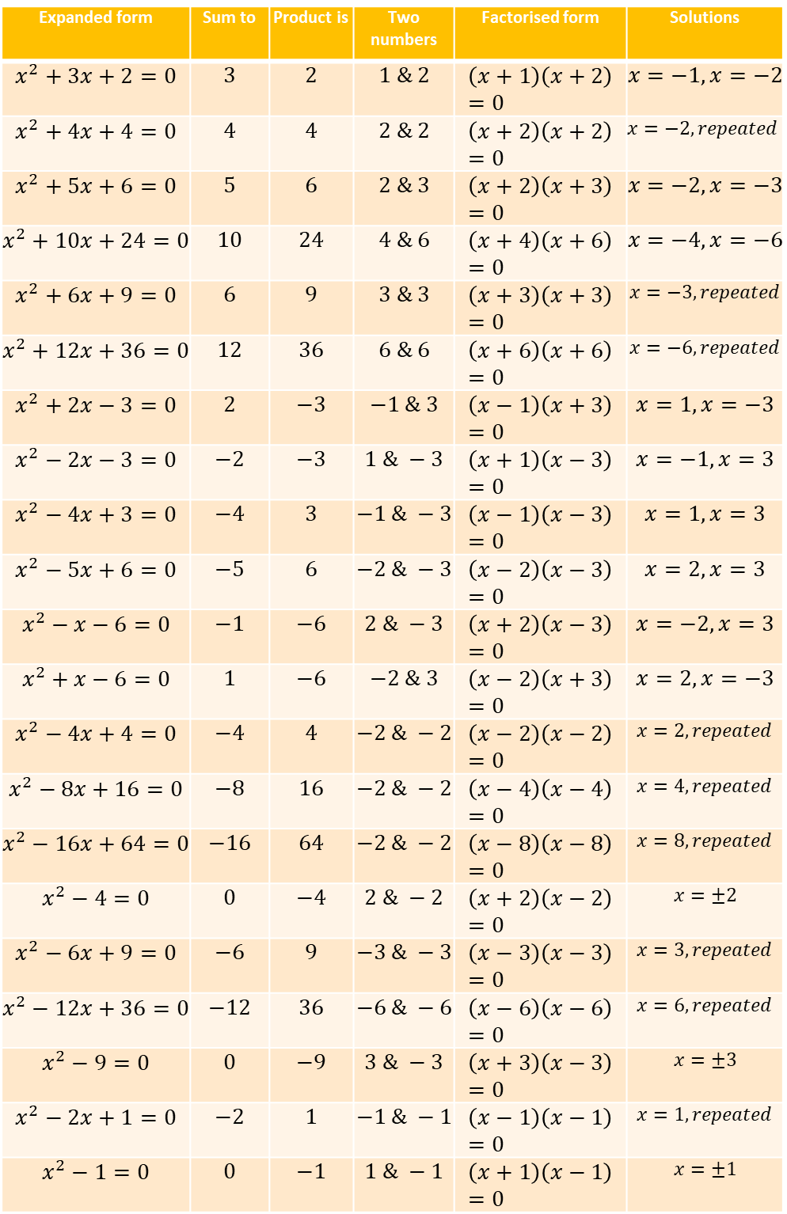
Expanded form | Sum to | Product is | Two numbers | Factorised form | Solutions
$$x^{2}+3x+2=0$$ | $$3$$ | $$2$$ | $$1 \& 2$$ | $$\left(x+1\right)\left(x+2\right)=0$$ | $$x=−1, x=−2$$
$$x^{2}+4x+4=0$$ | $$4$$ | $$4$$ | $$2 \& 2$$ | $$\left(x+2\right)\left(x+2\right)=0$$ | $$x=−2, repeated$$
$$x^{2}+5x+6=0$$ | $$5$$ | $$6$$ | $$2 \& 3$$ | $$\left(x+2\right)\left(x+3\right)=0$$ | $$x=−2, x=−3$$
$$x^{2}+10x+24=0$$ | $$10$$ | $$24$$ | $$4 \& 6$$ | $$\left(x+4\right)\left(x+6\right)=0$$ | $$x=−4, x=−6$$
$$x^{2}+6x+9=0$$ | $$6$$ | $$9$$ | $$3 \& 3$$ | $$\left(x+3\right)\left(x+3\right)=0$$ | $$x=−3, repeated$$
$$x^{2}+12x+36=0$$ | $$12$$ | $$36$$ | $$6 \& 6$$ | $$\left(x+6\right)\left(x+6\right)=0$$ | $$x=−6, repeated$$
$$x^{2}+2x−3=0$$ | $$2$$ | $$−3$$ | $$−1 \& 3$$ | $$\left(x−1\right)\left(x+3\right)=0$$ | $$x=1, x=−3$$
$$x^{2}−2x−3=0$$ | $$−2$$ | $$−3$$ | $$1 \& −3$$ | $$\left(x+1\right)\left(x−3\right)=0$$ | $$x=−1, x=3$$
$$x^{2}−4x+3=0$$ | $$−4$$ | $$3$$ | $$−1 \& −3$$ | $$\left(x−1\right)\left(x−3\right)=0$$ | $$x=1, x=3$$
$$x^{2}−5x+6=0$$ | $$−5$$ | $$6$$ | $$−2 \& −3$$ | $$\left(x−2\right)\left(x−3\right)=0$$ | $$x=2, x=3$$
$$x^{2}−x−6=0$$ | $$−1$$ | $$−6$$ | $$2 \& −3$$ | $$\left(x+2\right)\left(x−3\right)=0$$ | $$x=−2, x=3$$
$$x^{2}+x−6=0$$ | $$1$$ | $$−6$$ | $$−2 \& 3$$ | $$\left(x−2\right)\left(x+3\right)=0$$ | $$x=2, x=−3$$
$$x^{2}−4x+4=0$$ | $$−4$$ | $$4$$ | $$−2 \& −2$$ | $$\left(x−2\right)\left(x−2\right)=0$$ | $$x=2, repeated$$
$$x^{2}−8x+16=0$$ | $$−8$$ | $$16$$ | $$−2 \& −2$$ | $$\left(x−4\right)\left(x−4\right)=0$$ | $$x=4, repeated$$
$$x^{2}−16x+64=0$$ | $$−16$$ | $$64$$ | $$−2 \& −2$$ | $$\left(x−8\right)\left(x−8\right)=0$$ | $$x=8, repeated$$
$$x^{2}−4=0$$ | $$0$$ | $$−4$$ | $$2 \& −2$$ | $$\left(x+2\right)\left(x−2\right)=0$$ | $$x=±2$$
$$x^{2}−6x+9=0$$ | $$−6$$ | $$9$$ | $$−3 \& −3$$ | $$\left(x−3\right)\left(x−3\right)=0$$ | $$x=3, repeated$$
$$x^{2}−12x+36=0$$ | $$−12$$ | $$36$$ | $$−6 \& −6$$ | $$\left(x−6\right)\left(x−6\right)=0$$ | $$x=6, repeated$$
$$x^{2}−9=0$$ | $$0$$ | $$−9$$ | $$3 \& −3$$ | $$\left(x+3\right)\left(x−3\right)=0$$ | $$x=±3$$
$$x^{2}−2x+1=0$$ | $$−2$$ | $$1$$ | $$−1 \& −1$$ | $$\left(x−1\right)\left(x−1\right)=0$$ | $$x=1, repeated$$
$$x^{2}−1=0$$ | $$0$$ | $$−1$$ | $$1 \& −1$$ | $$\left(x+1\right)\left(x−1\right)=0$$ | $$x=±1$$
1
2
3
4
5
6
7
8
9
10
11
12
13
14
15
16
17
18
19
20
21
@dare_richard

Slide 4
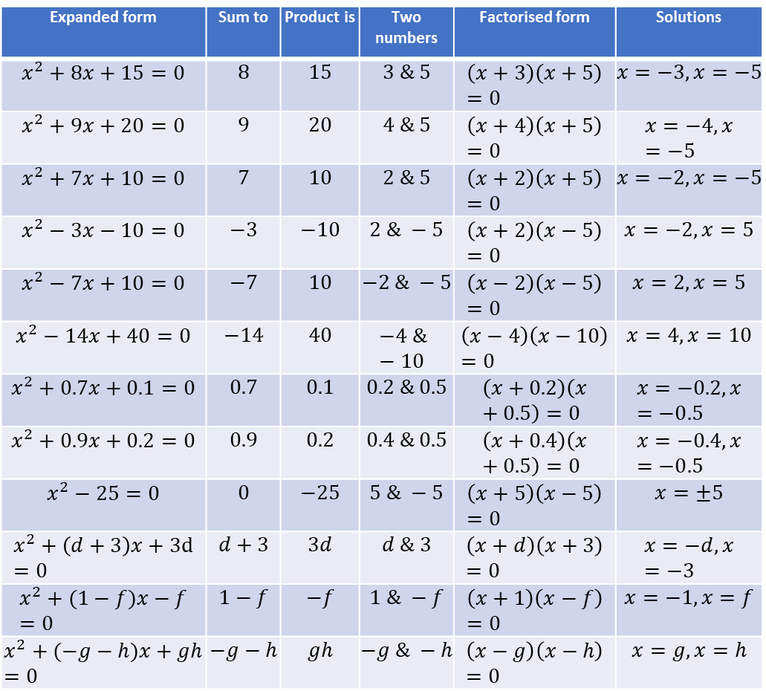
Expanded form | Sum to | Product is | Two numbers | Factorised form | Solutions
$$x^{2}+8x+15=0$$ | $$8$$ | $$15$$ | $$3 \& 5$$ | $$\left(x+3\right)\left(x+5\right)=0$$ | $$x=−3, x=−5$$
$$x^{2}+9x+20=0$$ | $$9$$ | $$20$$ | $$4 \& 5$$ | $$\left(x+4\right)\left(x+5\right)=0$$ | $$x=−4, x=−5$$
$$x^{2}+7x+10=0$$ | $$7$$ | $$10$$ | $$2 \& 5$$ | $$\left(x+2\right)\left(x+5\right)=0$$ | $$x=−2, x=−5$$
$$x^{2}−3x−10=0$$ | $$−3$$ | $$−10$$ | $$2 \& −5$$ | $$\left(x+2\right)\left(x−5\right)=0$$ | $$x=−2, x=5$$
$$x^{2}−7x+10=0$$ | $$−7$$ | $$10$$ | $$−2 \& −5$$ | $$\left(x−2\right)\left(x−5\right)=0$$ | $$x=2, x=5$$
$$x^{2}−14x+40=0$$ | $$−14$$ | $$40$$ | $$−4 \& −10$$ | $$\left(x−4\right)\left(x−10\right)=0$$ | $$x=4, x=10$$
$$x^{2}+0.7x+0.1=0$$ | $$0.7$$ | $$0.1$$ | $$0.2 \& 0.5$$ | $$\left(x+0.2\right)\left(x+0.5\right)=0$$ | $$x=−0.2, x=−0.5$$
$$x^{2}+0.9x+0.2=0$$ | $$0.9$$ | $$0.2$$ | $$0.4 \& 0.5$$ | $$\left(x+0.4\right)\left(x+0.5\right)=0$$ | $$x=−0.4, x=−0.5$$
$$x^{2}−25=0$$ | $$0$$ | $$−25$$ | $$5 \& −5$$ | $$\left(x+5\right)\left(x−5\right)=0$$ | $$x=±5$$
$$x^{2}+\left(d+3\right)x+3d=0$$ | $$d+3$$ | $$3d$$ | $$d \& 3$$ | $$\left(x+d\right)\left(x+3\right)=0$$ | $$x=−d, x=−3$$
$$x^{2}+(1−f)x−f=0$$ | $$1−f$$ | $$−f$$ | $$1 \& −f$$ | $$\left(x+1\right)\left(x−f\right)=0$$ | $$x=−1, x=f$$
$$x^{2}+(−g−h)x+gh=0$$ | $$−g−h$$ | $$gh$$ | $$−g \& −h$$ | $$\left(x−g\right)\left(x−h\right)=0$$ | $$x=g, x=h$$
1
2
3
4
5
6
7
8
9
10
11
12
@dare_richard

