Slide 1
Finish Factorising [Single Brackets]
Silent
Teacher
Intelligent Practice
Narration
Your Turn
$$2\left(3x+9\right)$$
$$2\left(6x+9\right)$$
Practice

Slide 2
Worked Example
Your Turn
Finish factorising:
Finish factorising:
$$4(10x+50)$$
$$4(5x+15)$$
$$4(30x+50)$$
$$4(25x+15)$$
@mansbridgemaths

Slide 3
Worked Example
Your Turn
Finish factorising:
Finish factorising:
$$4(10x+50)$$
$$4(5x+15)$$
$$40(x+5)$$
$$20(x+3)$$
$$4(30x+50)$$
$$4(25x+15)$$
$$40(3x+5)$$
$$20(5x+3)$$
@mansbridgemaths

Slide 4
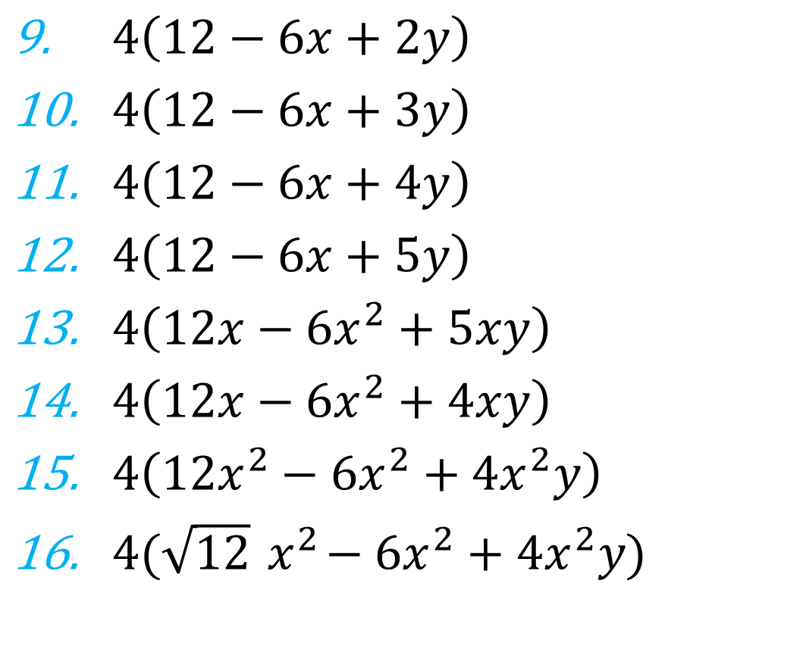
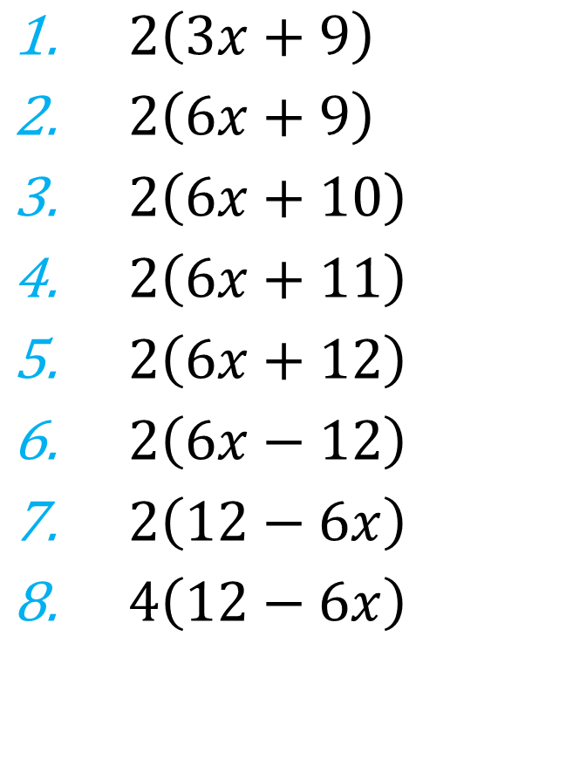
Where possible, finish factorising:
$4\left(12−6x+2y\right)$
$4\left(12−6x+3y\right)$
$4\left(12−6x+4y\right)$
$4\left(12−6x+5y\right)$
$4\left(12x−6x^{2}+5xy\right)$
$4\left(12x−6x^{2}+4xy\right)$
$4\left(12x^{2}−6x^{2}+4x^{2}y\right)$
$4(\sqrt{12}{ x}^{2}−6x^{2}+4x^{2}y)$
$2\left(3x+9\right)$
$2\left(6x+9\right)$
$2\left(6x+10\right)$
$2\left(6x+11\right)$
$2\left(6x+12\right)$
$2\left(6x−12\right)$
$2\left(12−6x\right)$
$4\left(12−6x\right)$
@mansbridgemaths

Slide 5
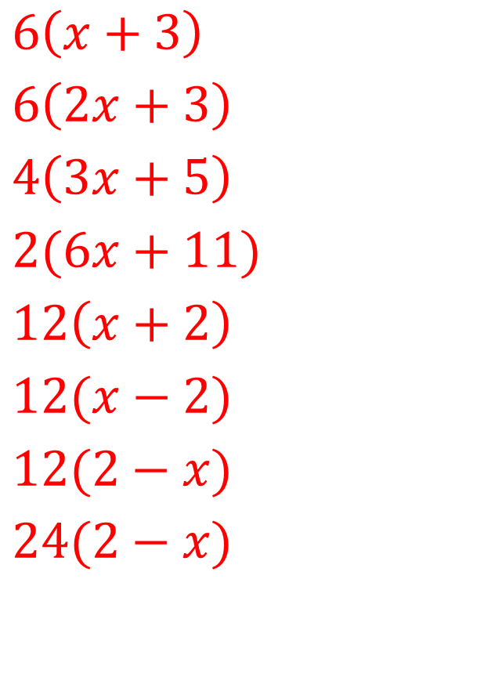
Where possible, finish factorising:
$2\left(3x+9\right)$
$2\left(6x+9\right)$
$2\left(6x+10\right)$
$2\left(6x+11\right)$
$2\left(6x+12\right)$
$2\left(6x−12\right)$
$2\left(12−6x\right)$
$4\left(12−6x\right)$
$6\left(x+3\right)$
$6\left(2x+3\right)$
$4\left(3x+5\right)$
$2(6x+11)$
$12\left(x+2\right)$
$12(x−2)$
$12(2−x)$
$24(2−x)$
@mansbridgemaths

Slide 6
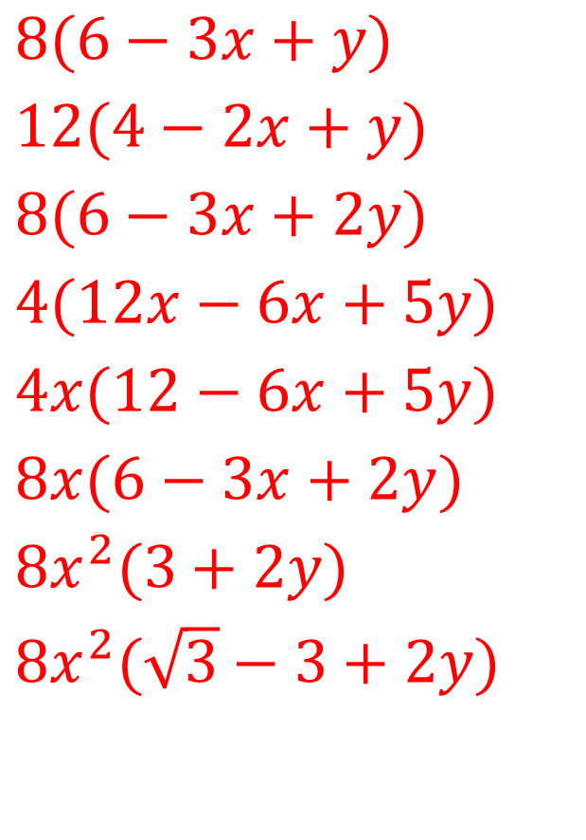
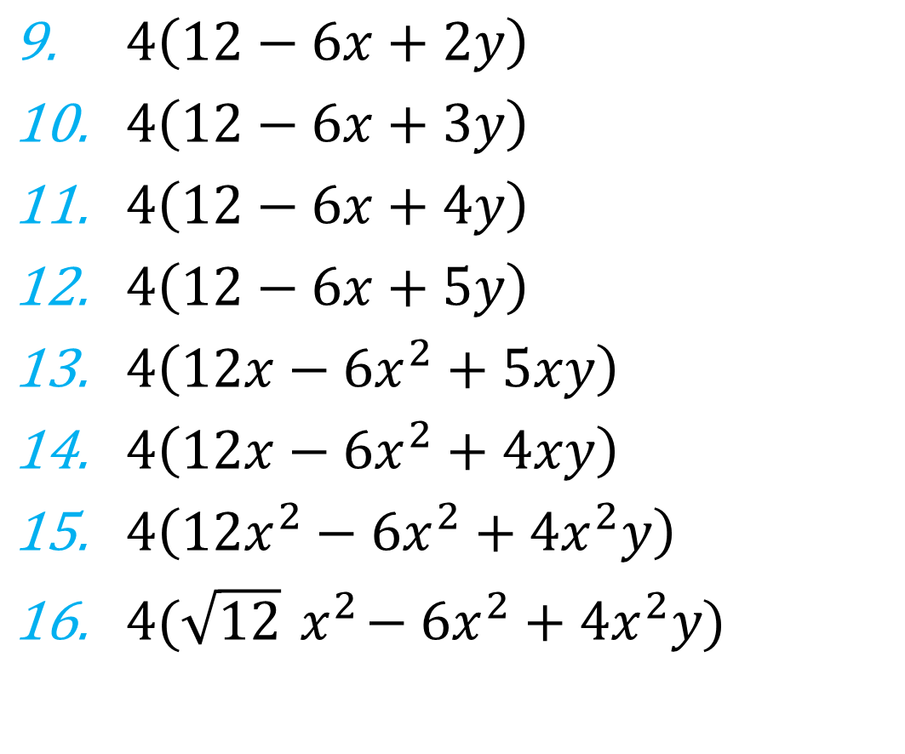
Where possible, finish factorising:
$4\left(12−6x+2y\right)$
$4\left(12−6x+3y\right)$
$4\left(12−6x+4y\right)$
$4\left(12−6x+5y\right)$
$4\left(12x−6x^{2}+5xy\right)$
$4\left(12x−6x^{2}+4xy\right)$
$4\left(12x^{2}−6x^{2}+4x^{2}y\right)$
$4(\sqrt{12}{ x}^{2}−6x^{2}+4x^{2}y)$
$8(6−3x+y)$
$12(4−2x+y)$
$8(6−3x+2y)$
$4(12x−6x+5y)$
$4x(12−6x+5y)$
$8x(6−3x+2y)$
$8x^{2}(3+2y)$
$8x^{2}(\sqrt{3}−3+2y)$
@mansbridgemaths

