Slide 1
Fill in the gaps: Mode, median and range from a list
Silent
Teacher
Intelligent Practice
Narration
Your Turn
Practice

Slide 2
Question | Data set (in ascending order) |  |  |  |  |  |  |  |  |  | Mode | Median | Range
(1) | 2 |  |  | 2 |  |  |  | 5
(2) | 3 |  |  | 3 |  |  |  |  |  |  |  |  | 2
(3) |  | 2 |  |  | 2 |  | 4 |  |  |  | 2 |  | 4
(4) | 2 | 4 |  |  |  |  | 8 |  |  |  |  | 4 | 8
(5) | 3 |  |  |  |  |  |  |  |  |  | 5, 9
(6) |  | 20 |  |  | 20 |  | 40 |  |  |  | 20 |  | 40
(7) | 1.3 | 2.6 |  |  |  |  | 9.1 |  |  |  |  | 3.5 | 7.9
(8) | 4 |  |  |  |  |  |  |  | 10 |  | 4 | 5.5
(9) | 6.8 |  | 6.8 |  |  |  |  |  |  |  | 6.8 | 15.35 | 74.95
(10) | n |  | n+2 |  |  | n+7 |  |  | 2n |  | 14 | 11.5 | 7

Slide 3
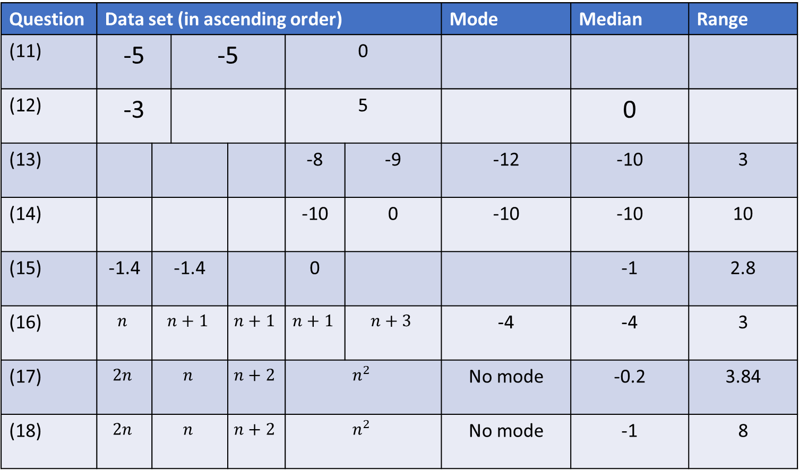
Question | Data set (in ascending order) |  |  |  |  |  | Mode | Median | Range
(11) | -5 |  | -5 |  | 0
(12) | -3 |  |  |  | 5 |  |  | 0
(13) |  |  |  |  | -8 | -9 | -12 | -10 | 3
(14) |  |  |  |  | -10 | 0 | -10 | -10 | 10
(15) | -1.4 | -1.4 |  |  | 0 |  |  | -1 | 2.8
(16) | $$n$$ | $$n+1$$ |  | $$n+1$$ | $$n+1$$ | $$n+3$$ | -4 | -4 | 3
(17) | $$2n$$ | $$n$$ |  | $$n+2$$ | $$n^{2}$$ |  | No mode | -0.2 | 3.84
(18) | $$2n$$ | $$n$$ |  | $$n+2$$ | $$n^{2}$$ |  | No mode | -1 | 8

Slide 4
Question | Data set (in ascending order) |  |  |  |  |  |  |  |  |  | Mode | Median | Range
(1) | 2 |  |  | 2 |  |  |  | 5 |  |  | 2 | 2 | 3
(2) | 3 |  |  | 3 |  |  |  | 5 |  |  | 3 | 3 | 2
(3) | 1, 2 | 2 |  |  | 2 |  | 4 |  |  | 5, 6 | 2 | 2 | 4
(4) | 2 | 4 |  |  | 4 |  | 8 |  |  | 10 | 4 | 4 | 8
(5) | 3 | 5 |  |  | 5 |  | 9 |  |  | 9 | 5, 9 | 5 | 6
(6) | 10 20 | 20 |  |  | 20 |  | 40 |  |  | 50 60 | 20 | 20 | 40
(7) | 1.3 | 2.6 |  |  | 3.5 |  | 9.1 |  |  | 9.2 | No mode | 3.5 | 7.9
(8) | 4 |  | 4 |  |  | 7 |  |  | 10 |  | 4 | 5.5 | 6
(9) | 6.8 |  | 6.8 |  |  | 23.9 |  |  | 81.75 |  | 6.8 | 15.35 | 74.95
(10) | 7 |  | 9 |  |  | 14 |  |  | 14 |  | 14 | 11.5 | 7

Slide 5
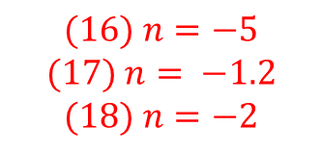
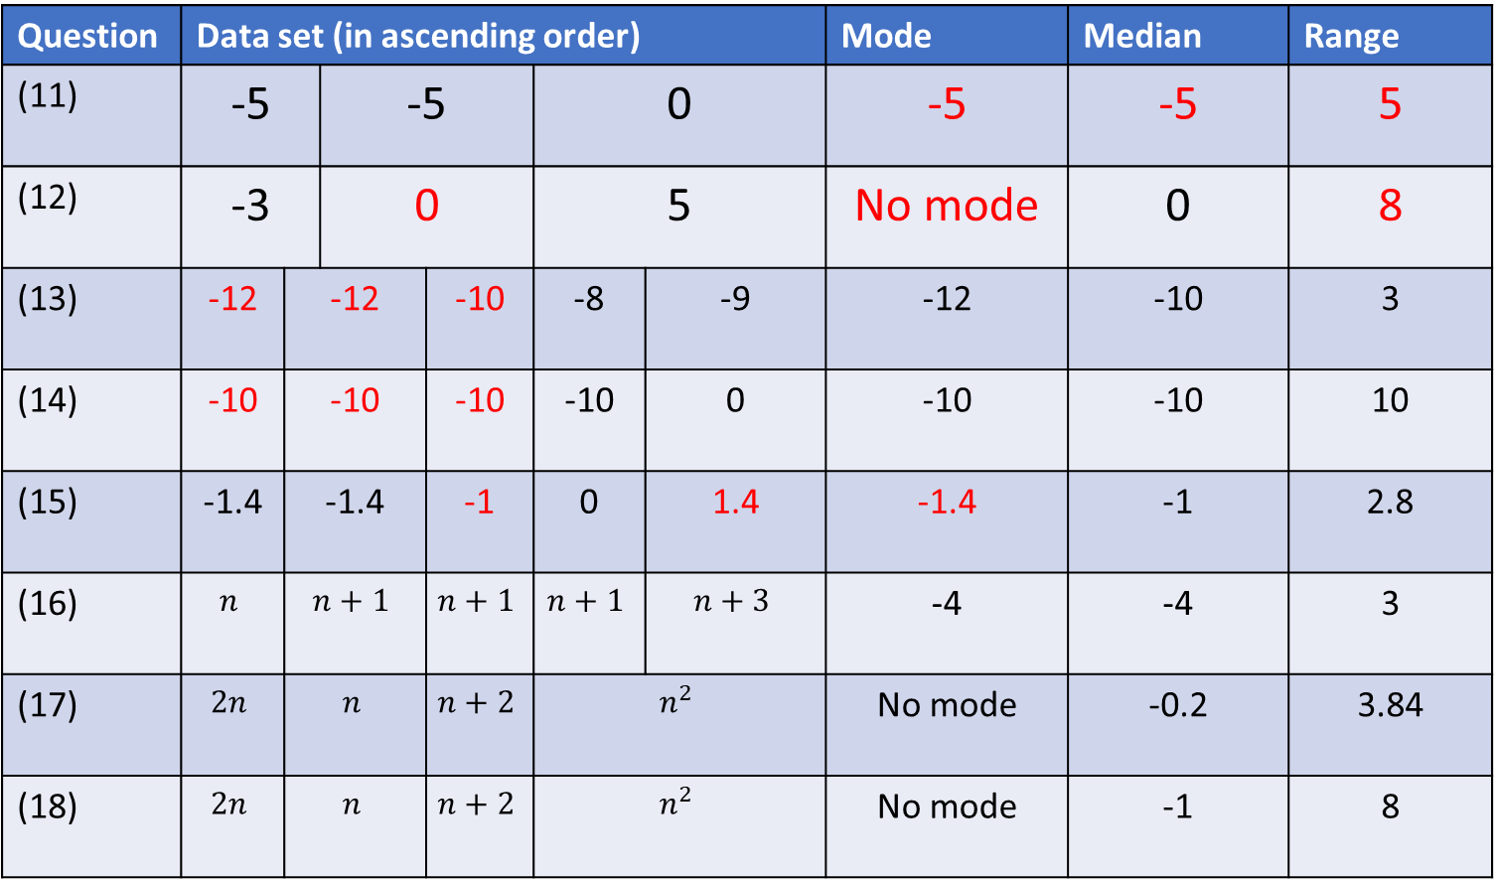
Question | Data set (in ascending order) |  |  |  |  |  | Mode | Median | Range
(11) | -5 |  | -5 |  | 0 |  | -5 | -5 | 5
(12) | -3 |  | 0 |  | 5 |  | No mode | 0 | 8
(13) | -12 | -12 |  | -10 | -8 | -9 | -12 | -10 | 3
(14) | -10 | -10 |  | -10 | -10 | 0 | -10 | -10 | 10
(15) | -1.4 | -1.4 |  | -1 | 0 | 1.4 | -1.4 | -1 | 2.8
(16) | $$n$$ | $$n+1$$ |  | $$n+1$$ | $$n+1$$ | $$n+3$$ | -4 | -4 | 3
(17) | $$2n$$ | $$n$$ |  | $$n+2$$ | $$n^{2}$$ |  | No mode | -0.2 | 3.84
(18) | $$2n$$ | $$n$$ |  | $$n+2$$ | $$n^{2}$$ |  | No mode | -1 | 8
$$(16) n=−5$$
$$(17) n= −1.2$$
$$(18) n=−2$$

