Slide 1
Sequences: Finding the Term to Term rule
Silent
Teacher
Intelligent Practice
Narration
Your Turn
$$\text{4, 6, 8, 10...}$$
$$\text{5, 7, 9, 11...}$$
$$\text{6, 8, 10, 12...}$$
@MrLadelStuart
Practice

Slide 2
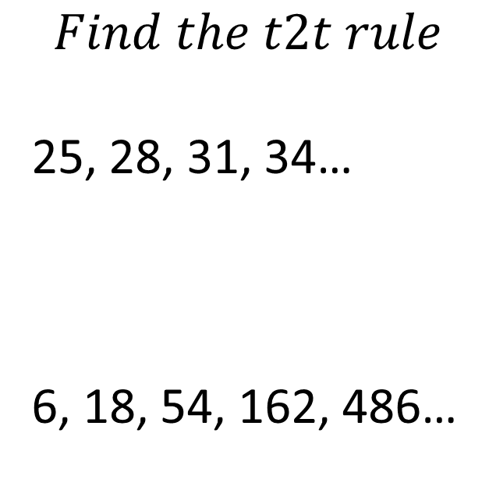
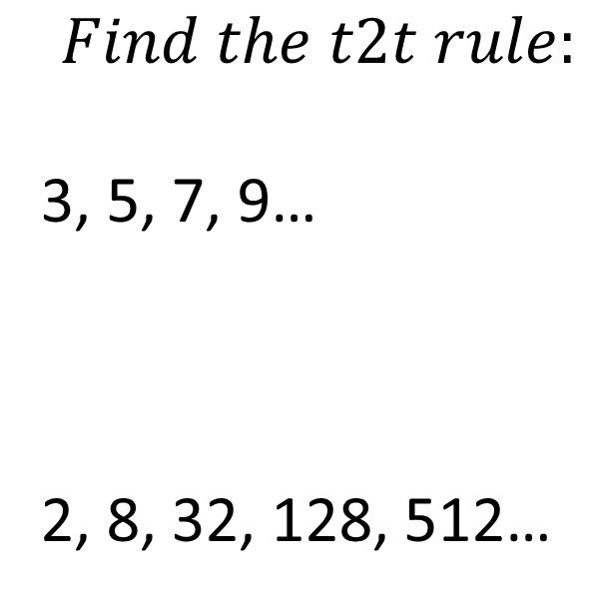
Worked Example
Your Turn
$$Find the t2t rule:$$
3, 5, 7, 9…
2, 8, 32, 128, 512…
$$Find the t2t rule$$
25, 28, 31, 34…
6, 18, 54, 162, 486…

Slide 3
1. 4, 6, 8, 10...
2. 5, 7, 9, 11...
3. 6, 8, 10, 12...
4. 1, 4, 9, 16, 25, 36, …
5. 8, 16, 32, 64, 128…
6. 7, 10, 13, 16...
7. 24, 22, 20,18, 16...
8. 800, 200, 50, 12.5….
9. 5, 9, 13, 17...
10. 17, 13, 9, 5...
11. 0.5, 0.9, 1.3, 1.7…
12. -3, 3, 13, 27, 45, 67, …
13. 0, 6, 16, 30, 48, 70, …
14. 5x+2, 9x+4, 13x+6, 17x+8...

Slide 4
1. 4, 6, 8, 10... +2
2. 5, 7, 9, 11... +2
3. 6, 8, 10, 12... +2
4. 1, 4, 9, 16, 25, 36, … +3,+4,+5…
5. 8, 16, 32, 64, 128… x2
6. 7, 10, 13, 16... +3
7. 24, 22, 20,18, 16... -2
8. 800, 200, 50, 12.5…. ÷4
9. 5, 9, 13, 17... +4
10. 17, 13, 9, 5... -4
11. 0.5, 0.9, 1.3, 1.7… +0.4
12. -3, 3, 13, 27, 45, 67, … +6, +10, +14, +18
13. 0, 6, 16, 30, 48, 70, … +6, +10, +14, +18
14. 5x+2, 9x+4, 13x+6, 17x+8... +4x+2

