Slide 1
Simultaneous Equations: Solving (multiplying one equation)
Silent
Teacher
Intelligent Practice
Narration
Your Turn
$$2x+4y=245x+2y=20$$
$$4x−y=203x+2y=26$$
$$5x−y=138x+3y=30$$
Practice

Slide 2
Worked Example
Your Turn
$$5x+2y=20$$
$$2x+4y=24$$
$$2x+9y=69$$
$$x+3y=24$$
$$3x+2y=26$$
$$4x−y=20$$
$$8x+3y=30$$
$$5x−y=13$$

Slide 3
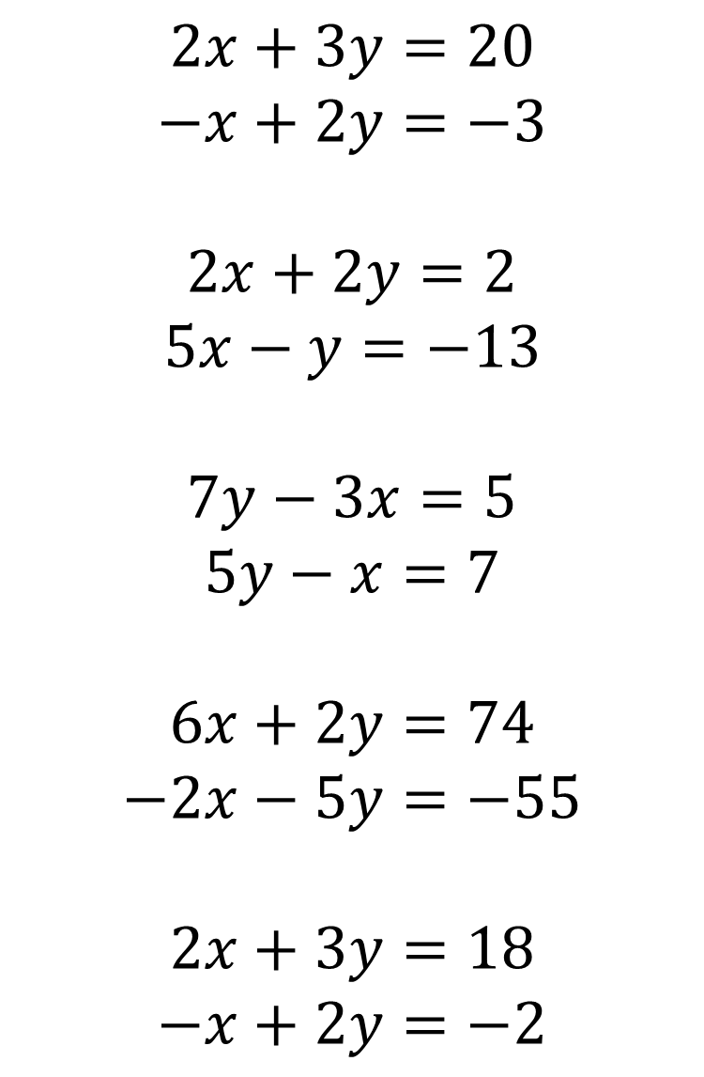
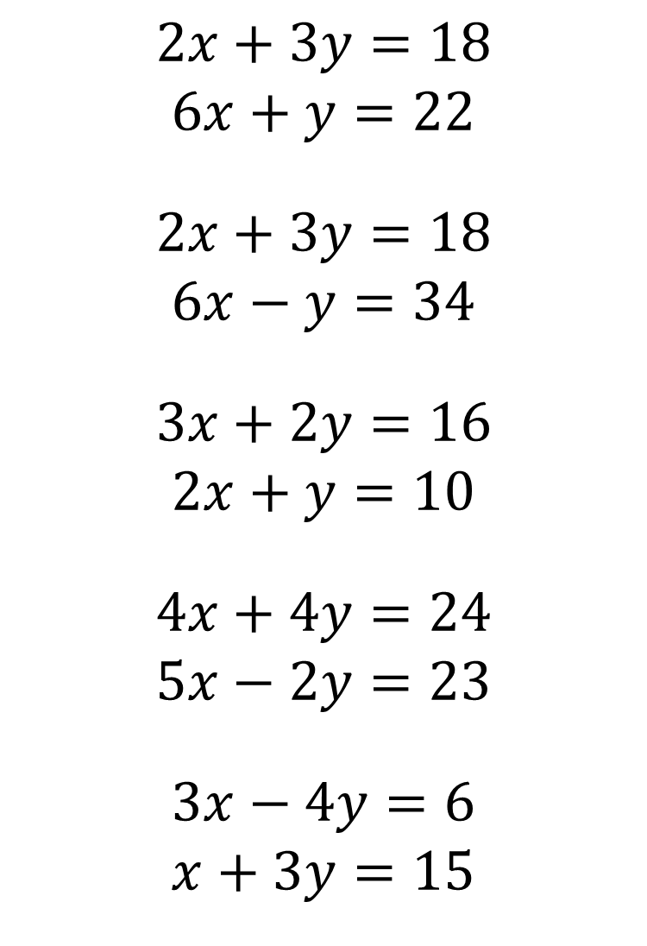
$$2x+3y=20$$
$$−x+2y=−3$$
$$2x+2y=2$$
$$5x−y=−13$$
$$7y−3x=5$$
$$5y−x=7$$
$$6x+2y=74$$
$$−2x−5y=−55$$
$$2x+3y=18$$
$$−x+2y=−2$$
$$2x+3y=18$$
$$6x+y=22$$
$$2x+3y=18$$
$$6x−y=34$$
$$3x+2y=16$$
$$2x+y=10$$
$$4x+4y=24$$
$$5x−2y=23$$
$$3x−4y=6$$
$$x+3y=15$$

Slide 4




$$2x+3y=20$$
$$−x+2y=−3$$
$$2x+2y=2$$
$$5x−y=−13$$
$$7y−3x=5$$
$$5y−x=7$$
$$6x+2y=74$$
$$−2x−5y=−55$$
$$2x+3y=18$$
$$−x+2y=−2$$
$$2x+3y=18$$
$$6x+y=22$$
$$2x+3y=18$$
$$6x−y=34$$
$$3x+2y=16$$
$$2x+y=10$$
$$4x+4y=24$$
$$5x−2y=23$$
$$3x−4y=6$$
$$x+3y=15$$
$$x=3, y=4$$
$$x=6, y=2$$
$$x=4, y=2$$
$$x=7, y=2$$
$$x=−2, y=3$$
$$x=3, y=2$$
$$x=5, y=1$$
$$x=6, y=3$$
$$x=10, y=7$$
$$x=6, y=2$$

