Slide 1
Solving One-step Inequalities (Adding and Subtracting)
Silent
Teacher
Intelligent Practice
Narration
Your Turn
Solve $x+4<11$
Solve $x−5≤12$
Solve $x+11≥12$
Practice

Slide 2
Worked Example
Your Turn
Solve $x+3<10$
Solve $x+4<10$
@MrDWilsonMaths

Slide 3
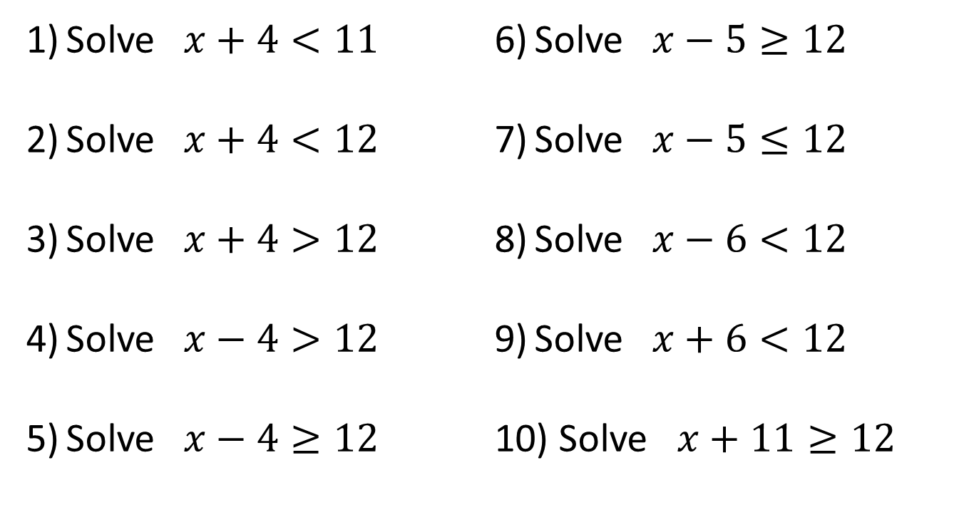
Solve $x+4<11$
Solve $x+4<12$
Solve $x+4>12$
Solve $x−4>12$
Solve $x−4≥12$
Solve $x−5≥12$
Solve $x−5≤12$
Solve $x−6<12$
Solve $x+6<12$
Solve $x+11≥12$
Challenge:
Solve $x+\frac{1}{7}≥\frac{6}{7}$
@MrDWilsonMaths

Slide 4

$x<7$
$x<8$
$x>8$
$x>16$
$x≥16$
$x≥17$
$x≤17$
$x<18$
$x<6$
$x≥1$
Challenge:
Solve $x≥\frac{5}{7}$
@MrDWilsonMaths

