Slide 1
Solving One-step Inequalities (Mixed)
Silent
Teacher
Intelligent Practice
Narration
Your Turn
Solve $2x<10$
Solve $x+2>10$
Solve $x−2>10$
Solve $\frac{x}{2}≤10$
Practice

Slide 2

Worked Example
Your Turn
Solve:
$4x<20$
$\frac{x}{4}>20$
$x+4≥20$
$x−4<20$
Solve:
$5x>20$
$\frac{x}{5}>20$
$x+5<20$
$x−5≥20$
@MrDWilsonMaths

Slide 3
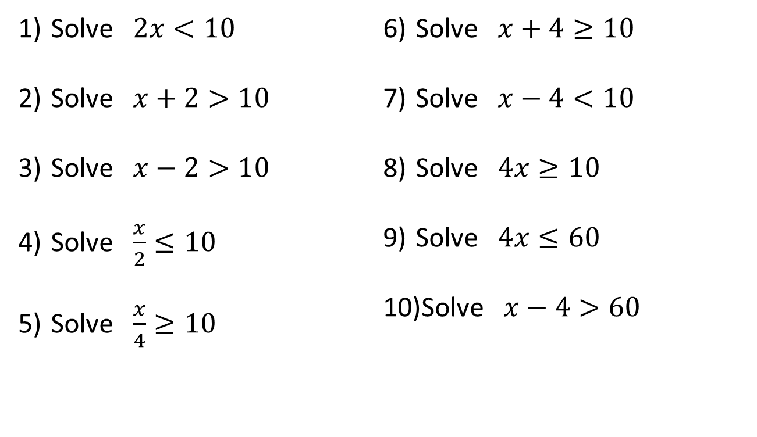

Solve $2x<10$
Solve $x+2>10$
Solve $x−2>10$
Solve $\frac{x}{2}≤10$
Solve $\frac{x}{4}≥10$
Solve $x+4≥10$
Solve $x−4<10$
Solve $4x≥10$
Solve $4x≤60$
Solve $x−4>60$
Challenge:
Solve $x−\frac{1}{9}≥\frac{7}{9}$
@MrDWilsonMaths

Slide 4


$x<5$
$x>8$
$x>12$
$x≤20$
$x≥40$
$x≥6$
$x<14$
$x≥2.5$
$x≤15$
$x>64$
Challenge:
Solve $x≥\frac{8}{9}$
@MrDWilsonMaths

