Slide 1
Solving One-step Inequalities (Multiplying and Dividing)
Silent
Teacher
Intelligent Practice
Narration
Your Turn
Solve $4x<20$
Solve $\frac{x}{10}≥20$
Practice

Slide 2
Worked Example
Your Turn
(A) Solve $3x<12$
(A) Solve $4x<12$
(B) Solve $\frac{x}{3}<12$
(B) Solve $\frac{x}{4}<12$
@MrDWilsonMaths

Slide 3
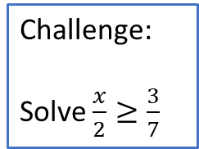
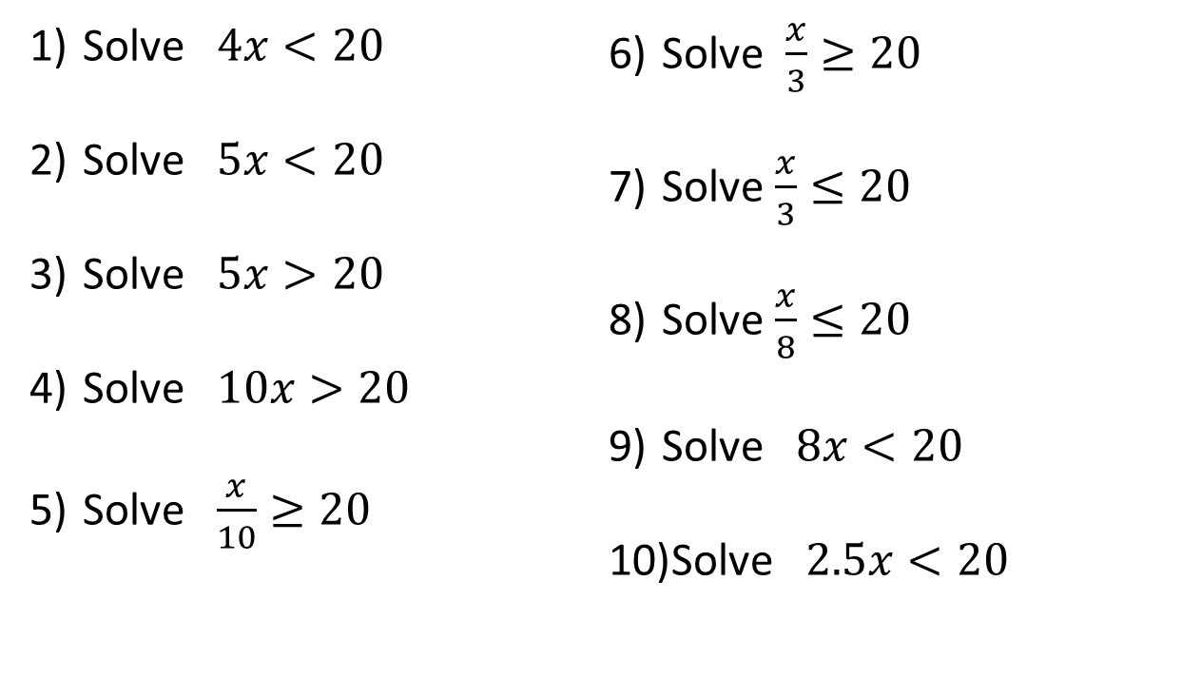
Solve $4x<20$
Solve $5x<20$
Solve $5x>20$
Solve $10x>20$
Solve $\frac{x}{10}≥20$
Solve $\frac{x}{3}≥20$
Solve $\frac{x}{3}≤20$
Solve $\frac{x}{8}≤20$
Solve $8x<20$
Solve $2.5x<20$
Challenge:
Solve $\frac{x}{2}≥\frac{3}{7}$
@MrDWilsonMaths

Slide 4

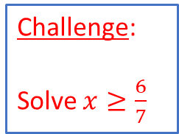
$x<5$
$x<4$
$x>4$
$x>2$
$x≥20$0
$x≥60$
$x≤60$
$x≤160$
$x<2.5$
$x<8$
Challenge:
Solve $x≥\frac{6}{7}$
@MrDWilsonMaths

