Slide 1
Solving Two-step Inequalities
Silent
Teacher
Intelligent Practice
Narration
Your Turn
Solve $3x+4>16$
Solve $3x−4>14$
Practice

Slide 2
Worked Example
Your Turn
Solve $2x+4<10$
Solve $2x+4<12$
@MrDWilsonMaths

Slide 3
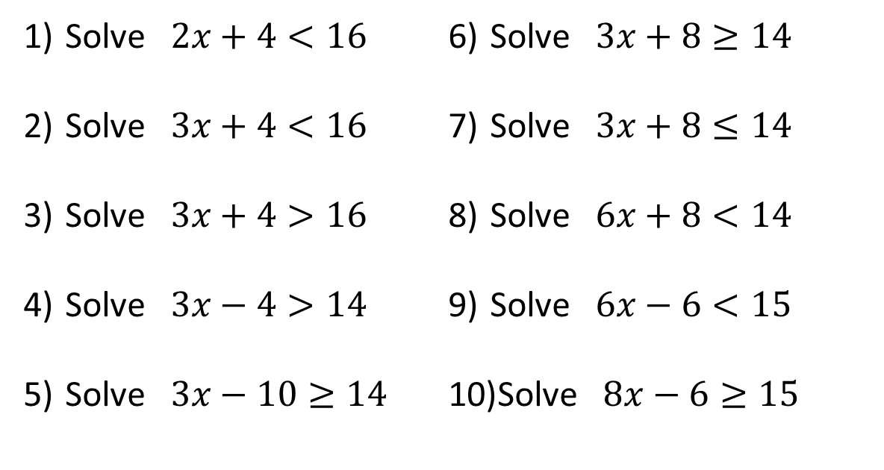
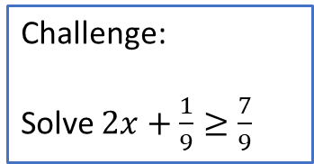
Solve $2x+4<16$
Solve $3x+4<16$
Solve $3x+4>16$
Solve $3x−4>14$
Solve $3x−10≥14$
Solve $3x+8≥14$
Solve $3x+8≤14$
Solve $6x+8<14$
Solve $6x−6<15$
Solve $8x−6≥15$
Challenge:
Solve $2x+\frac{1}{9}≥\frac{7}{9}$
@MrDWilsonMaths

Slide 4

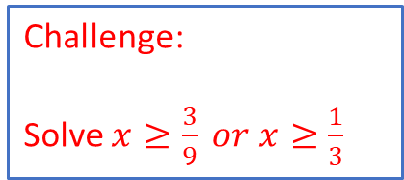
$x<6$
$x<4$
$x>4$
$x>6$
$x≥8$
$x≥2$
$x≤2$
$x<1$
$x<3.5$
$x≥2.625$
Challenge:
Solve $x≥\frac{3}{9} or x≥\frac{1}{3}$
@MrDWilsonMaths

