Slide 1
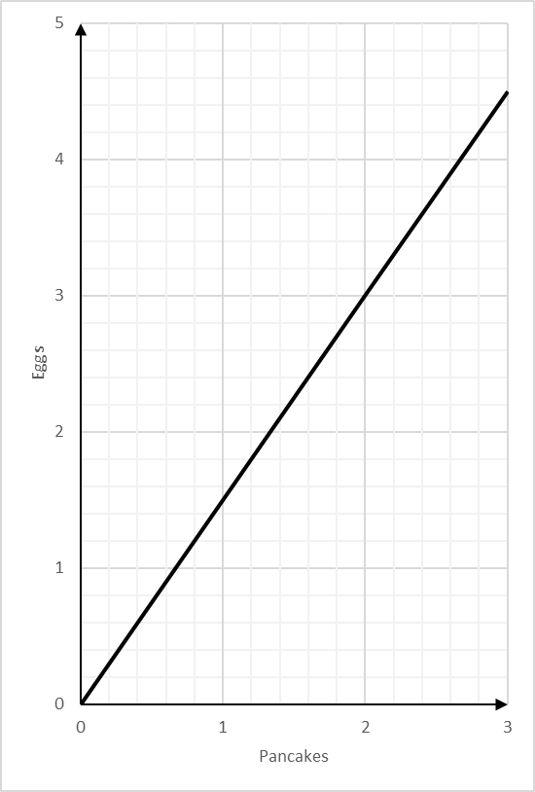
Conversion Graphs: Read and Interpret
Silent
Teacher
Intelligent Practice
Narration
Your Turn
You can use this graph to change between the number of eggs and number of pancakes you can make
Practice

Slide 2
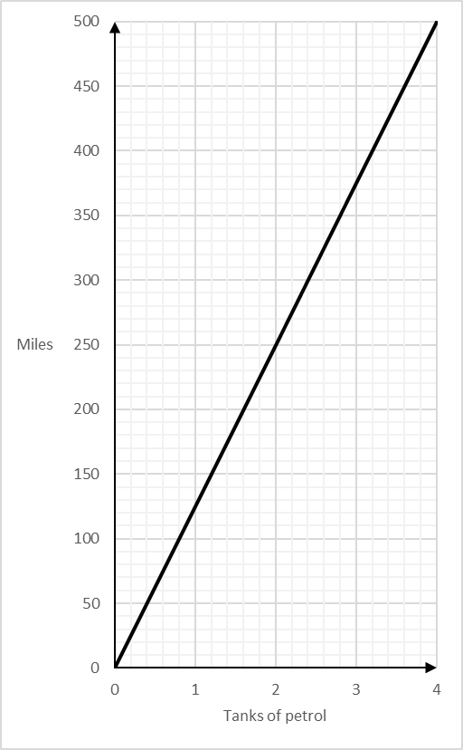
Worked Example
Your Turn
You can use this graph to change between the number of miles travelled and tanks of petrol you need.
You can use this graph to change between the number of miles travelled and tanks of petrol you need.
Change 250 miles to tanks of petrol
Change 500 miles to tanks of petrol
$$2 tanks of petrol$$
$$4 tanks of petrol$$

Slide 3
Worked Example
Your Turn
You can use this graph to change between the number of miles travelled and tanks of petrol you need.
You can use this graph to change between the number of miles travelled and tanks of petrol you need.
Change 300 miles to tanks of petrol
Change 200 miles to tanks of petrol
$$2.4 tanks of petrol$$
$$1.6 tanks of petrol$$

Slide 4
Worked Example
Your Turn
You can use this graph to change between the number of miles travelled and tanks of petrol you need.
You can use this graph to change between the number of miles travelled and tanks of petrol you need.
Change 3 tanks of petrol to miles
Change 2 tanks of petrol to miles
$$375 miles$$
$$250 miles$$

Slide 5
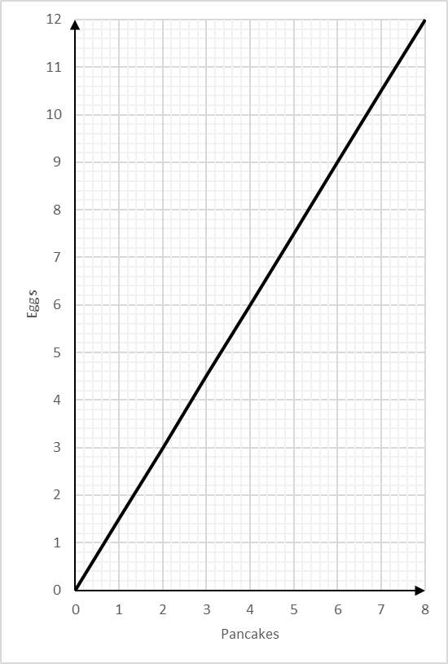
You can use this graph to change between the number of eggs and number of pancakes you can make
1)
Change 3 eggs to pancakes
5)
Change 10.5 eggs to pancakes
$$2 pancakes$$
$$7 pancakes$$
2)
Change 6 eggs to pancakes
6)
Change 1.5 eggs to pancakes
$$4 pancakes$$
$$1 pancake$$
7)
3)
Change 9 eggs to pancakes
Change 3 pancakes to eggs
$$6 pancakes$$
$$4.5 eggs$$
4)
Change 12 eggs to pancakes
8)
Change 5 pancakes to eggs
$$8 pancakes$$
$$7.5 eggs$$

Slide 6
You can use this graph to change between the number of eggs and number of pancakes you can make
1)
Change 3 eggs to pancakes
5)
Change 10.5 eggs to pancakes
2)
Change 6 eggs to pancakes
6)
Change 1.5 eggs to pancakes
7)
3)
Change 9 eggs to pancakes
Change 3 pancakes to eggs
4)
Change 12 eggs to pancakes
8)
Change 5 pancakes to eggs

