Slide 1
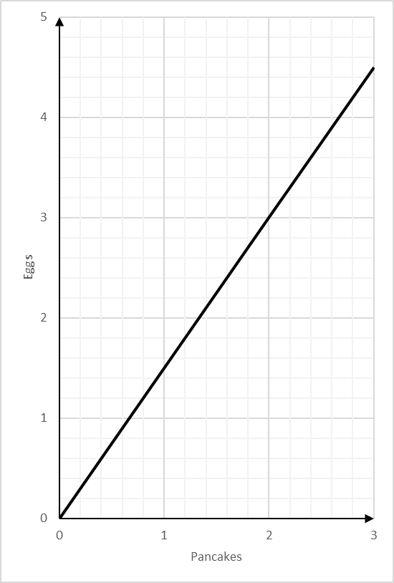
Conversion Graphs: Scale up from values
Silent
Teacher
Intelligent Practice
Narration
Your Turn
You can use this graph to change between the number of eggs and number of pancakes you can make
Practice

Slide 2
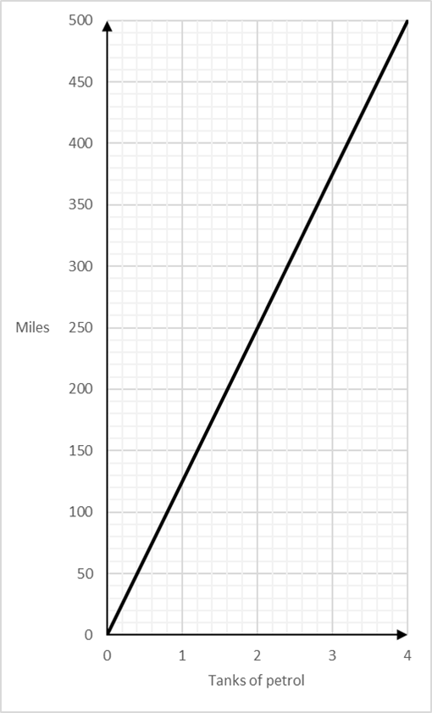
Worked Example
Your Turn
You can use this graph to change between the number of miles travelled and tanks of petrol you need.
You can use this graph to change between the number of miles travelled and tanks of petrol you need.
How many miles would 8 tanks of petrol take you?
How many miles would 9 tanks of petrol take you?
$$4 tanks=500$$
$$3 tanks=375 miles$$
$$×2$$
$$×3$$
$$8 tanks=1000$$
$$9 tanks=1125 miles$$

Slide 3
Worked Example
Your Turn
You can use this graph to change between the number of miles travelled and tanks of petrol you need.
You can use this graph to change between the number of miles travelled and tanks of petrol you need.
How many tanks of petrol would you need for 100 miles?
How many miles does one tank of petrol take you?
$$100 miles=$$
$$1 tank =125 miles$$
$$0.8 or \frac{4}{5} of a tank$$

Slide 4
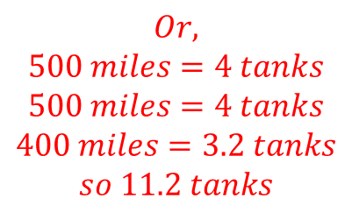
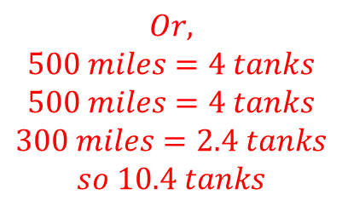
Worked Example
Your Turn
You can use this graph to change between the number of miles travelled and tanks of petrol you need.
You can use this graph to change between the number of miles travelled and tanks of petrol you need.
How many tanks of petrol would you need for 1300 miles?
How tanks of petrol would you need for 1600 miles?
$$100 miles=0.8 tanks$$
$$100 miles=0.8 tanks$$
$$×13$$
$$×14$$
$$1300 miles=10.4 tanks$$
$$1400 miles=11.2 tanks$$
$$Or,$$
$$500 miles=4 tanks$$
$$500 miles=4 tanks$$
$$300 miles=2.4 tanks$$
$$so 10.4 tanks$$
$$Or,$$
$$500 miles=4 tanks$$
$$500 miles=4 tanks$$
$$400 miles=3.2 tanks$$
$$so 11.2 tanks$$

Slide 5
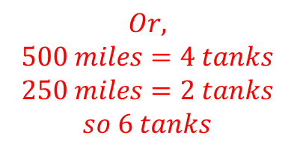
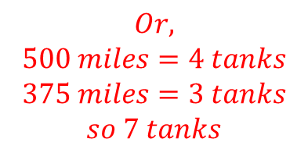
Worked Example
Your Turn
You can use this graph to change between the number of miles travelled and tanks of petrol you need.
You can use this graph to change between the number of miles travelled and tanks of petrol you need.
How many tanks of petrol would you need for 875 miles?
How tanks of petrol would you need for 750?
$$125 miles=1 tank$$
$$125 miles=1 tank$$
$$×7$$
$$×6$$
$$750 miles=6 tanks$$
$$875 miles=7 tanks$$
$$Or,$$
$$500 miles=4 tanks$$
$$375 miles=3 tanks$$
$$so 7 tanks$$
$$Or,$$
$$500 miles=4 tanks$$
$$250 miles=2 tanks$$
$$so 6 tanks$$

Slide 6
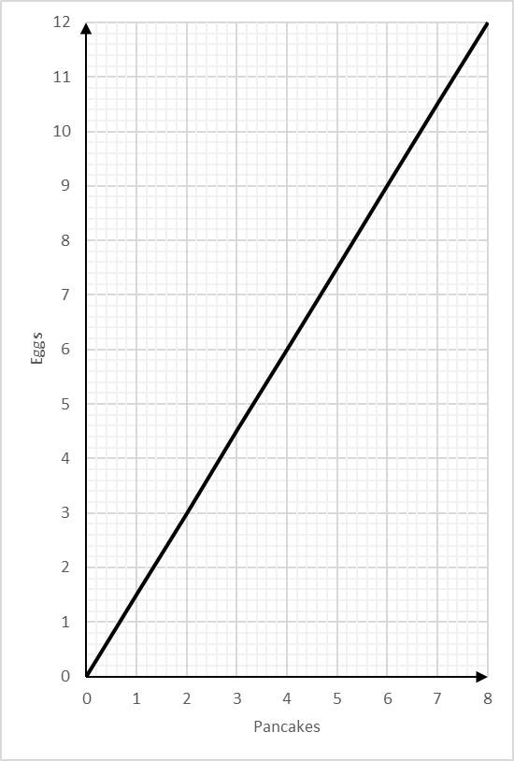
You can use this graph to change between the number of eggs and number of pancakes you can make
1)
Change 1 pancake to eggs
6)
Change 1 egg to pancakes
2)
Change 16 pancakes to eggs
7)
Change 24 eggs to pancakes
3)
Change 13 pancakes to eggs
8)
Change 30 eggs to pancakes
4)
Change 17 pancakes to eggs
9)
Change 29 eggs to pancakes
5)
Change 27 pancakes to eggs
10)
Change 13 eggs to pancakes

Slide 7
You can use this graph to change between the number of eggs and number of pancakes you can make
1)
Change 1 pancake to eggs
6)
Change 1 egg to pancakes
$$1.5 eggs$$
$$0.66 or \frac{2}{3}of a pancake$$
2)
Change 16 pancakes to eggs
7)
Change 24 eggs to pancakes
$$24 eggs$$
$$16 pancakes$$
3)
Change 13 pancakes to eggs
8)
Change 30 eggs to pancakes
$$19.5 eggs$$
$$20 pancakes$$
4)
Change 17 pancakes to eggs
9)
Change 29 eggs to pancakes
$$25.5 eggs$$
$$19.3 pancakes$$
5)
Change 27 pancakes to eggs
10)
Change 13 eggs to pancakes
$$40.5 eggs$$
$$8.6 pancakes$$

