Slide 1
Solve one-step inequalities
Silent
Teacher
Intelligent Practice
Narration
Your Turn
$$6<x+4$$
$$6<x+5$$
$$6<x+6$$
Practice

Slide 2
Worked Example
Your Turn
$$6<x+5$$
$$6<x+3$$
@MrMylesMaths

Slide 3
$$6<x+4$$
$$6<x+2$$
$$6<x+5$$
$$6<x+1$$
$$6<x+6$$
$$6<x+0$$
$$6<x+7$$
$$6<x−1$$
$$6<x+8$$
$$6<x−2$$
$$6<x+9$$
$$6<x−3$$
$$6<x+10$$
$$6<x−6$$
@MrMylesMaths

Slide 4
$$6<x+4$$
$$2<x$$
$$6<x+2$$
$$4<x$$
$$6<x+5$$
$$1<x$$
$$6<x+1$$
$$5<x$$
$$6<x+6$$
$$0<x$$
$$6<x+0$$
$$6<x$$
$$6<x+7$$
$$−1<x$$
$$6<x−1$$
$$7<x$$
$$6<x+8$$
$$−2<x$$
$$6<x−2$$
$$8<x$$
$$6<x+9$$
$$−3<x$$
$$6<x−3$$
$$9<x$$
$$6<x+10$$
$$−4<x$$
$$6<x−6$$
$$10<x$$
@MrMylesMaths

Slide 5
Worked Example
Your Turn
$$4>x−8$$
$$4>x−10$$
@MrMylesMaths

Slide 6
$$4>x−5$$
$$2>x−5$$
$$4<x−5$$
$$0>x−5$$
$$4≤x−5$$
$$−1>x−5$$
$$4≥x−5$$
$$−2>x−5$$
$$10≥x−5$$
$$−2<x−5$$
$$10>x−5$$
$$−2≤x−5$$
@MrMylesMaths

Slide 7
$$4>x−5$$
$$9>x$$
$$2>x−5$$
$$7>x$$
$$4<x−5$$
$$9<x$$
$$0>x−5$$
$$5>x$$
$$4≤x−5$$
$$9≤x$$
$$−1>x−5$$
$$4>x$$
$$4≥x−5$$
$$9≥x$$
$$−2>x−5$$
$$3>x$$
$$10≥x−5$$
$$15≥x$$
$$−2<x−5$$
$$3<x$$
$$10>x−5$$
$$15>x$$
$$−2≤x−5$$
$$3≤x$$
@MrMylesMaths

Slide 8
Worked Example
Your Turn
$$20>4x$$
$$20>5x$$
@MrMylesMaths

Slide 9
$$20>10x$$
$$30<4.5x$$
$$30>10x$$
$$30<3.5x$$
$$30>5x$$
$$30<2.5x$$
$$30≥5x$$
$$30≥0.5x$$
$$30≤ 5x$$
$$30<5x$$
@MrMylesMaths

Slide 10
$$20>10x$$
$$2>x$$
$$30>7.5x$$
$$4>x$$
$$30>10x$$
$$3>x$$
$$30<7.5x$$
$$4<x$$
$$30>5x$$
$$6>x$$
$$30<2.5x$$
$$12<x$$
$$30≥5x$$
$$6≥x$$
$$30<0.5x$$
$$60<x$$
$$30≤ 5x$$
$$6≤x$$
$$30<5x$$
$$6<x$$
@MrMylesMaths

Slide 11
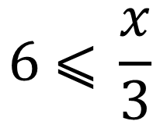
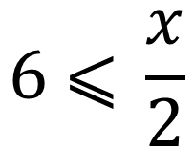
Worked Example
Your Turn
$$6 \text{⩽} \frac{x}{2}$$
$$6 \text{⩽} \frac{x}{3}$$
@MrMylesMaths

Slide 12
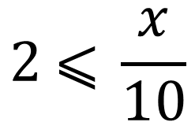
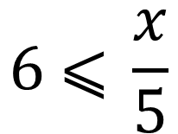
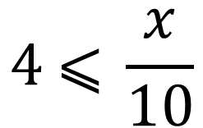
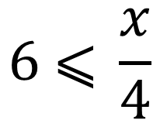
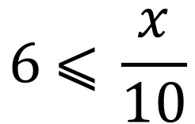
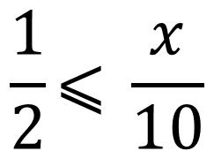
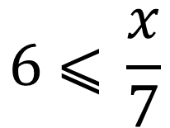
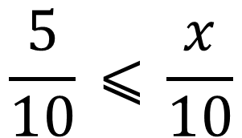
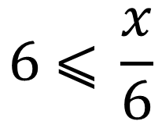
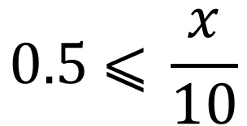
$$6 \text{⩽} \frac{x}{4}$$
$$4 \text{⩽} \frac{x}{10}$$
$$6 \text{⩽} \frac{x}{5}$$
$$2 \text{⩽} \frac{x}{10}$$
$$6 \text{⩽} \frac{x}{6}$$
$$0.5 \text{⩽} \frac{x}{10}$$
$$6 \text{⩽} \frac{x}{7}$$
$$\frac{5}{10} \text{⩽} \frac{x}{10}$$
$$6 \text{⩽} \frac{x}{10}$$
$$\frac{1}{2}\text{⩽} \frac{x}{10}$$
@MrMylesMaths

Slide 13
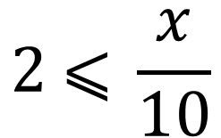
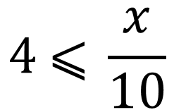
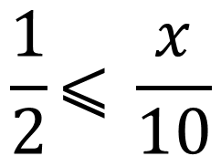
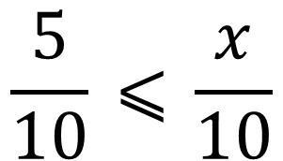
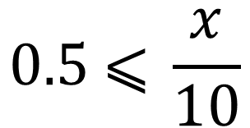
$$6 \text{⩽} \frac{x}{4}$$
$$24≤x$$
$$4 \text{⩽} \frac{x}{10}$$
$$40≤x$$
$$6 \text{⩽} \frac{x}{5}$$
$$30≤x$$
$$2 \text{⩽} \frac{x}{10}$$
$$20≤x$$
$$6 \text{⩽} \frac{x}{6}$$
$$36≤x$$
$$0.5 \text{⩽} \frac{x}{10}$$
$$5≤x$$
$$6 \text{⩽} \frac{x}{7}$$
$$42≤x$$
$$\frac{5}{10} \text{⩽} \frac{x}{10}$$
$$5≤x$$
$$6 \text{⩽} \frac{x}{10}$$
$$60≤x$$
$$\frac{1}{2}\text{⩽} \frac{x}{10}$$
$$5≤x$$
@MrMylesMaths

