Slide 1
Sides of a trapezium
True/false
Reflect
Your Turn
Rule

Slide 2
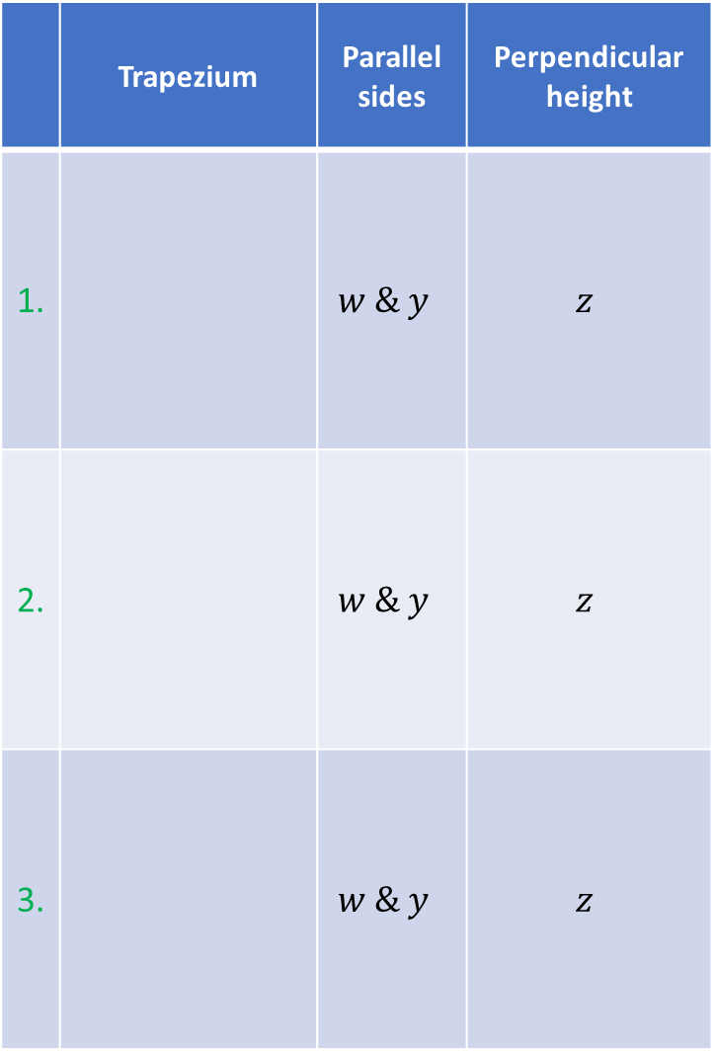
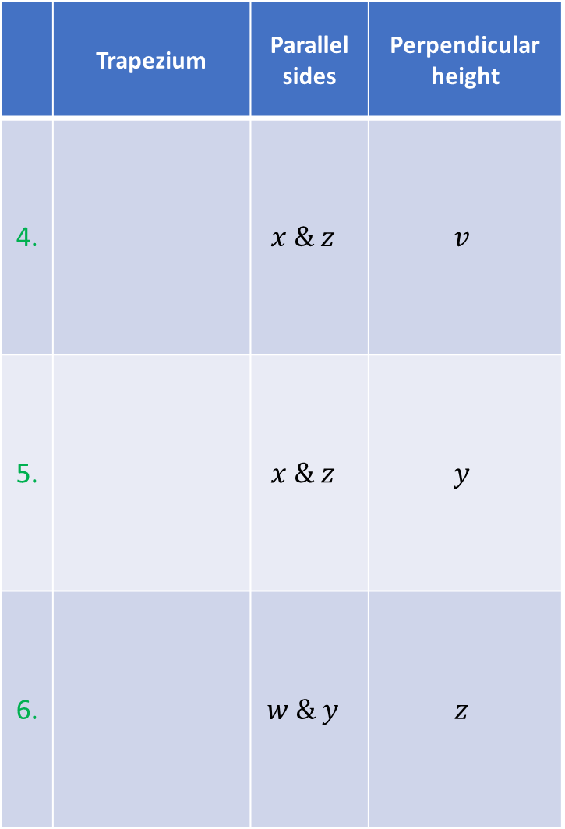
 | Trapezium | Parallel sides | Perpendicular height
1. |  | $$w \& y$$ | $$z$$
2. |  | $$w \& y$$ | $$z$$
3. |  | $$w \& y$$ | $$z$$
 | Trapezium | Parallel sides | Perpendicular height
4. |  | $$x \& z$$ | $$v$$
5. |  | $$x \& z$$ | $$y$$
6. |  | $$w \& y$$ | $$z$$
$$w$$
$$w$$
$$w$$
$$w$$
$$x$$
$$v$$
$$x$$
$$x$$
$$v$$
$$z$$
$$x$$
$$z$$
$$z$$
$$z$$
$$y$$
$$y$$
$$y$$
$$y$$
$$w$$
$$w$$
$$w$$
$$w$$
$$x$$
$$z$$
$$x$$
$$z$$
$$z$$
$$x$$
$$z$$
$$x$$
$$y$$
$$y$$
$$y$$
$$y$$
$$w$$
$$w$$
$$w$$
$$w$$
$$x$$
$$z$$
$$x$$
$$z$$
$$z$$
$$z$$
$$x$$
$$x$$
$$y$$
$$y$$
$$y$$
$$y$$

Slide 3
 | Trapezium | Parallel sides | Perpendicular height
1. |  | $$w \& y$$ | $$z$$
2. |  | $$w \& y$$ | $$z$$
3. |  | $$w \& y$$ | $$z$$
 | Trapezium | Parallel sides | Perpendicular height
4. |  | $$x \& z$$ | $$v$$
5. |  | $$x \& z$$ | $$y$$
6. |  | $$w \& y$$ | $$z$$
$$w$$
$$w$$
$$v$$
$$x$$
$$z$$
$$x$$
$$z$$
$$y$$
$$y$$
$$w$$
$$w$$
$$z$$
$$x$$
$$z$$
$$x$$
$$y$$
$$y$$
$$w$$
$$w$$
$$z$$
$$x$$
$$z$$
$$x$$
$$y$$
$$y$$

Slide 4
 | Trapezium | Parallel sides | Perpendicular height
1.
2.
3.
 | Trapezium | Parallel sides | Perpendicular height
4.
5.
6.
$$w$$
$$w$$
$$v$$
$$x$$
$$z$$
$$x$$
$$z$$
$$y$$
$$y$$
$$w$$
$$w$$
$$z$$
$$x$$
$$z$$
$$x$$
$$y$$
$$y$$
$$w$$
$$w$$
$$z$$
$$x$$
$$z$$
$$x$$
$$y$$
$$y$$

Slide 5
a On your mini-whiteboards can you sketch…
a a trapezium and mark on the parallel sides and perpendicular height
another trapezium and mark on the parallel sides and perpendicular height
an interesting trapezium and mark on the parallel sides and perpendicular height
a trapezium someone might think is correctly labelled, but is not

