Slide 1
Shape properties: What is a triangle?
True/false
Reflect
Your Turn
Rule

Slide 2
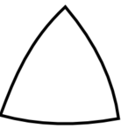
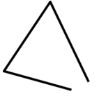
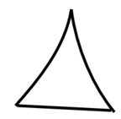
1.
5.
2.
6.
3.
7.
8.
4.

Slide 3
1.
5.
This is a triangle
This is a triangle
2.
6.
This is not a triangle
This is a triangle
3.
7.
This is not a triangle
This is not a triangle
8.
4.
This is a triangle
This is not a triangle

Slide 4
a On your mini-whiteboards can you sketch…
a triangle
another triangle
an interesting triangle
a shape someone might think is a triangle, but isn’t

