Slide 1
Multiplying fractions by integers
Silent
Teacher
Intelligent Practice
Narration
Your Turn
$$\frac{1}{4}×8=$$
$$8×\frac{x}{4}=$$
$$\frac{3x}{4}×8=$$
Practice

Slide 2
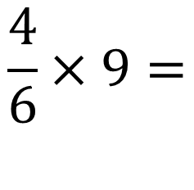
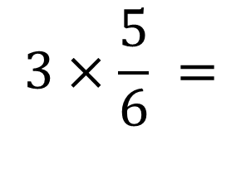
Worked Example
Your Turn
$$3×\frac{5}{6} =$$
$$\frac{4}{6}×9=$$
@RLordEM

Slide 3

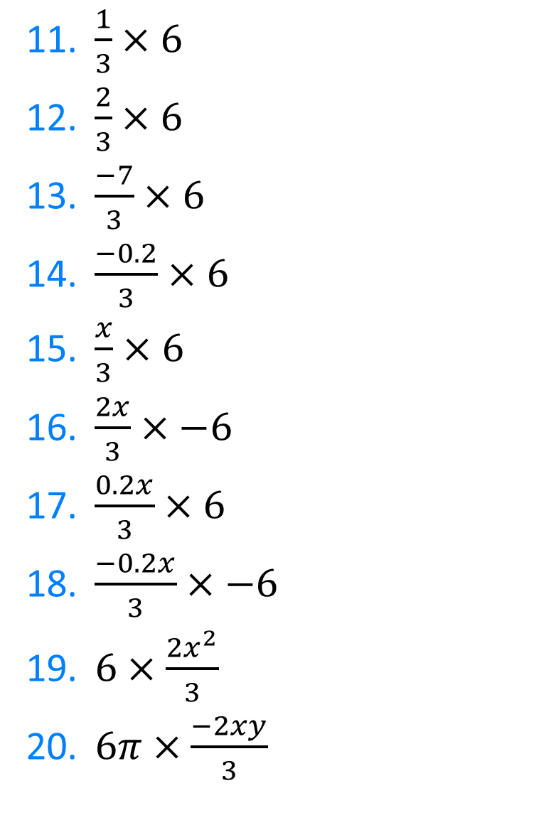
$6×\frac{1}{3}$
$6×\frac{2}{3}$
$6×\frac{4}{3}$
$6×\frac{6}{3}$
$6×\frac{5}{3}$
$6×\frac{−1}{3}$
$−6×\frac{1}{3}$
$6×\frac{0.1}{3}$
$6×\frac{−0.1}{3}$
$6×\frac{1}{0.3}$
$\frac{1}{3}×6$
$\frac{2}{3}×6$
$\frac{−7}{3}×6$
$\frac{−0.2}{3}×6$
$\frac{x}{3}×6$
$\frac{2x}{3}×−6$
$\frac{0.2x}{3}×6$
$\frac{−0.2x}{3}×−6$
$6×\frac{{2x}^{2}}{3}$
$6π×\frac{−2xy}{3}$
@RLordEM

Slide 4

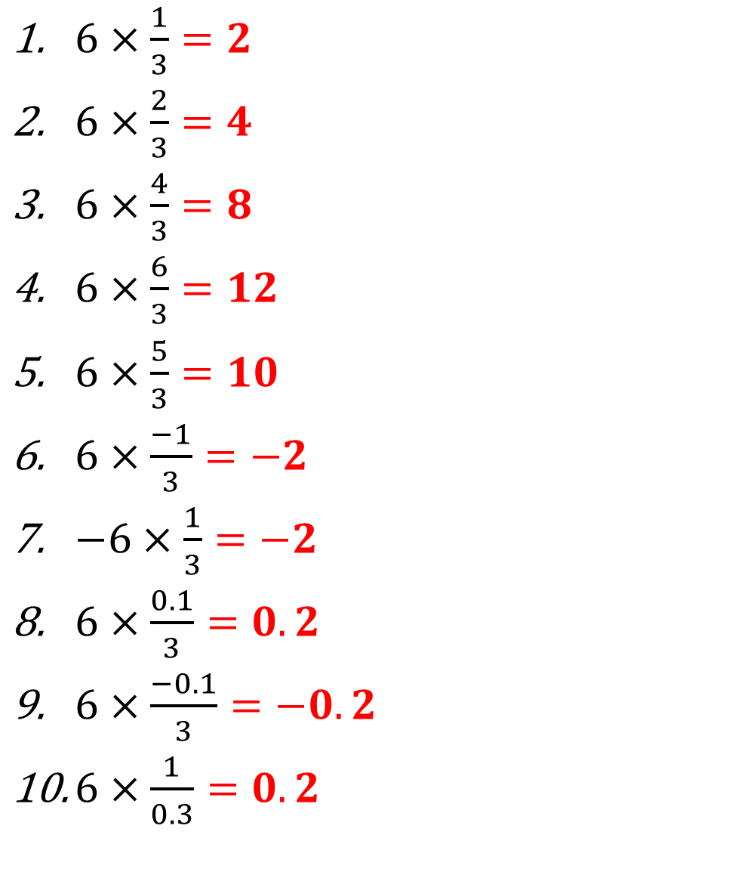
@RLordEM
$6×\frac{1}{3}=2$
$6×\frac{2}{3}=4$
$6×\frac{4}{3}=8$
$6×\frac{6}{3}=12$
$6×\frac{5}{3}=10$
$6×\frac{−1}{3}=−2$
$−6×\frac{1}{3}=−2$
$6×\frac{0.1}{3}=0.2$
$6×\frac{−0.1}{3}=−0.2$
$6×\frac{1}{0.3}=0.2$
$\frac{1}{3}×6=2$
$\frac{2}{3}×6=4$
$\frac{−7}{3}×6=−14$
$\frac{−0.2}{3}×6=−0.4$
$\frac{x}{3}×6=2x$
$\frac{2x}{3}×−6=−4x$
$\frac{0.2x}{3}×6=0.4x$
$\frac{−0.2x}{3}×−6=0.4x$
$6×\frac{{2x}^{2}}{3}=4x^{2}$
$6π×\frac{−2xy}{3}=−4πxy$

