Slide 1
Constructions: Drawing Right Angles and Angle Bisection
Silent
Teacher
Intelligent Practice
Narration
Your Turn
5cm
$$30°$$
10cm
Practice

Slide 2
Worked Example
Your Turn
Accurately construct this diagram.
Accurately construct this diagram.
7cm
7cm
10cm
10cm
Then, bisect the angle you have created.
Then, bisect the angle you have created.
@mansbridgemaths

Slide 3
Using only a pencil, a ruler, and a pair of compasses, accurately construct the shapes below.
1.
4.
7.
5cm
5cm
7cm
$$45°$$
7cm
$$135°$$
$$30°$$
10cm
10cm
10cm
7cm
5.
2.
8.
5cm
5cm
7cm
$$135°$$
$$60°$$
$$30°$$
10cm
10cm
10cm
3.
6.
5cm
7cm
5cm
$$30°$$
10cm
10cm
@mansbridgemaths

Slide 4
C
D
C
7cm
D
1.
2.
5cm
5cm
A
10cm
B
A
10cm
B
Draw a 10cm line AB.
Construct a right angle at A. Extend the line 5cm to create AC.
Construct a right angle at C. Extend the line 10cm to create CD.
Connect B and D.
Draw a 10cm line AB.
Construct a right angle at A. Extend the line 5cm to create AC.
Construct a right angle at C. Extend the line 7cm to create CD.
Connect B and D.

Slide 5
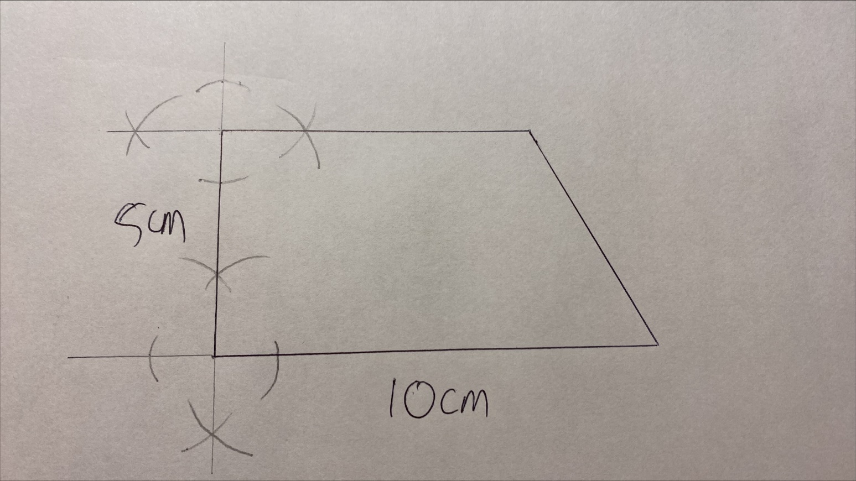

Slide 6
C
D
C
D
3.
4.
5cm
7cm
5cm
$$45°$$
A
10cm
B
A
10cm
B
Draw a 10cm line AB.
Construct a right angle at A. Extend the line 5cm to create AC.
Draw an arc 7cm from B.
Construct a right angle at C. Extend the line until it crosses the arc (at D).
Connect B and D.
Draw a 10cm line AB.
Construct a right angle at A. Extend the line 5cm to create AC.
Construct a right angle at B. Bisect the right angle at B.
Construct a right angle at C. Extend the line until it crosses the angle bisector (at D).
Connect B and D.

Slide 7
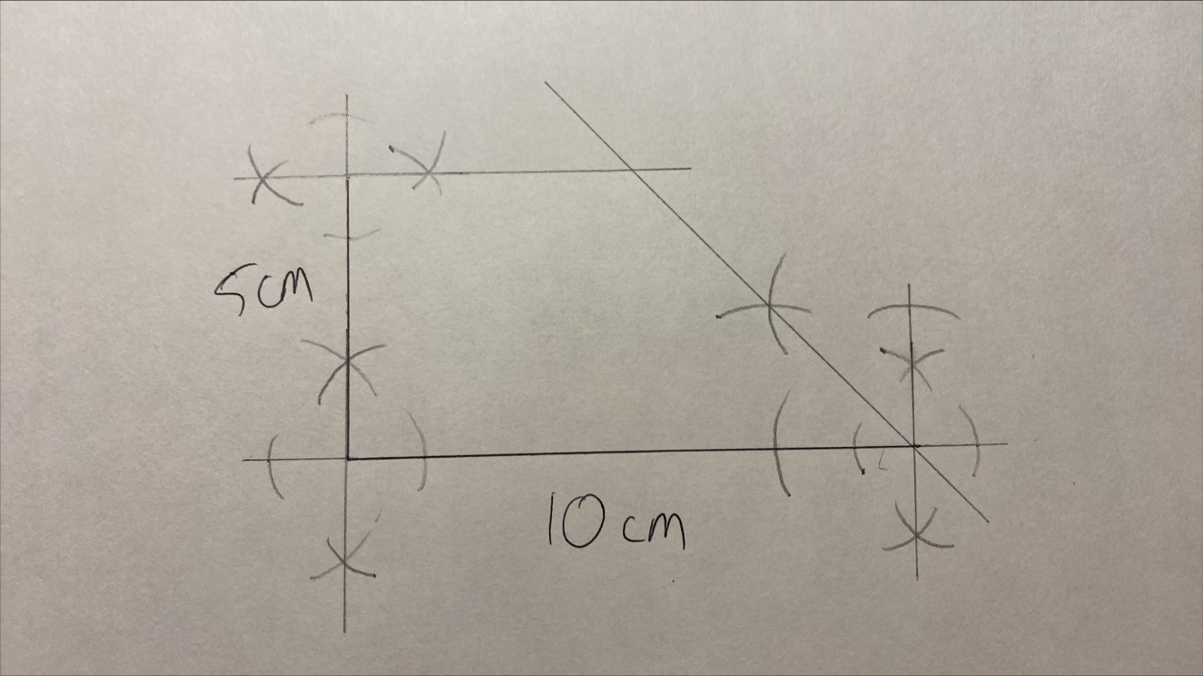

Slide 8
5.
C
D
6.
C
D
5cm
5cm
$$60°$$
$$30°$$
A
10cm
B
A
10cm
B
Draw a 10cm line AB.
Construct a right angle at A. Extend the line 5cm to create AC.
Construct an equilateral triangle with one vertex at B. Extend one side of this triangle.
Construct a right angle at C. Extend the line until it crosses the line from B (at D).
Draw a 10cm line AB.
Construct a right angle at A. Extend the line 5cm to create AC.
Construct an equilateral triangle with one vertex at B. Bisect the $60°$ angle at B.
Construct a right angle at C. Extend the line until it crosses the angle bisector (at D).

Slide 9
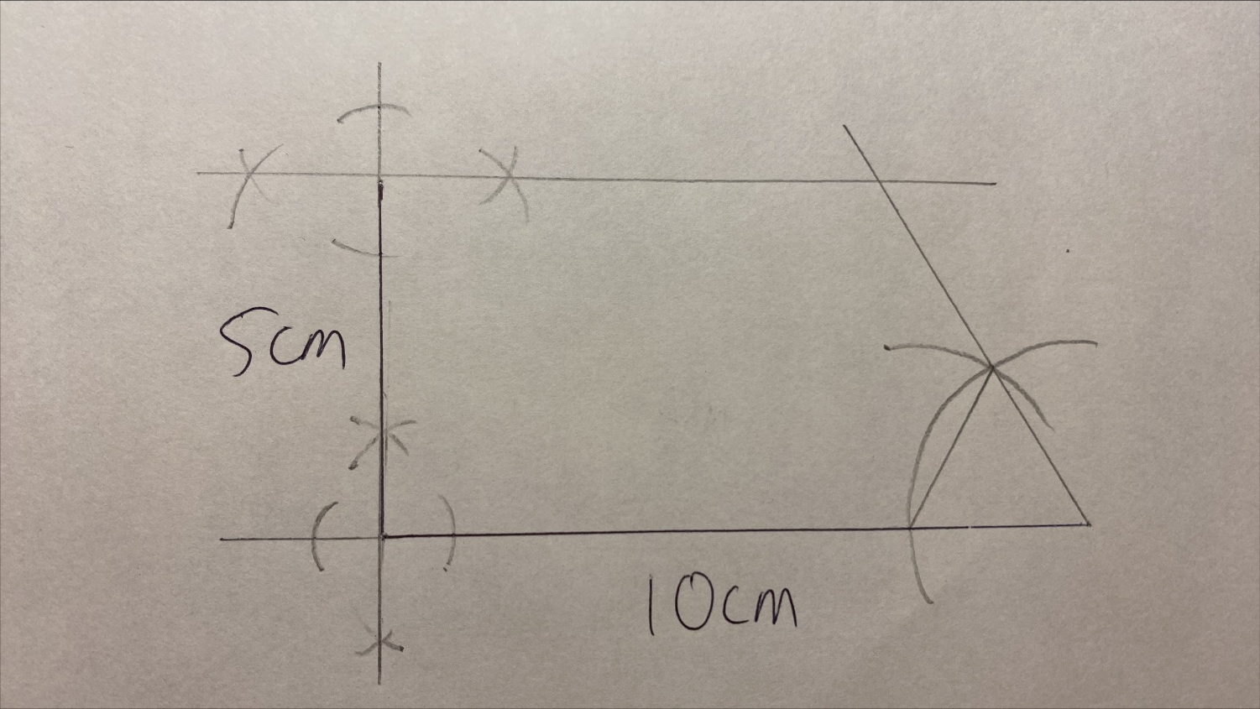

Slide 10
7.
C
D
8.
C
D
7cm
7cm
7cm
$$135°$$
$$135°$$
$$30°$$
$$30°$$
A
B
A
10cm
B
10cm
Draw a 10cm line AB.
Construct a right angle at A. Bisect the right angle at A.
Construct an equilateral triangle with one vertex at B. Bisect the $60°$ angle at B. Extend the line 7cm to create BD.
Construct an equilateral triangle and a right angle at D ($60°+90°=150°$).
Extend the line until it crosses the bisection from A.
Draw a 10cm line AB.
Construct a right angle at A. Bisect the right angle at A. Extend the line 7cm to create AC.
Construct an equilateral triangle with one vertex at B. Bisect the $60°$ angle at B. Extend the line 7cm to create BD.
Connect C and D.
Notes:
Q8 can be done in other ways! E.g. creating an alternate 30 degree angle at D, or constructing a perpendicular line through AB and D then a right angle at D.

Slide 11
