Slide 1
Non-standard form to standard form
Silent
Teacher
Intelligent Practice
Narration
Your Turn
$$482 ×{10}^{6}=$$
$$48.2 ×{10}^{6}=$$
$$48.2 ×{10}^{7}=$$
Practice

Slide 2

Worked Example
Your Turn
$$4367 ×{10}^{6}$$
$$0.125 ×{10}^{−6}$$
$$0.4367 ×{10}^{6}$$
$$125 ×{10}^{−6}$$
@AgMaths112

Slide 3
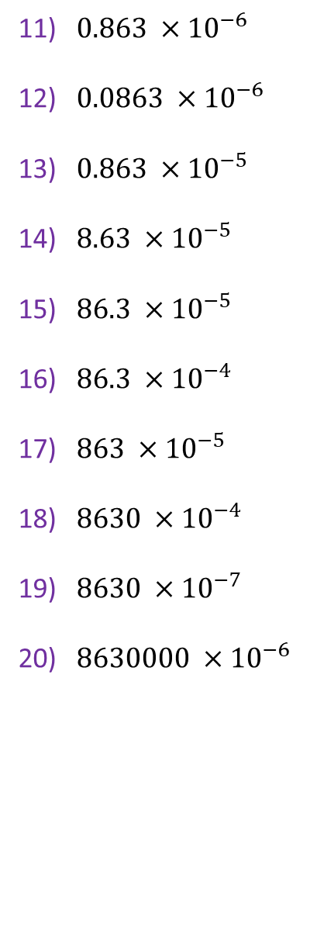
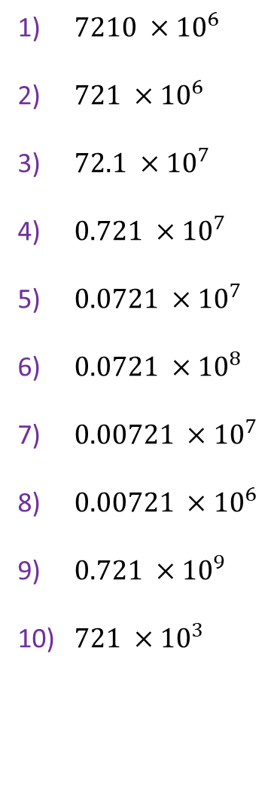
1) $7210 ×{10}^{6}$
2) $721 ×{10}^{6}$
3) $72.1 ×{10}^{7}$
4) $0.721 ×{10}^{7}$
5) $0.0721 ×{10}^{7}$
6) $0.0721 ×{10}^{8}$
7) $0.00721 ×{10}^{7}$
8) $0.00721 ×{10}^{6}$
9) $0.721 ×{10}^{9}$
10) $721 ×{10}^{3}$
11) $0.863 ×{10}^{−6}$
12) $0.0863 ×{10}^{−6}$
13) $0.863 ×{10}^{−5}$
14) $8.63 ×{10}^{−5}$
15) $86.3 ×{10}^{−5}$
16) $86.3 ×{10}^{−4}$
17) $863 ×{10}^{−5}$
18) $8630 ×{10}^{−4}$
19) $8630 ×{10}^{−7}$
20) $8630000 ×{10}^{−6}$
@AgMaths112

Slide 4
1) $7210 ×{10}^{6}$
2) $721 ×{10}^{6}$
3) $72.1 ×{10}^{7}$
4) $0.721 ×{10}^{7}$
5) $0.0721 ×{10}^{7}$
6) $0.0721 ×{10}^{8}$
7) $0.00721 ×{10}^{7}$
8) $0.00721 ×{10}^{6}$
9) $0.721 ×{10}^{9}$
10) $721 ×{10}^{3}$
$$=7.21 ×{10}^{9}$$
$$=7.21 ×{10}^{8}$$
$$=7.21 ×{10}^{8}$$
$$=7.21 ×{10}^{6}$$
$$=7.21 ×{10}^{5}$$
$$=7.21 ×{10}^{6}$$
$$=7.21 ×{10}^{4}$$
$$=7.21 ×{10}^{3}$$
$$=7.21 ×{10}^{8}$$
$$=7.21 ×{10}^{5}$$
11) $0.863 ×{10}^{−6}$
12) $0.0863 ×{10}^{−6}$
13) $0.863 ×{10}^{−5}$
14) $8.63 ×{10}^{−5}$
15) $86.3 ×{10}^{−5}$
16) $86.3 ×{10}^{−4}$
17) $863 ×{10}^{−5}$
18) $8630 ×{10}^{−4}$
19) $8630 ×{10}^{−7}$
20) $8630000 ×{10}^{−6}$
$$=8. 63×{10}^{−7}$$
$$=8. 63×{10}^{−8}$$
$$=8. 63×{10}^{−6}$$
$$=8. 63×{10}^{−5}$$
$$=8. 63×{10}^{−4}$$
$$=8. 63×{10}^{−3}$$
$$=8. 63×{10}^{−3}$$
$$=8. 63×{10}^{−1}$$
$$=8. 63×{10}^{−7}$$
$$=8. 63×{10}^{0}$$
@AgMaths112

