Slide 1
Circle Theorems: Angle at the centre
Spider

Slide 2
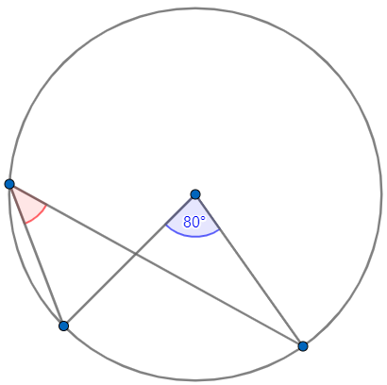
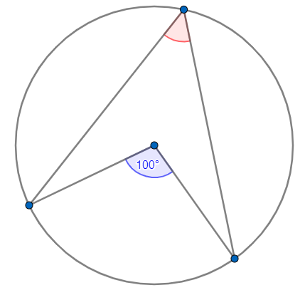
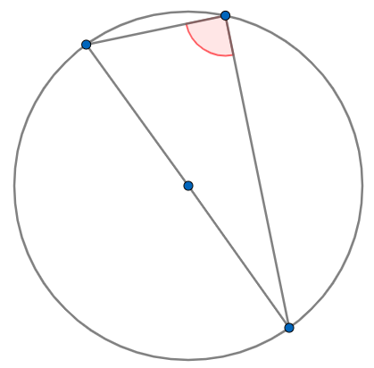
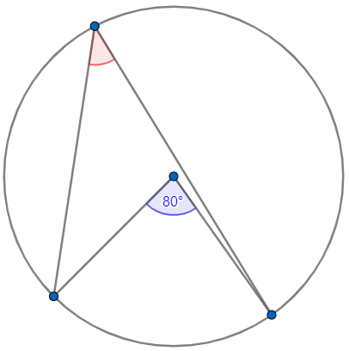
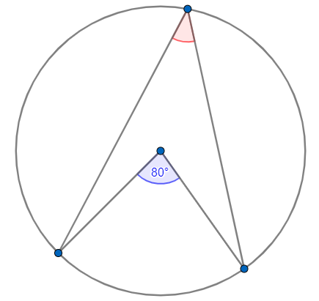
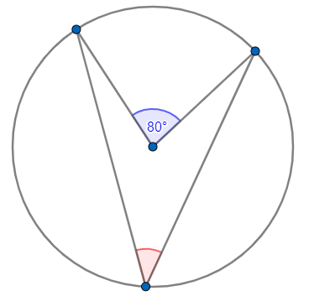
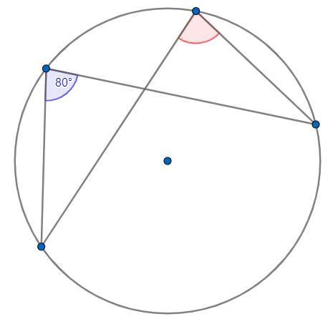
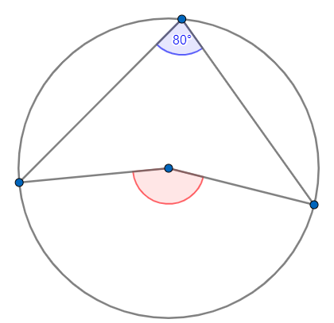
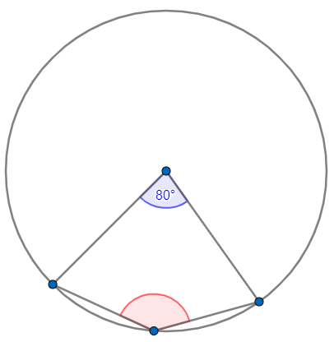
Reflect
Expect
Explain
$$45°$$
Check

Slide 3
Reflect
Expect
$$50°$$
$$90°$$
$$40°$$
$$40°$$
$$80°$$
$$40°$$
$$160°$$
$$140°$$
Explain
$$45°$$
Check

